Slide 1

The kNOw Program
Diocese of Lansing Safe Environment Project

Slide 2
The kNOw Program will help you to be safe and respected.

Slide 3

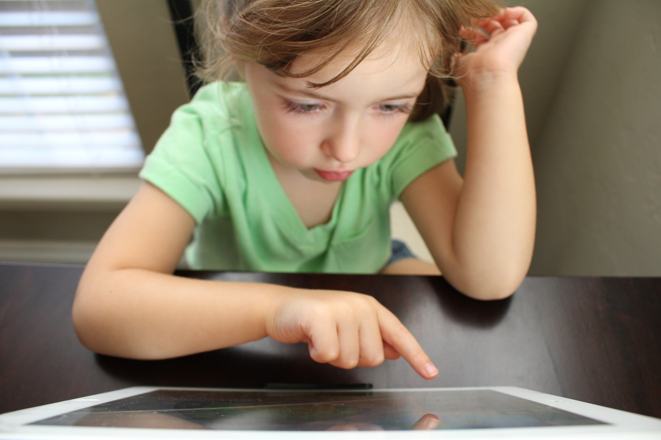
People Take Very Good Care of Things That Are Special.

Slide 4
People Take Very Good Care Of Special Things.

Slide 5

People Take Very Good Care Of Special Things.

Slide 6

This Little Guy Deserves
Special Care!

Slide 7

What Would You Do For This Little Guy If He Was Yours?

Slide 8
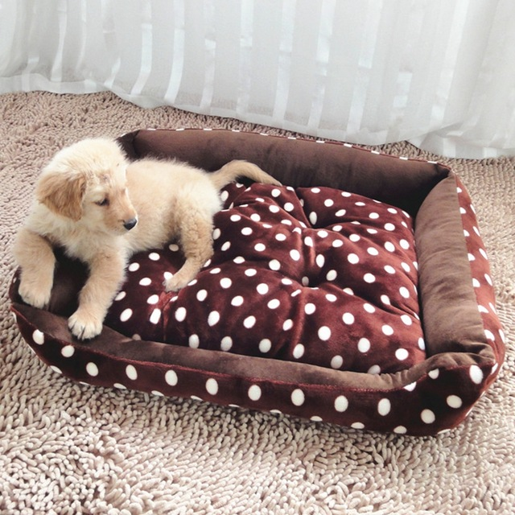
What Special Things Would You Do For This Little Guy If He Was Yours?

Slide 9
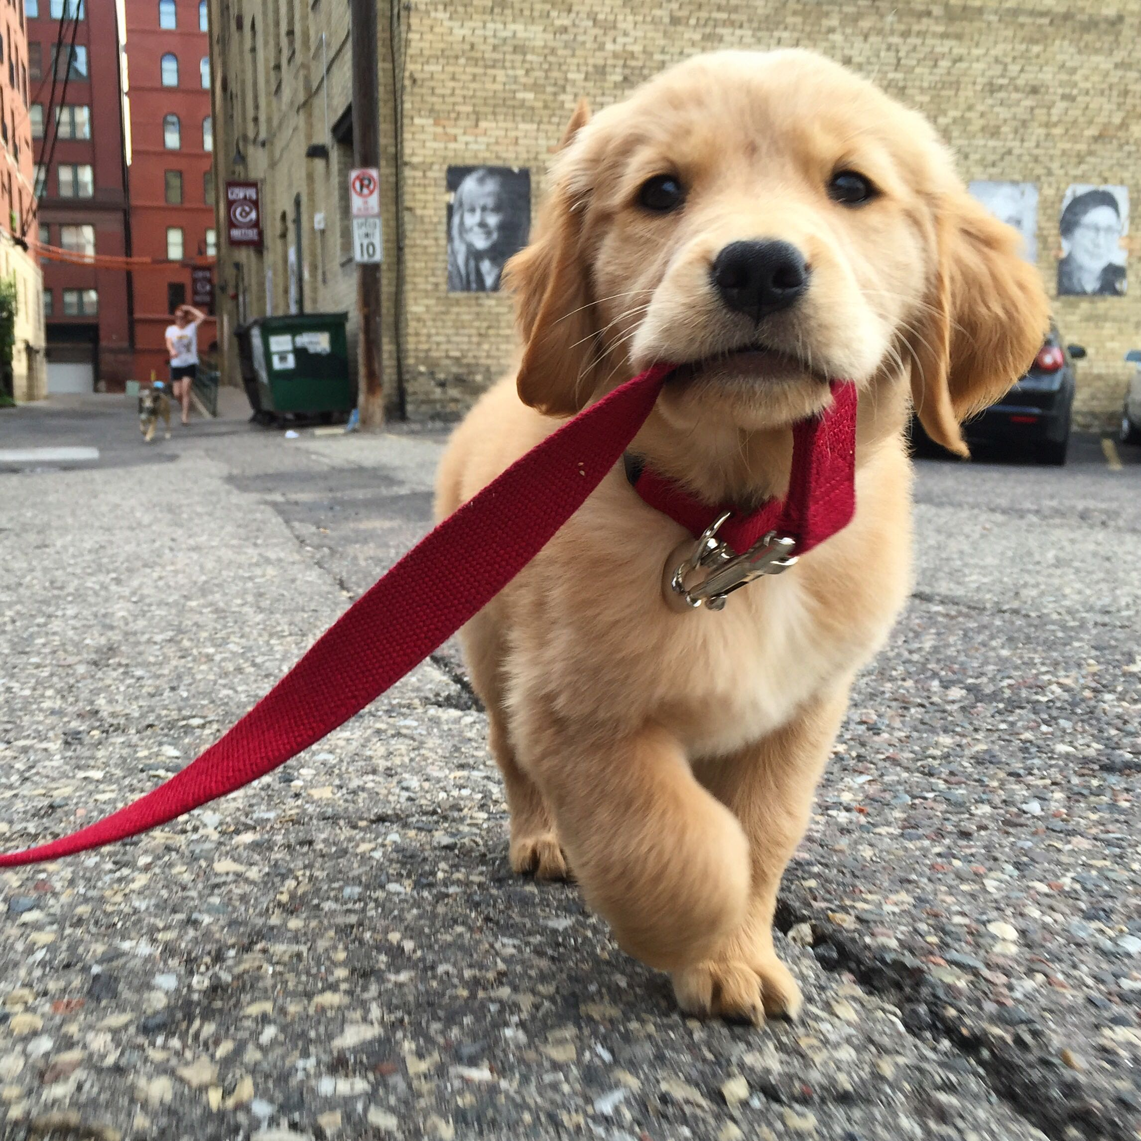
What Special Things Would You Do For This Little Guy If He Was Yours?

Slide 10
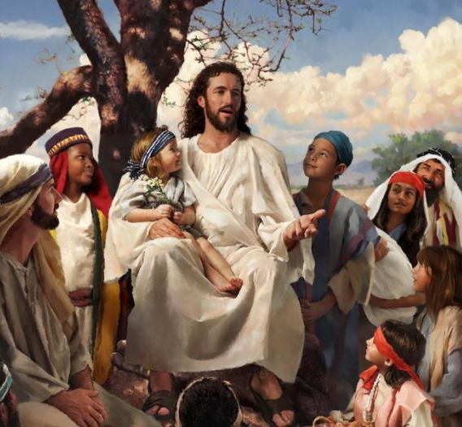
To Jesus, YOU
Are Very Special.

Slide 11
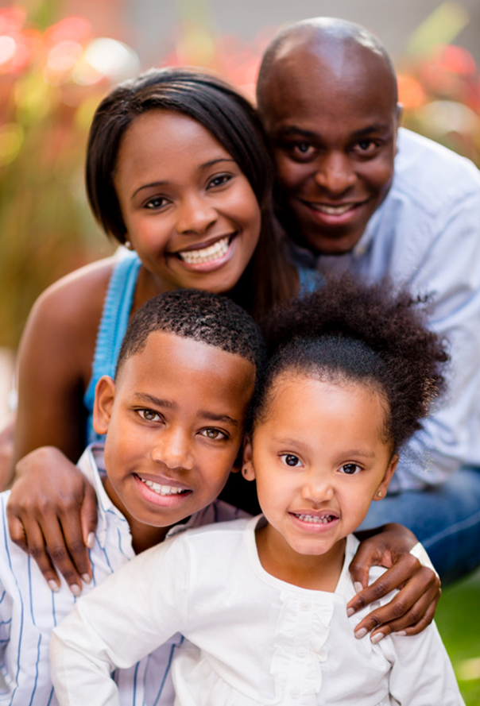
It's Only Right
That People Should
Take Care Of You!

Slide 12

Jesus Wants You To Be Happy.
He Wants Your Family & Community To Take Special Care Of You.
He Wants YOU To Take Care of You, Too!

Slide 13
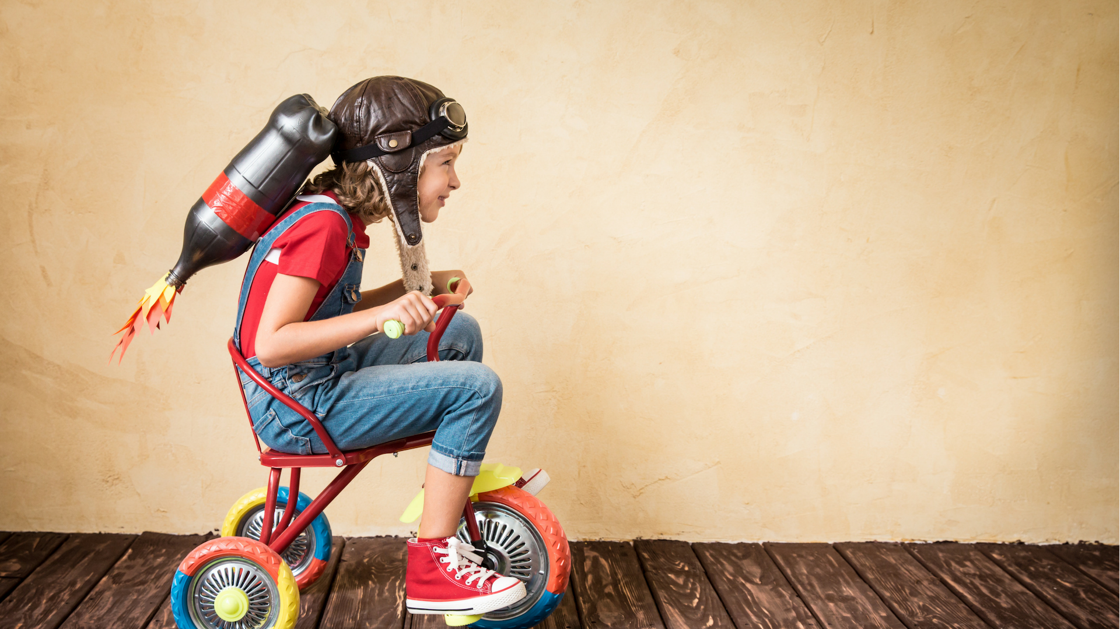
Jesus Wants You To Know You're Loved.
He Wants You To
Know You're Safe!

Slide 14
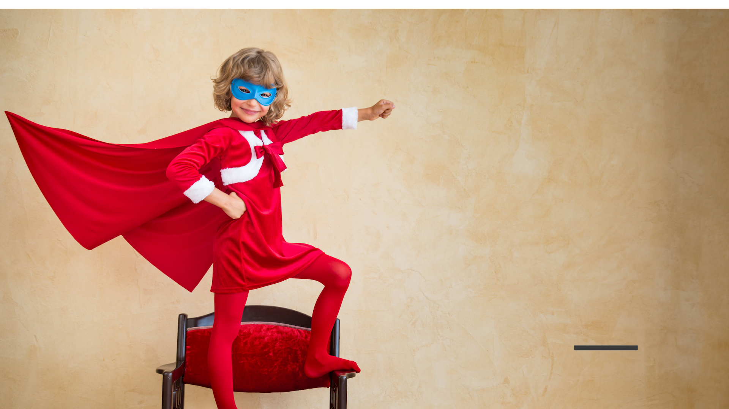
Jesus Wants You To Know You're Loved.
He Wants You To
Know You're Safe!

Slide 15
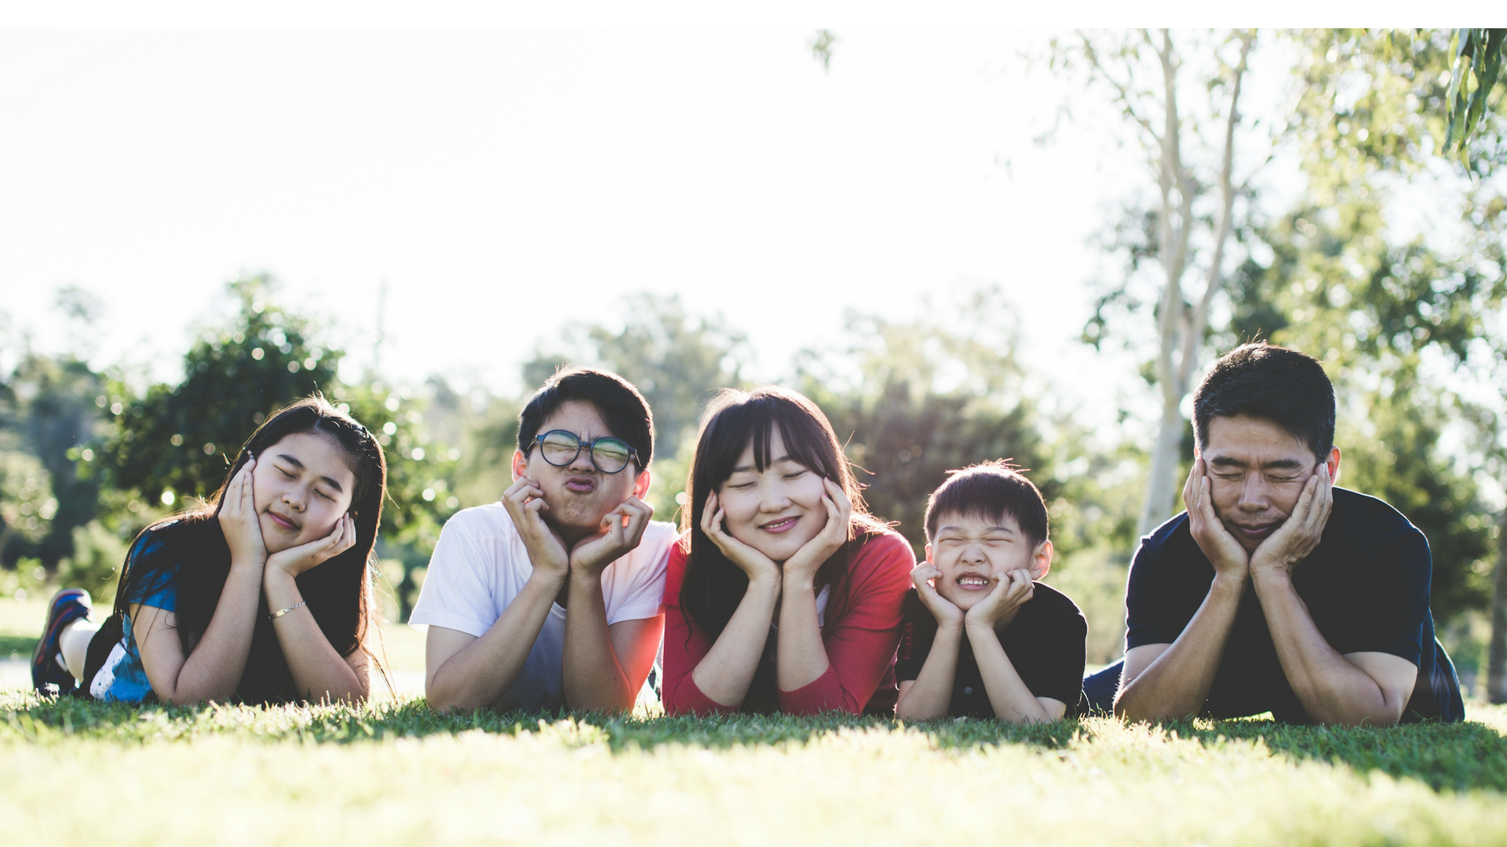
You Probably Have A Family To Help Care For You.

Slide 16
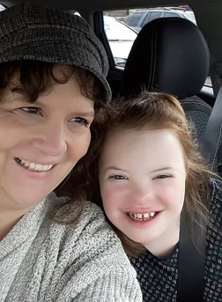
You Probably Have A Family To Help Care For You.

Slide 17
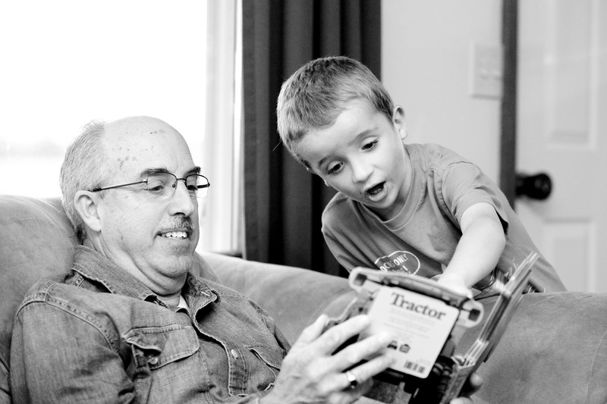
Grandfathers & Grandmothers Can Help Care For You, Too!

Slide 18
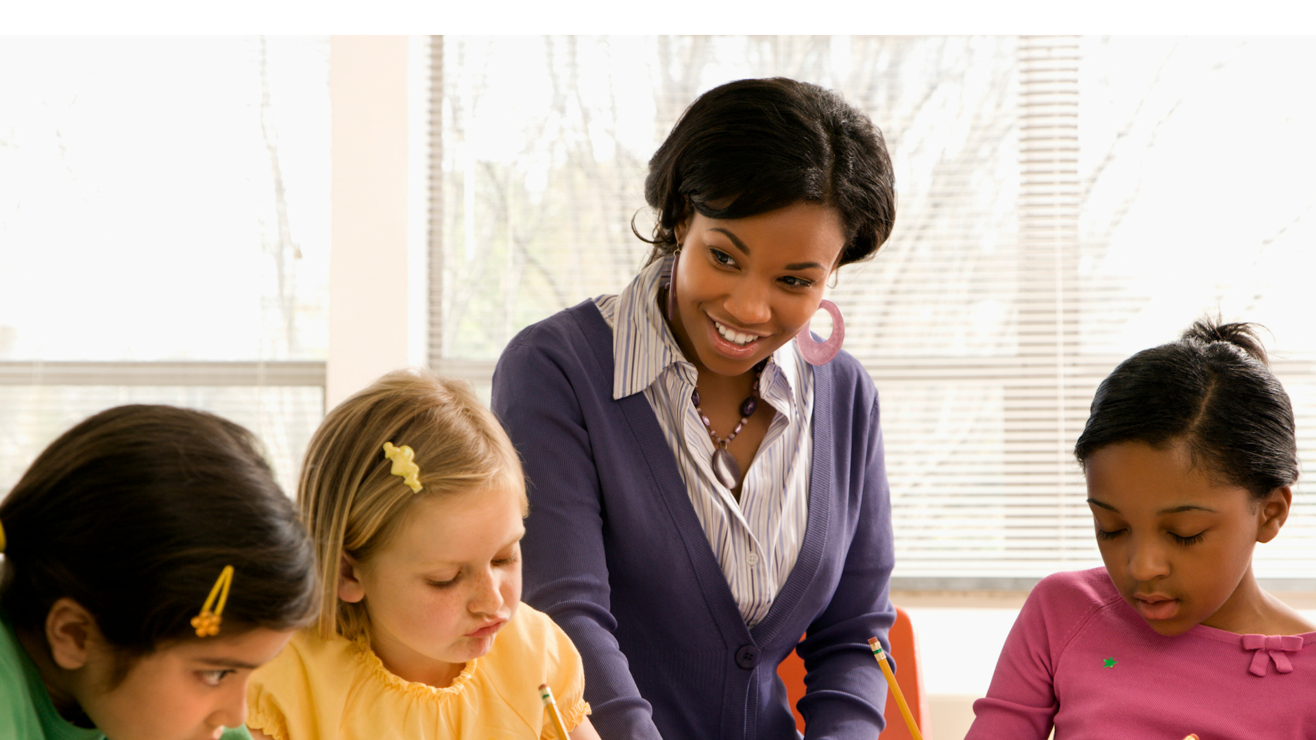
Teachers Can Help You To Know You're Cared For, Too!

Slide 19
Can you think of an adult who cares for you?
Think in your mind--
who is that person?

Slide 20
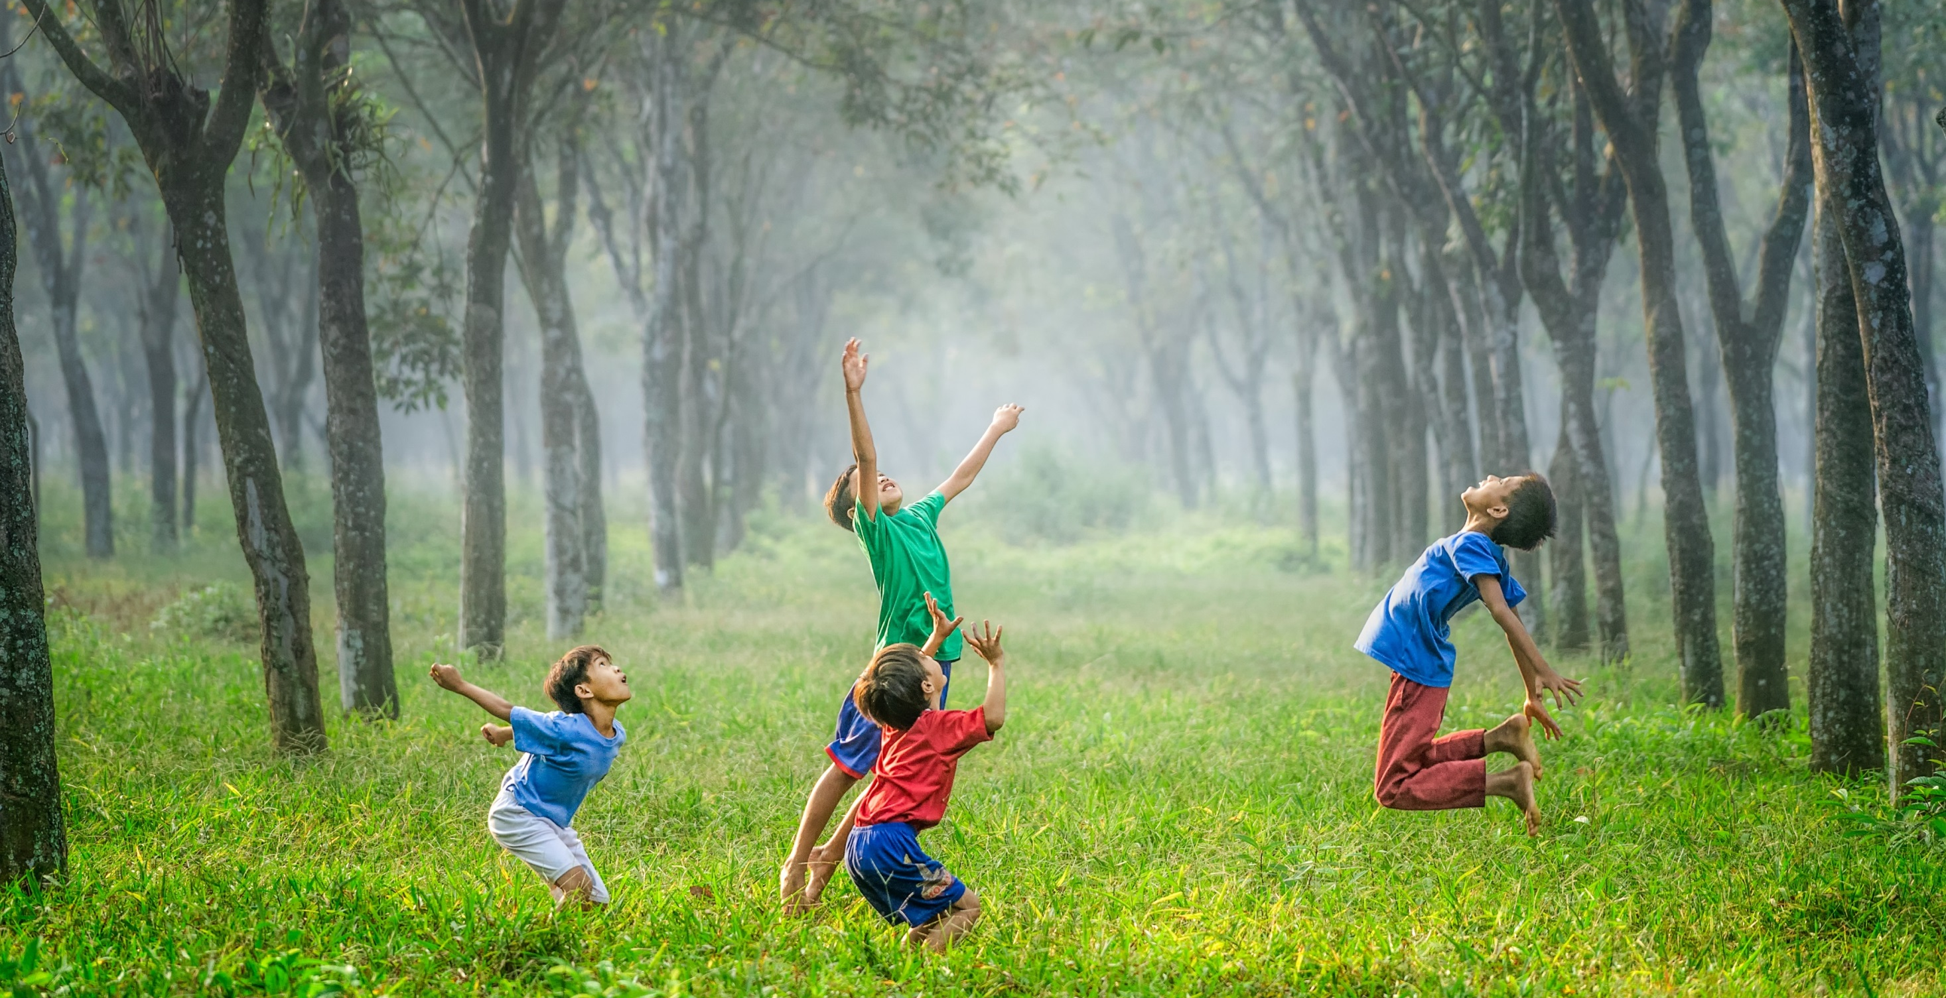
There Is So Much To You!
You're Made Of A Body, A Soul, Feelings, Thoughts & Ideas!

Slide 21
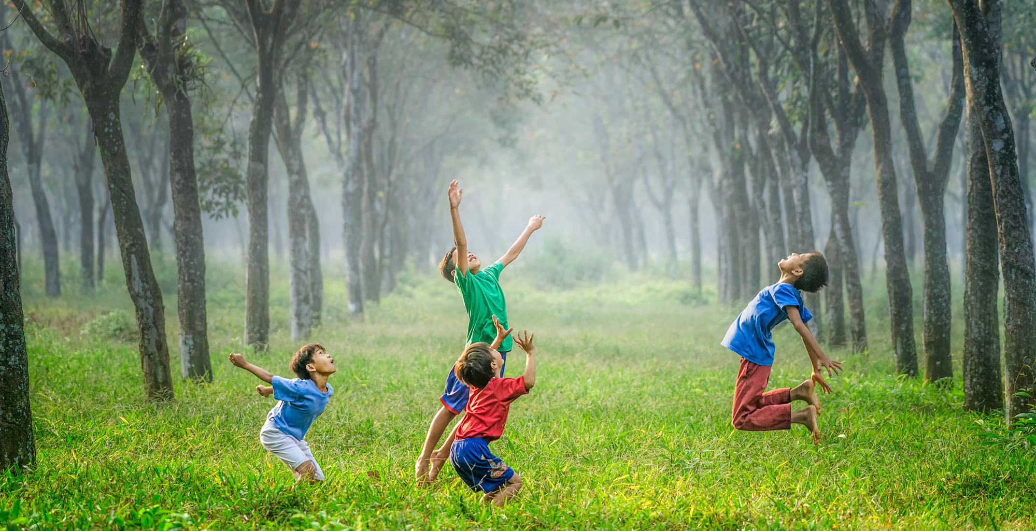
There Is So Much To You!
You Really Are Pretty Amazing & Special!

Slide 22
There Is So Much To You!
God Wants You To Be Safe.

Slide 23
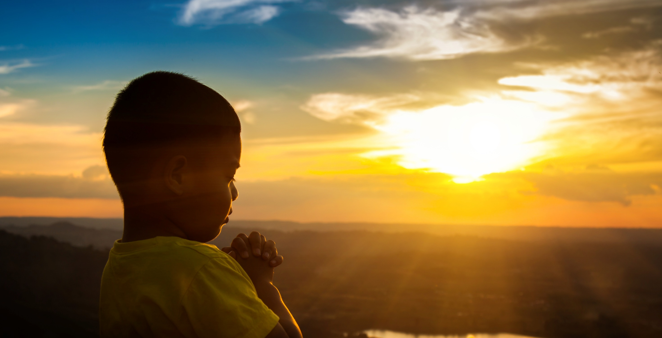
Let's Talk About Your Soul.
It Deserves Special Care Because It's The Place Where God Comes To Live Inside Of You.
Even Though You Can't See Your Soul, It Still Deserves Very Special Care.

Slide 24
Let's Talk About Your Soul.
The People Who Love You Know Your Soul Is Special.
They Help You Learn To Talk To God- To Pray.
YOU Know Your Soul Is Really Special, So You DO Pray & Spend Time With God-
Who Loves You.

Slide 25
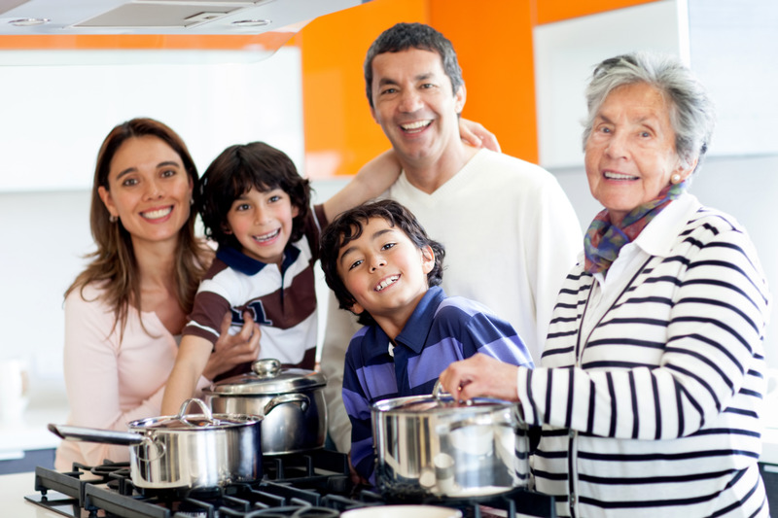
Your Feelings Are Special, Too.
The People Who Love You, Care About Your Feelings.
They Want You To Feel Safe & Loved.

Slide 26
The People Who Love You Care About Your Feelings.
You Talk About Your Feelings With People You Trust.

Slide 27
Another Special Part Of You Is Your Body.

Slide 28
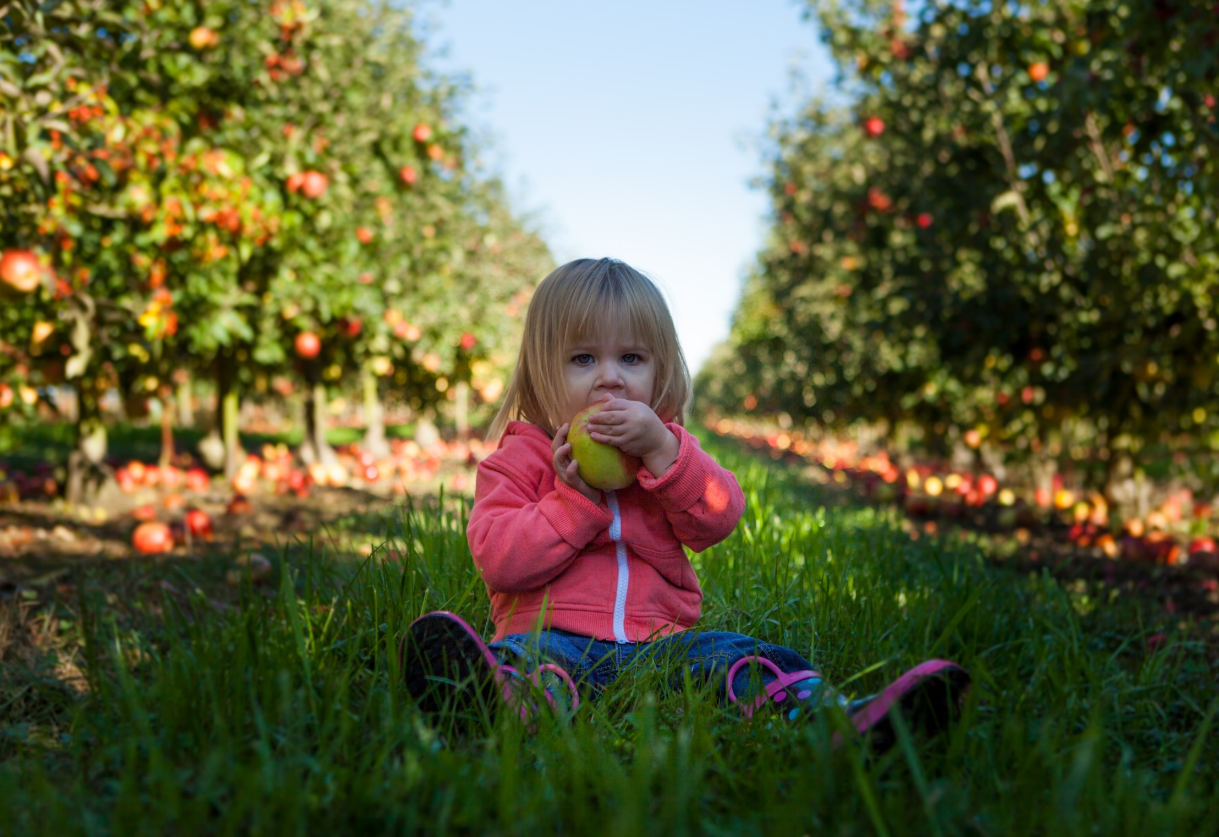
The People Who Love You Take Special Care Of Your Body.

Slide 29

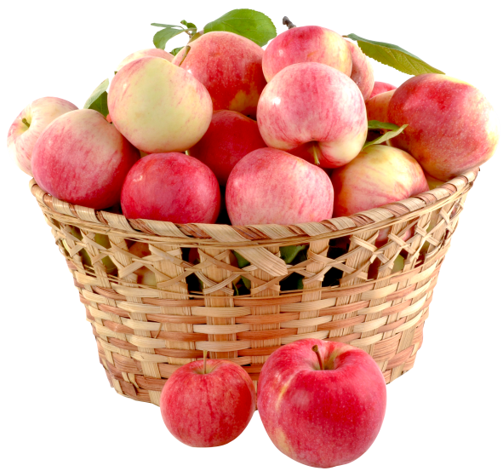
They Give You Healthy Food To Eat. You Help To Take Care Of Your Own Body By Making Healthy Food Choices.

Slide 30
The People Who Love You Take Care Of Your Body By Making Your Home A Safe Place To Live.

Slide 31
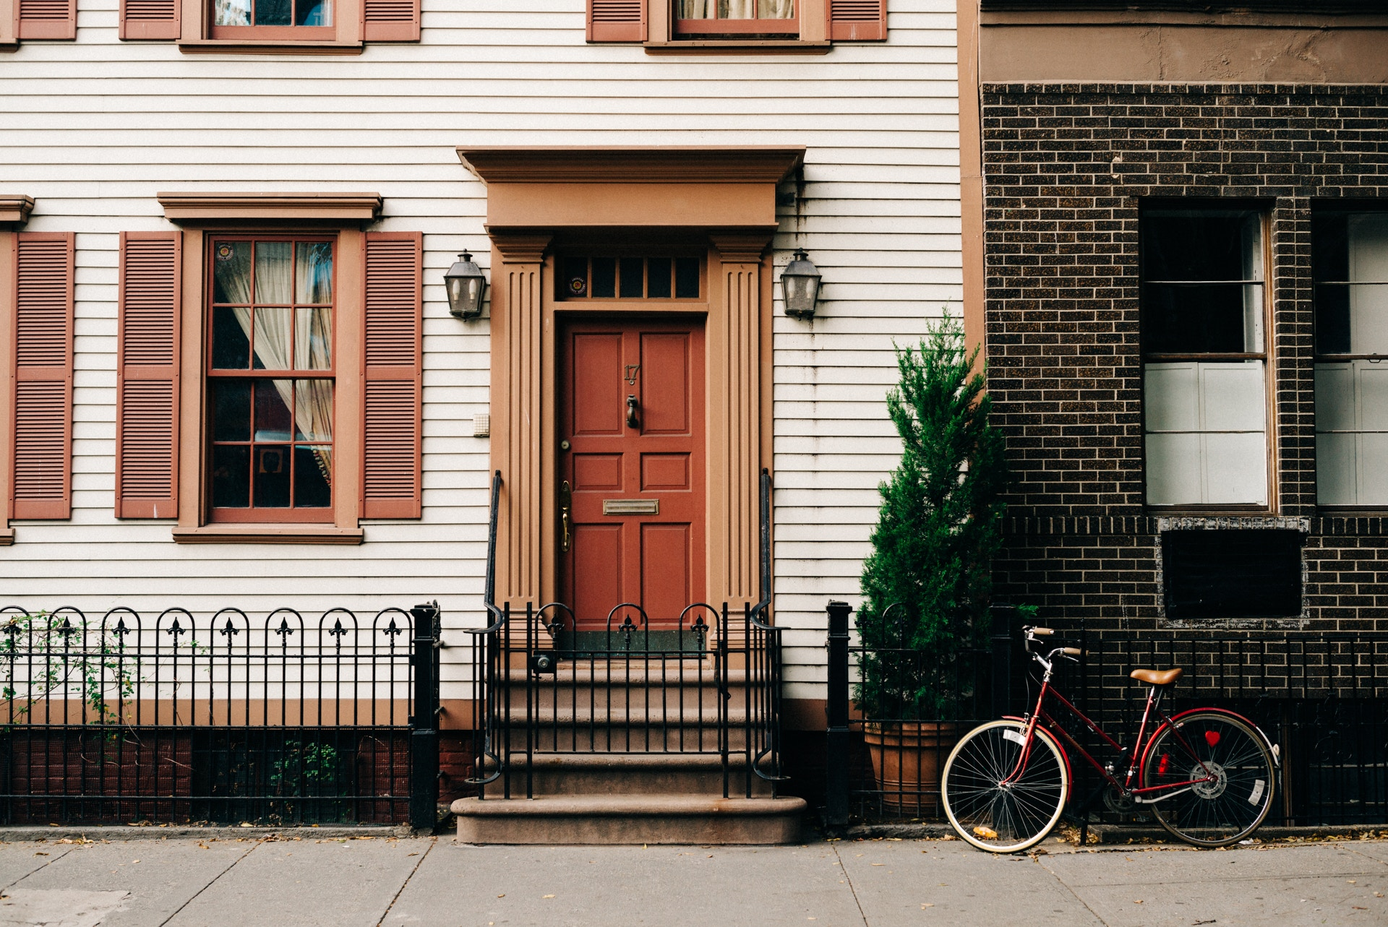
What does your family do to make your home safe?

Slide 32

The People Who Love You Take Care Of Your Body By Showing You How To Be Safe.
You Take Care Of Your Own Body By Making Good Choices, Safe Choices.

Slide 33
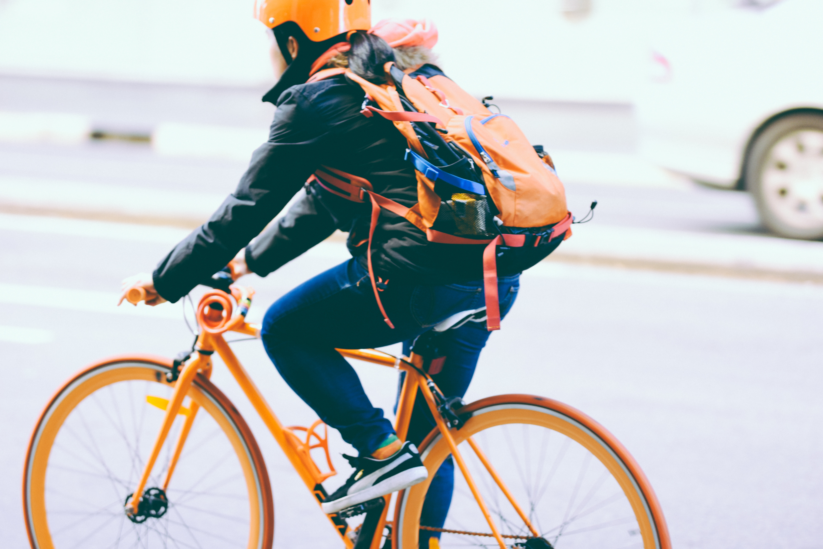
You Take Care Of Your Own Body By Making Good Choices, Safe Choices.

Slide 34
What other choices can you make to keep you safe?

Slide 35
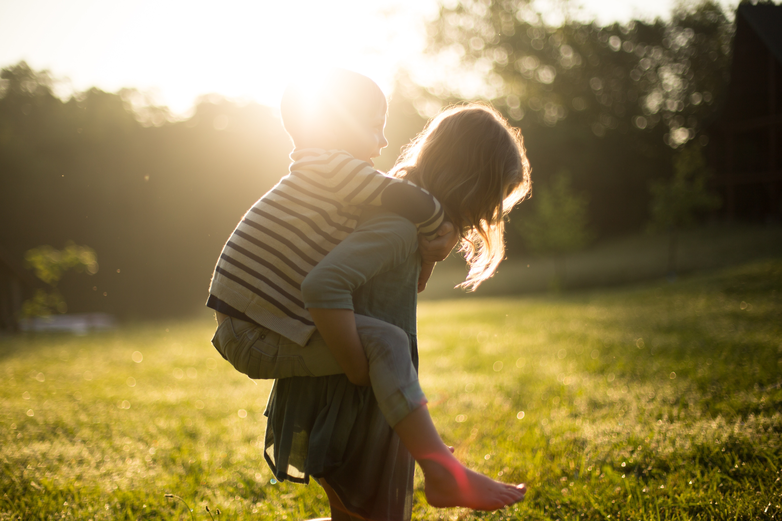
You Can Do A Lot Of Awesome Things With Your Body.
You
Can Play.

Slide 36

You Can Do A Lot Of Awesome Things With Your Body.
You Can Sleep.

Slide 37
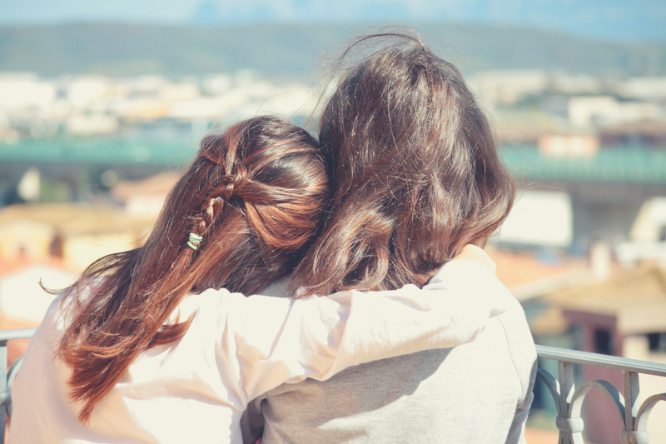
You Can Do A Lot Of Awesome Things With Your Body.
You
Can Hug.

Slide 38
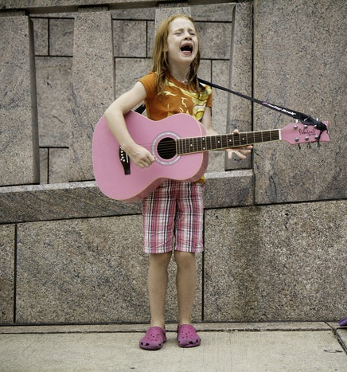
You Can Do A Lot Of Awesome Things With Your Body.
You
Can Sing!

Slide 39
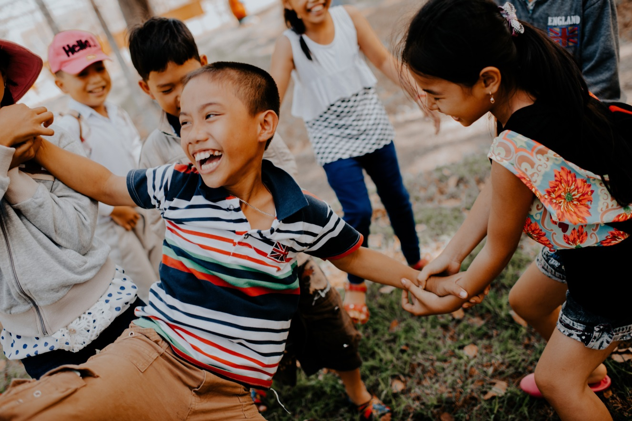
You Can Do A Lot Of Awesome Things With Your Body.
You Can
Laugh
With
Friends.

Slide 40
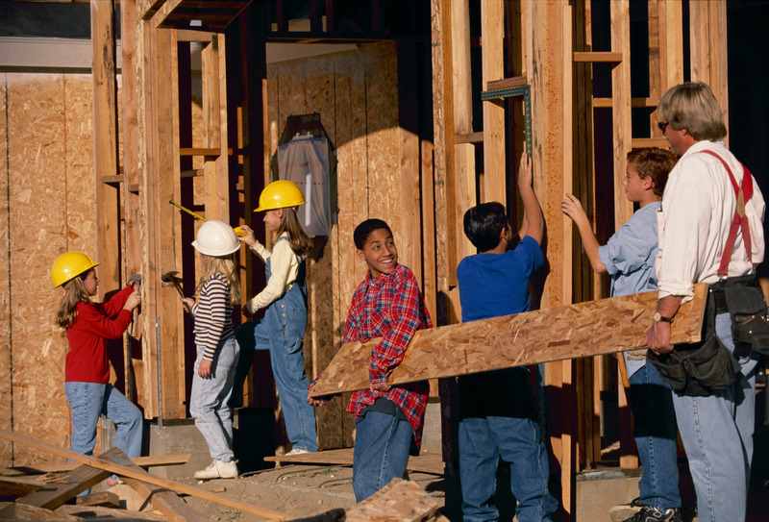
You Can Do A Lot Of Awesome Things With Your Body.
You
Can
Help
Others.

Slide 41
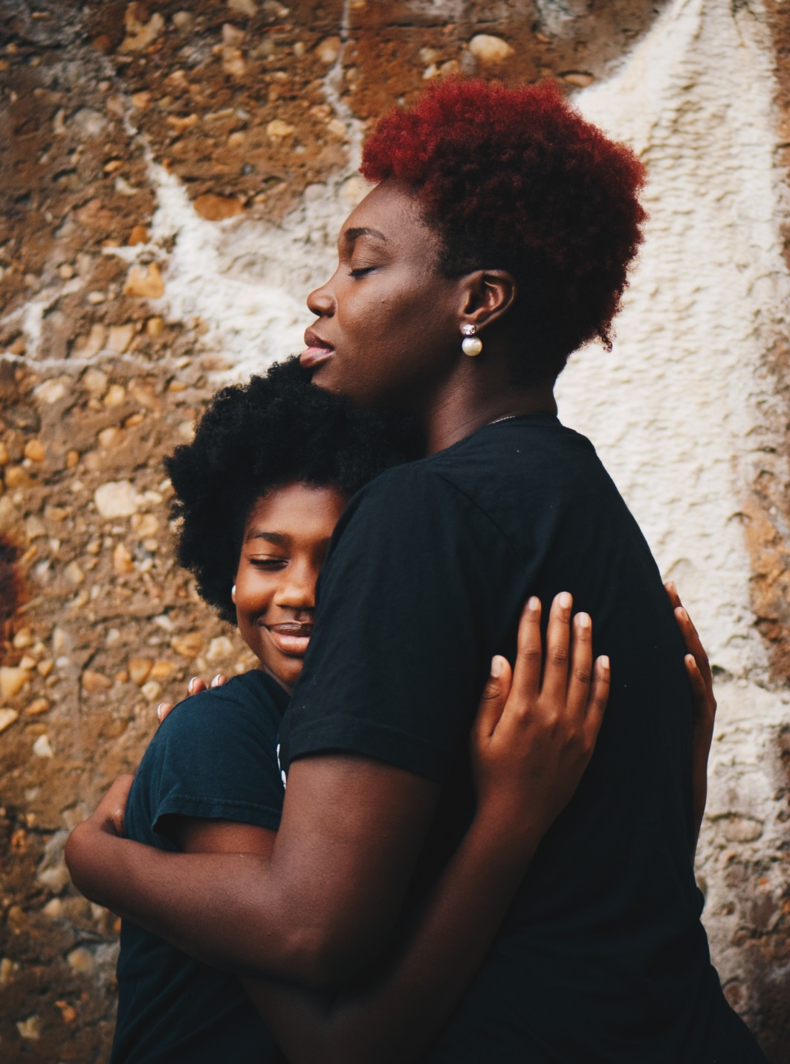
God Did An Amazing Job Of Making Everything About You Special-
Your Body,
Your Feelings &
Your Soul.

Slide 42
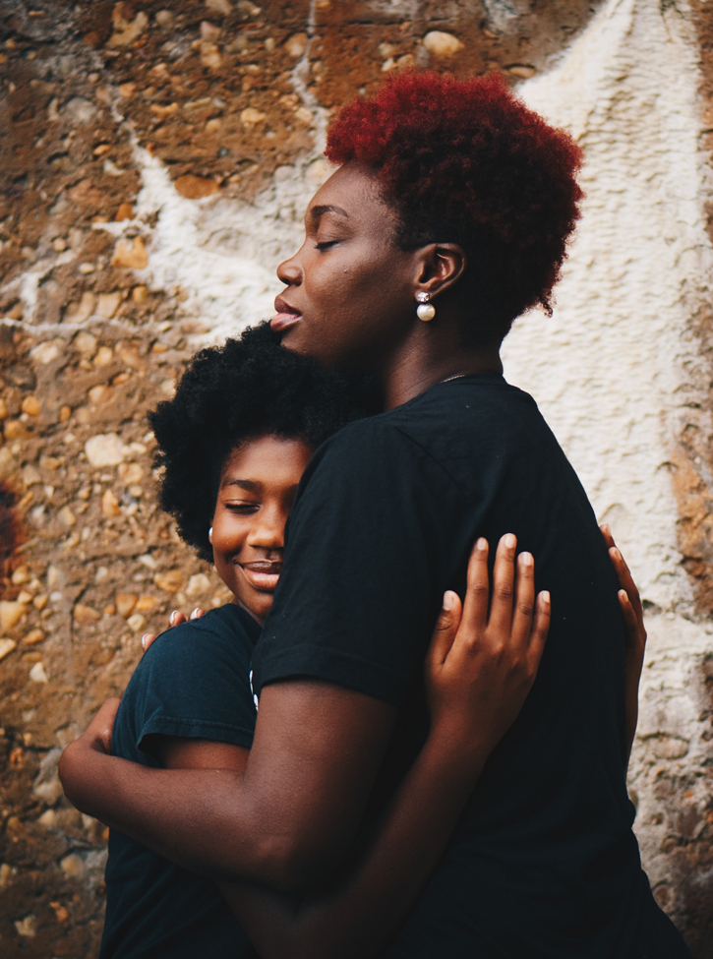
No One
Should Ever Try To Hurt
Your Feelings.

Slide 43
No One
Should Ever Try To Hurt
Your Soul.

Slide 44
No One
Should Ever Try To Hurt
Your Body.

Slide 45
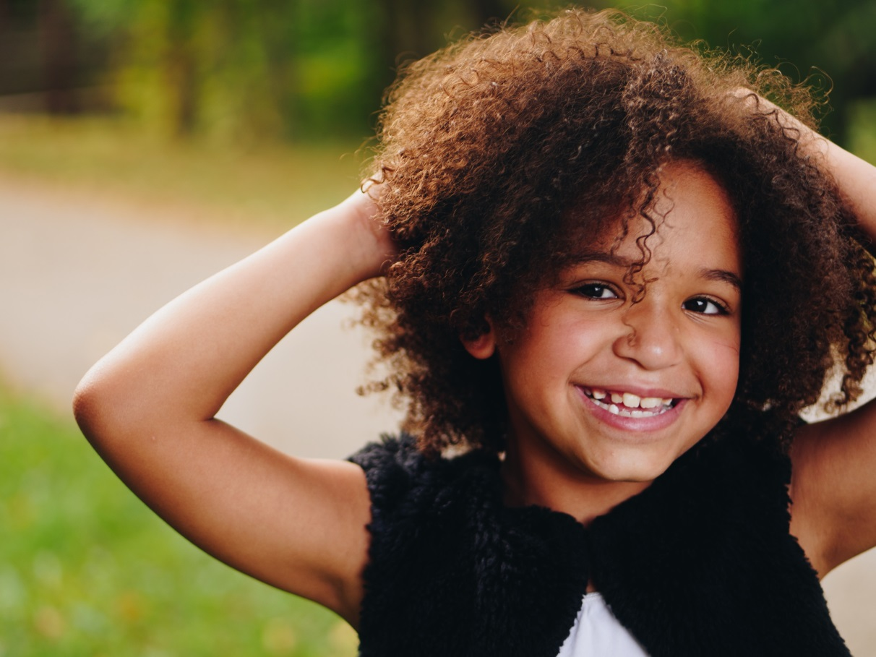
Let's Talk About Your Special, Holy Body.
You Wear Clothes On Your Body, To Protect Your Body From The Weather.

Slide 46
Let's Talk About Your Special, Holy Body.
You Also Wear Clothes Because They Look Nice!

Slide 47
Let's Talk About Your Special, Holy Body.
Also, You Wear Clothes On Your Body To Cover The Most Private Parts Of Your Body.

Slide 48
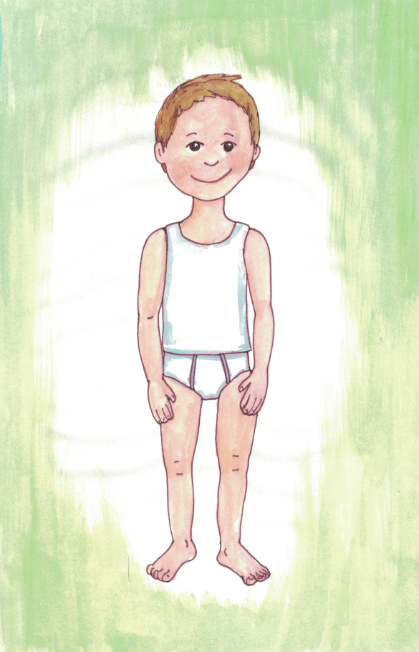
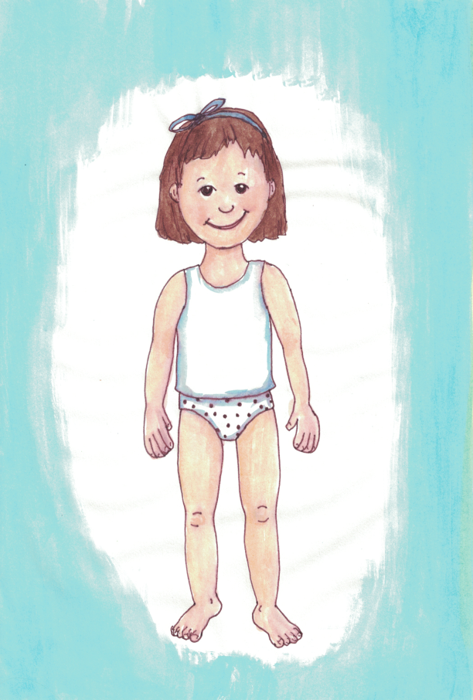
Let's Talk About Your Special, Holy Body.
This Boy and Girl Aren't Dressed To Go To School.

Slide 49
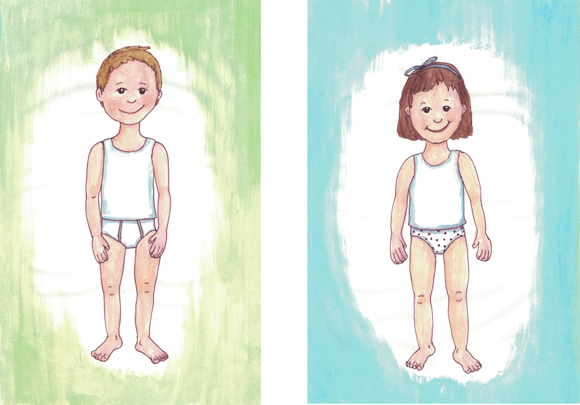
Let's Talk About Your Special, Holy Body.
They Aren't Dressed To Go Out With Friends.

Slide 50
Let's Talk About Your Special, Holy Body.
But, Their Clothes Still Cover The Most Special and
Private Parts Of Their Bodies.

Slide 51
Let's Talk About Your Special, Holy Body.
The People Who Love You Want To Make Sure Your Private Body Parts Are Safe and Respected.
YOU Have The Right To Make Sure
YOUR Body &
YOUR Private Body Parts Are Safe and Respected.

Slide 52
Let's Talk About Your Special, Holy Body.
There's A Lot You Can Do To Make Sure
Your Body and Your Private Body Parts Are
Safe and
Respected.

Slide 53


You Can Say:
"I Have Boundaries. My Private Body Parts Will Be Safe & Respected."
You Can Even Say That Loudly.

Slide 54
You Can Say:
"My Private Body Parts Will Be Safe & Respected. No Touching. No Looking."
You Can Even Say That Loudly.

Slide 55
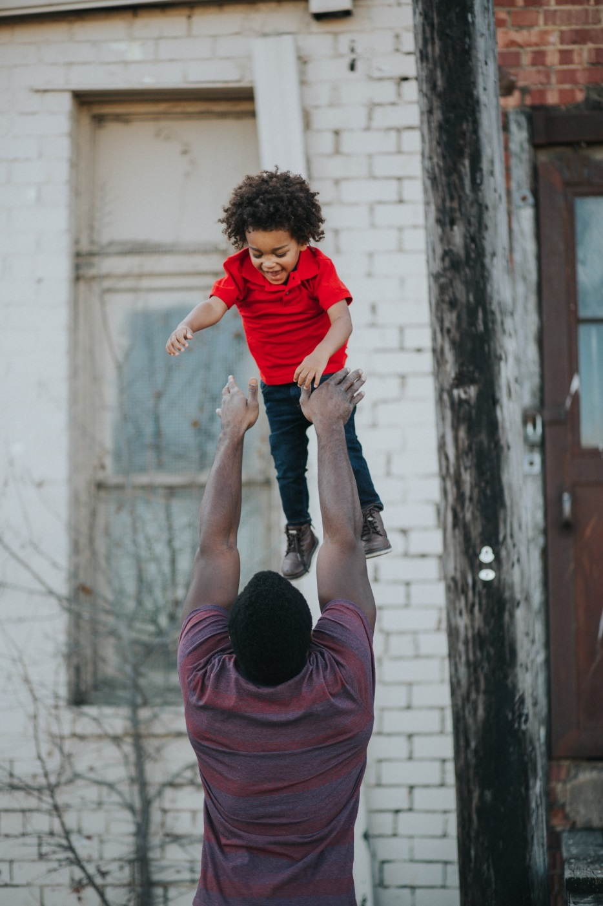
Your Body Is Special. If For Some Reason, Your Body Needs Special Care, Someone Who Loves You Can Help.
A Doctor or Nurse Can Help You, Too.
You Can Talk About This With The Adults Who Love & Care For You.

Slide 56
Are You Worried That Someone Has Tried To Make Your Body Disrespected Or Unsafe?
Tell Someone Who Loves You.
Say,
"I Feel Worried. I DO want to talk about being safe and respected.”

Slide 57
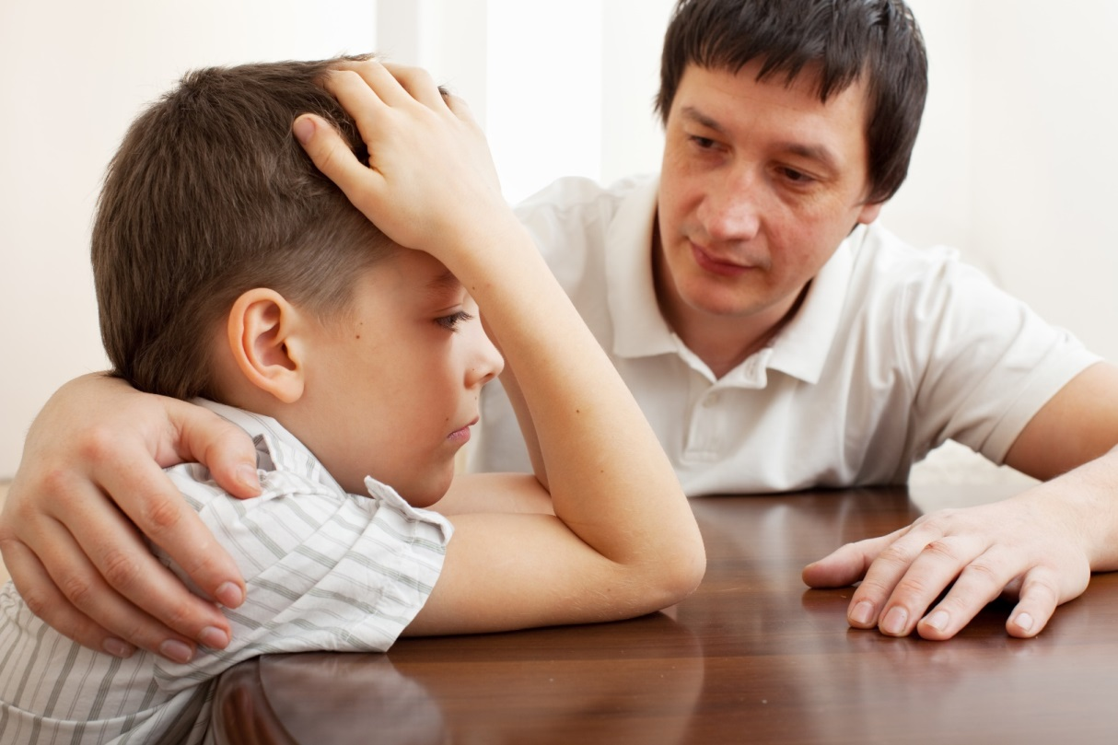
Can you talk about this to someone?
Think. Who is an adult
that cares for you,
and for your feelings?
Who wants to keep you safe from harm?
Which adult respects the privacy and holiness of your body? ​
​
Think in your mind--​
who is that person?

Slide 58
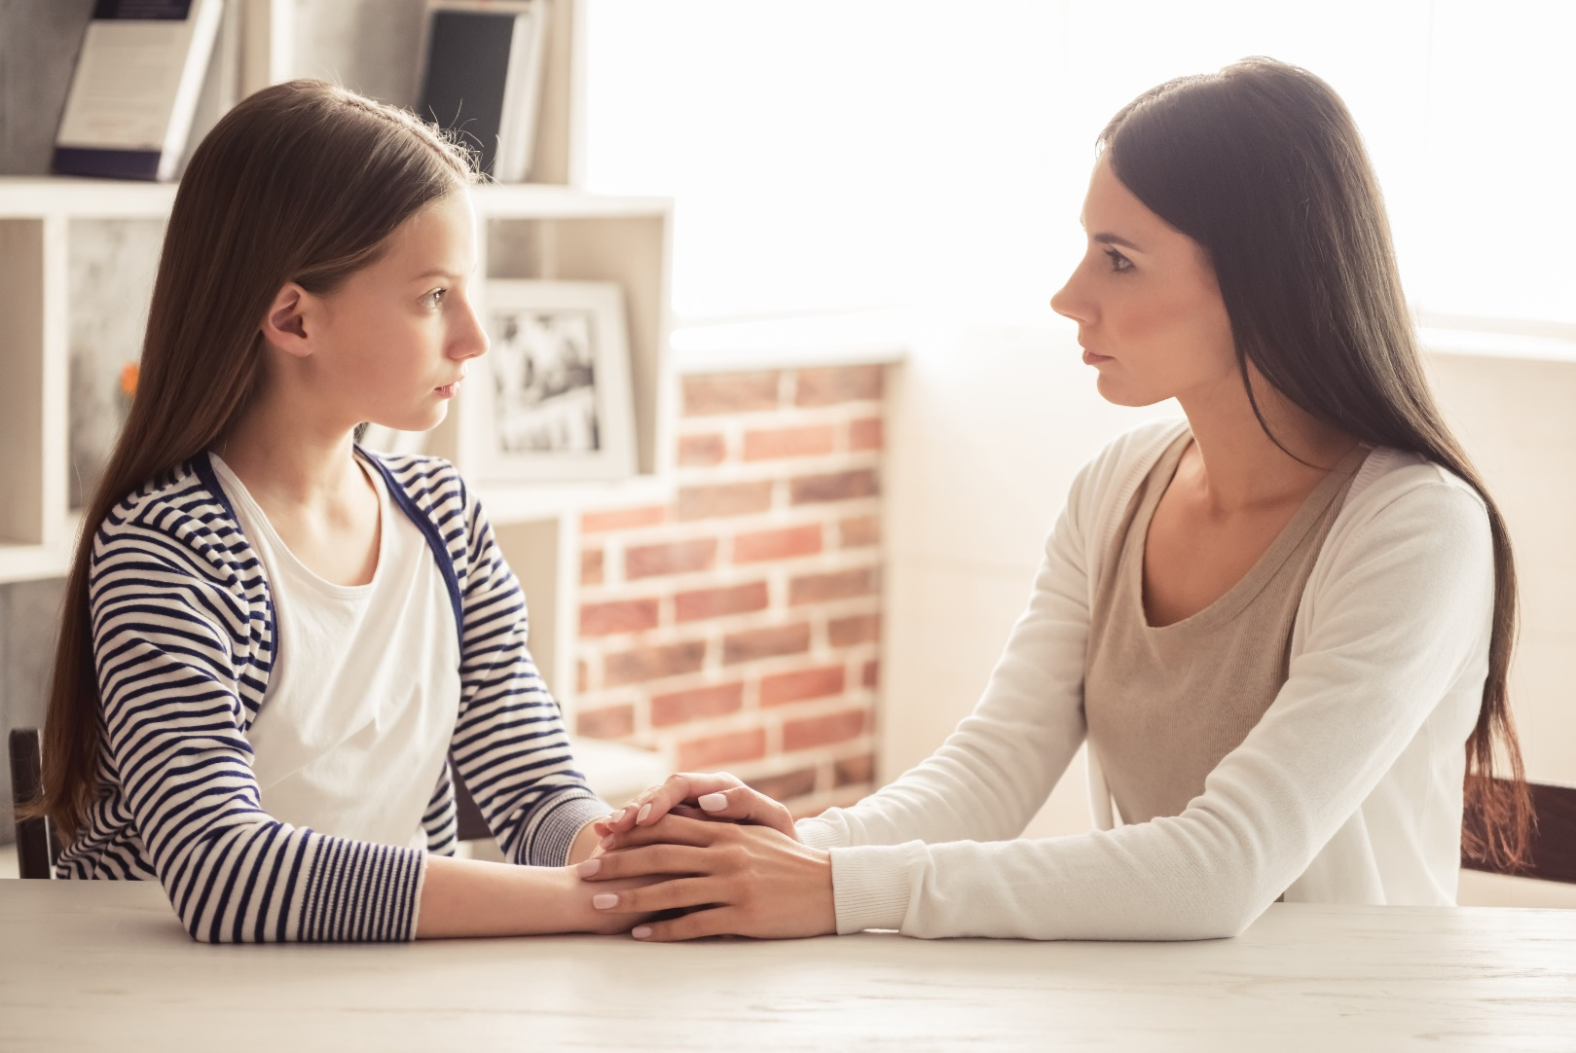
You can trust that adult.
You can say to that person, "I feel disrespected.
I want to talk about it."

Slide 59

What Ways Could A Person Disrespect Your Boundaries?
What Ways Could Another Person Disrespect The Privacy Of Your Body?
Well, Most People Won't Ever Want Or Try To Disrespect The Privacy & Holiness Of Your Body.
But... ... ...

Slide 60

Maybe Someone Wants To Show You Pictures of Private, Holy Body Parts.

Slide 61

Tell a trusted adult as quickly as possible.

Slide 62
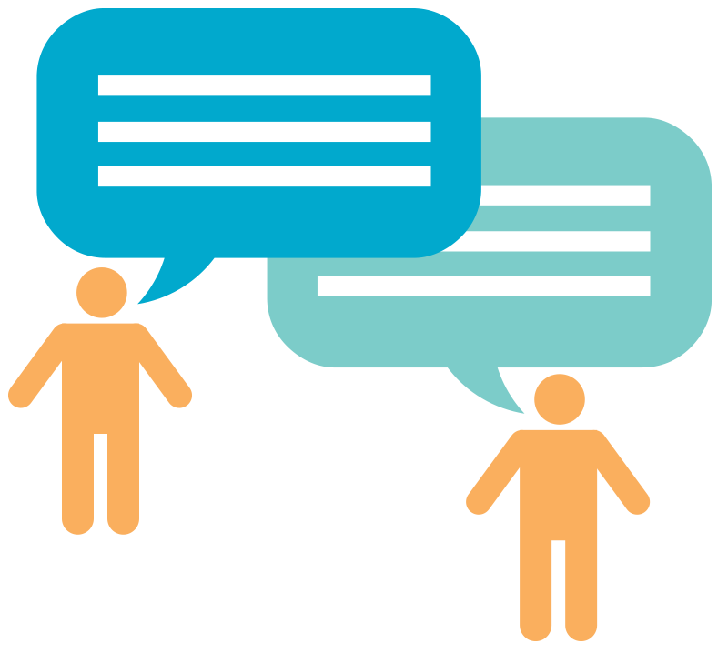
Maybe a person wants to TALK
about private body parts.

Slide 63
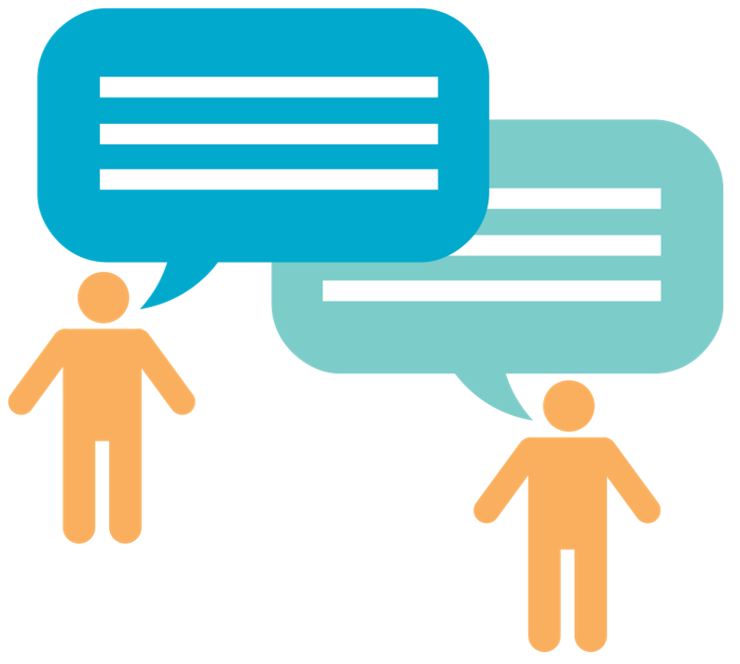
Say, “This disrespects me.”
Tell a trusted adult as quickly as possible.

Slide 64
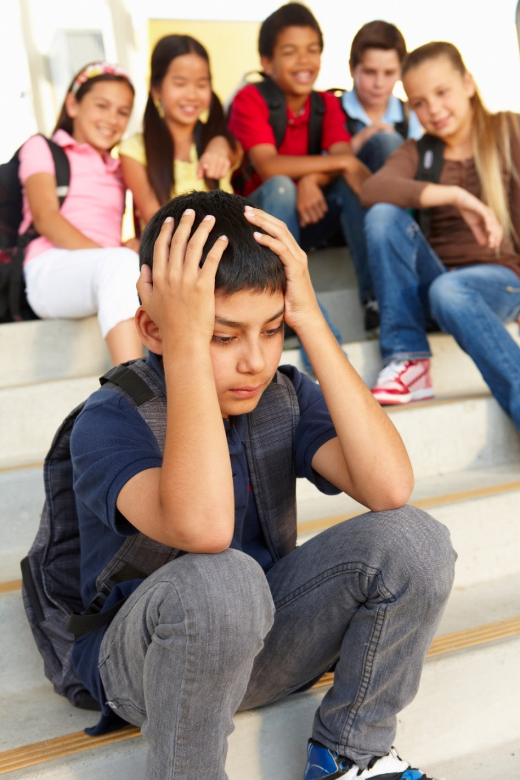
Does a Friend want to talk about another person’s private body parts?

Slide 65

Say, “This disrespects me.”
Tell a trusted adult as quickly as possible.

Slide 66
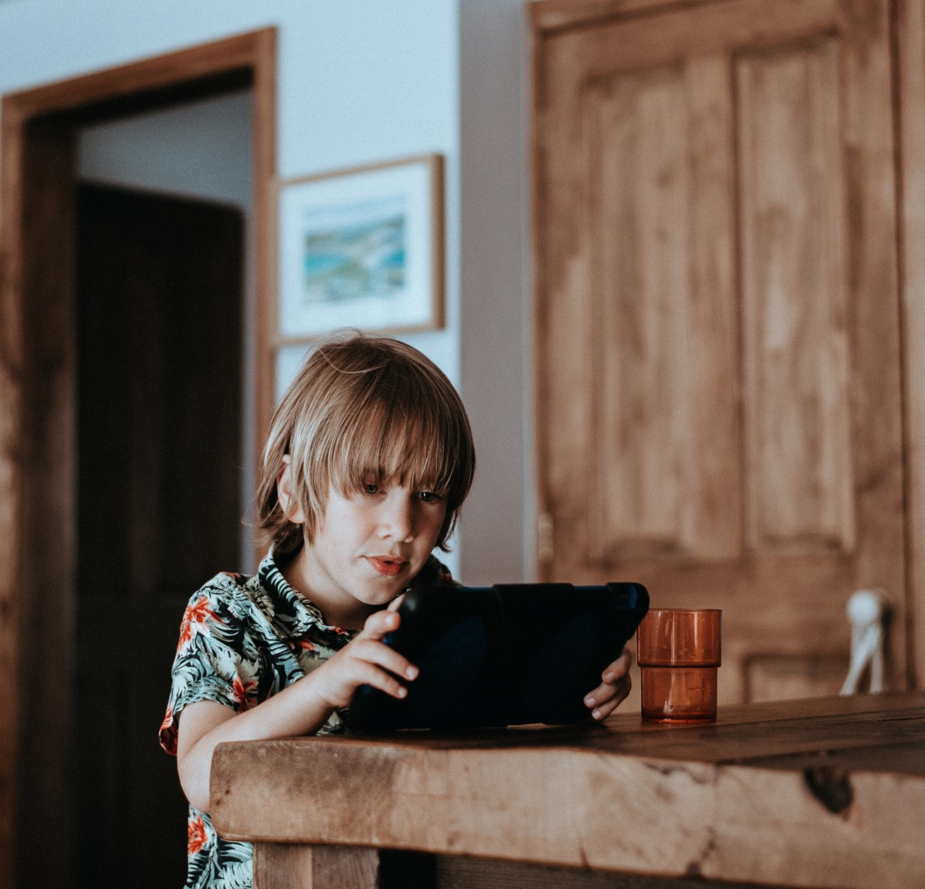
What if someone wants to show you movies and pictures that disrespect the privacy and holiness of another person’s body?

Slide 67

Say, “This disrespects me.”
Even If You Looked, Tell a trusted adult as quickly as possible.
You Will Not Be in Trouble. A Trusted Adult Will Help You

Slide 68
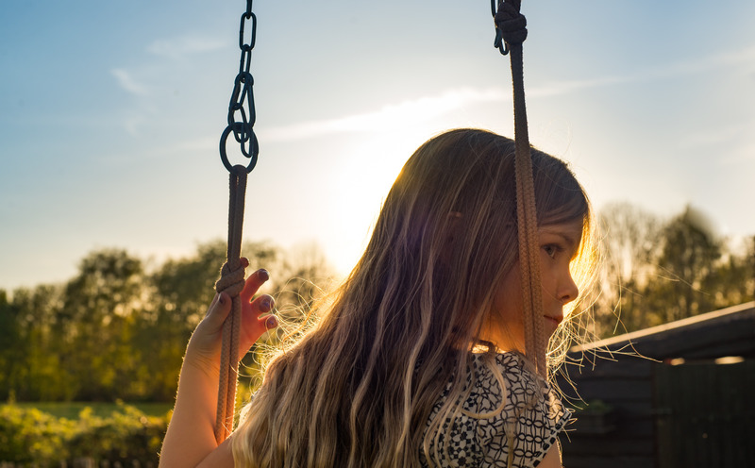
Maybe a person wants to be close to you in ways that make you feel uncomfortable.
You can say, “I don’t want you to be so close to me.”

Slide 69

If they ignore you, or make a joke of it,
say, “This disrespects me.”
Tell a trusted adult as quickly as possible.

Slide 70
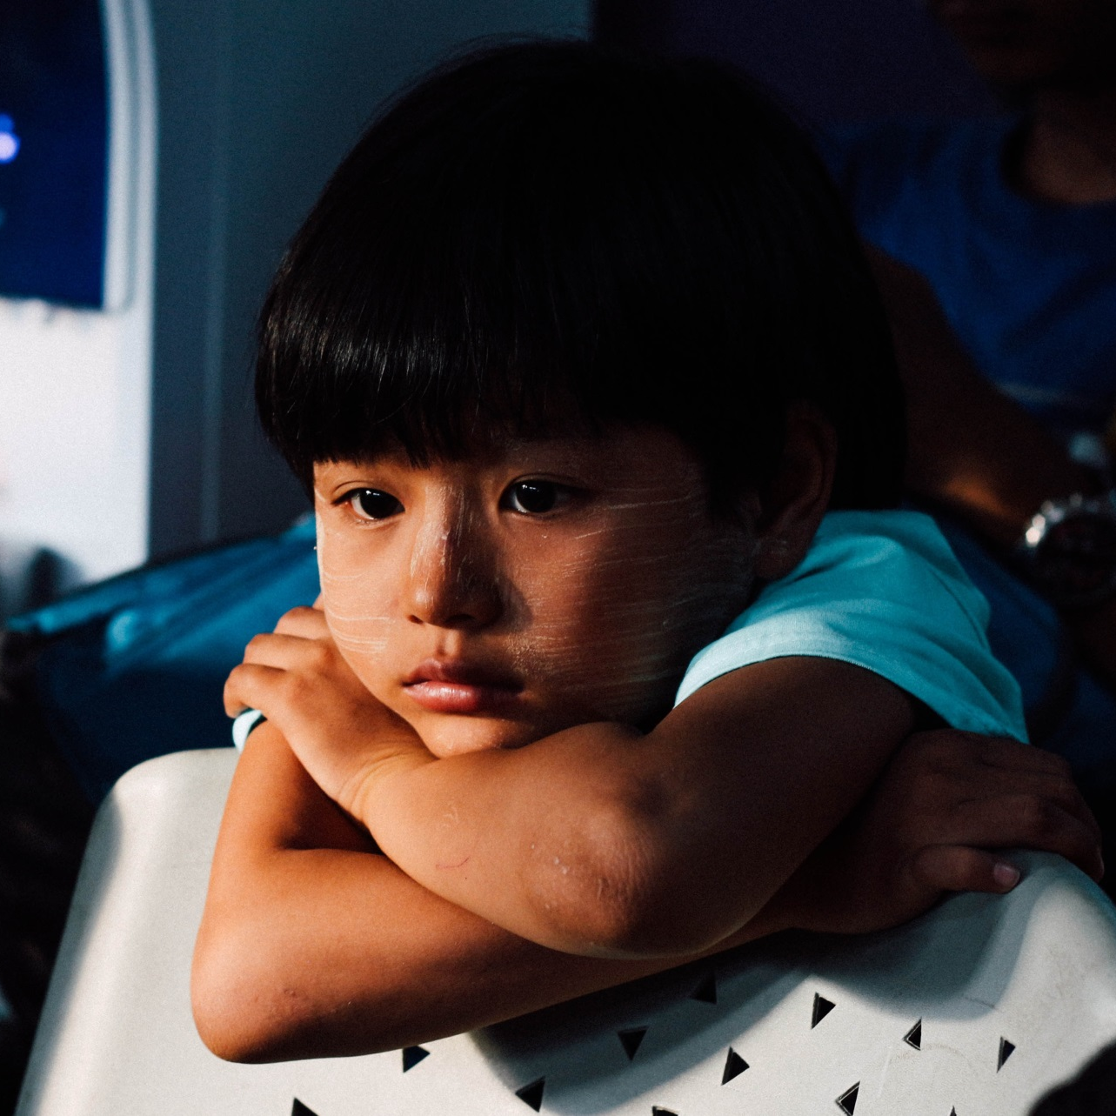
Sometimes, a person who wants
to disrespect you may try to make you feel sorry or silly for having boundaries.

Slide 71
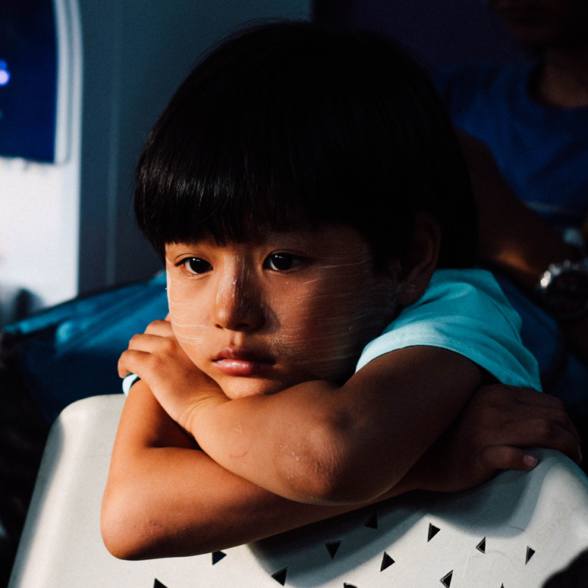
That person may try to make you feel ashamed of having the feelings you have.

Slide 72
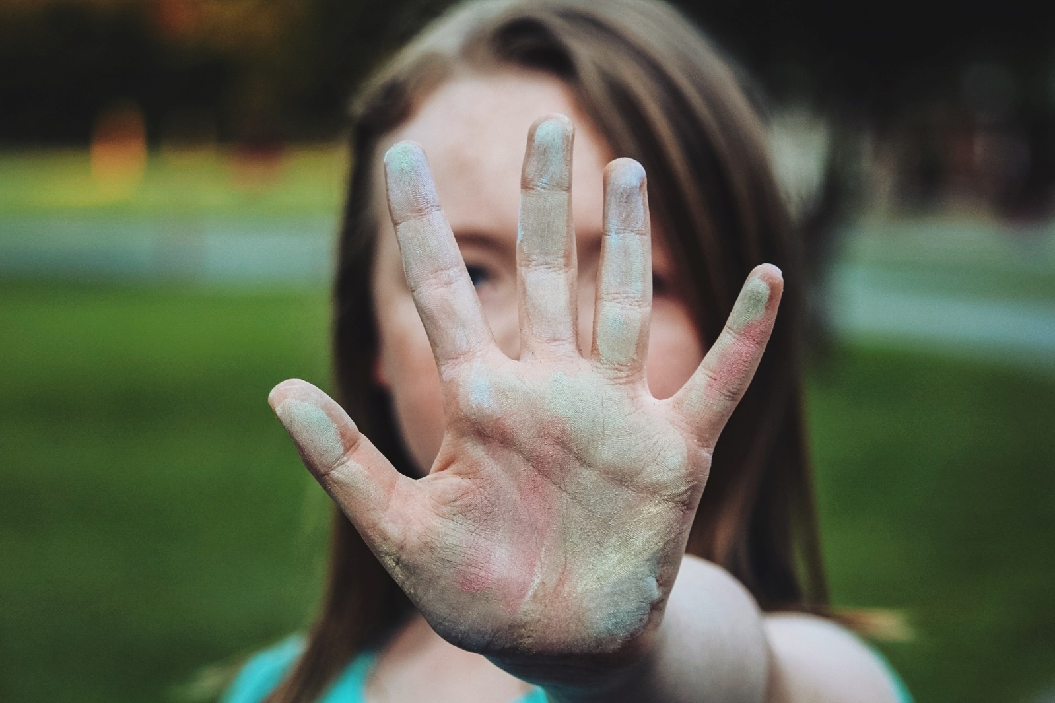
Don’t buy that.
The people who love you care about your feelings. The people who love you will not try to make you feel ashamed of your feelings.
Don’t Buy That.

Slide 73
It doesn’t matter if
the person who is disrespecting you is
the same gender or opposite, or the same age or not.
Don’t Buy it. Tell a trusted adult.

Slide 74
It doesn’t matter if the person who is disrespecting you is in charge of you in some way.
Don’t Buy it. Tell a trusted adult.

Slide 75
It doesn’t matter if the person disrespecting you tells you not to tell anyone.
Don’t Buy it. Tell a trusted adult.

Slide 76
It doesn’t matter.
If ANYONE does these things to you, or says these things to you,
tell a trusted adult.

Slide 77
If ANYONE tries to
frighten you into
not telling,
or tries to give you gift
so that you don't tell,
or says you will be in
trouble if you tell,
don’t believe them.
Tell a trusted adult.

Slide 78
You are special to God,
and special to yourself,
and special to others.
You are special.
You deserve to be respected and safe.
If you ever feel disrespected, tell an adult you trust.
You matter.

Slide 79
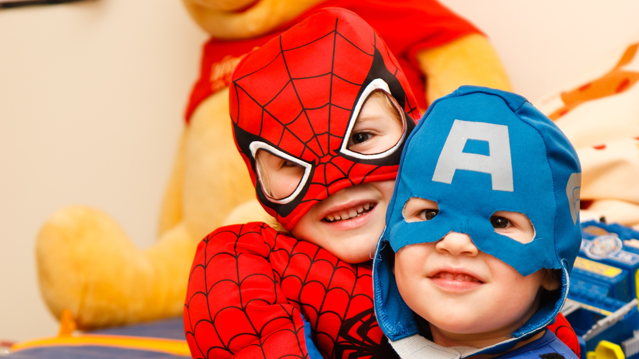
If Your Friend Has Been Hurt
or Disrespected,
Tell a Trusted Adult.

Slide 80

If you feel worried, or disrespected, the people who love you want to know about your feelings.

Slide 81
If you feel worried, or disrespected, the people who love you will listen to you when you talk about
your feelings.

Slide 82
The people who love you will listen to you and help to make things better. The people who love you will work hard to make sure you feel safe.

Slide 83
Jesus loves you. He has made you amazing and special. He made your body special. He has given you important feelings. He has given you people who love you and who care about you.

Slide 84
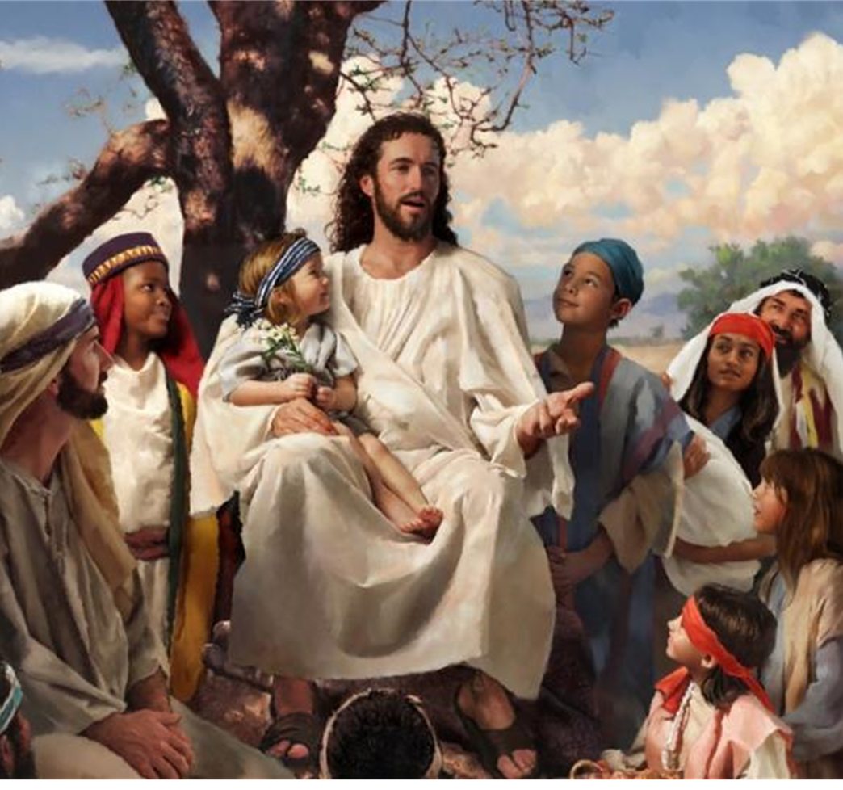
Jesus loves you.
He wants you to kNOw
you matter.

Slide 85
Jesus loves you.
He wants you to
kNOw
you deserve
to be safe and respected.

Slide 86
Jesus loves you.
He wants you to
kNOw
you have the right to say
“NO!”

Slide 87
Say:
I kNOw I am a child of God.
I kNOw I deserve to be safe and respected.

Slide 88
Say:
I kNOw my body is holy and private.
NO touching or looking.

Slide 89
Say:
I kNOw other people’s bodies are holy and private.
NO touching, NO looking.

Slide 90
Say:
I kNOw that I can say
“NO touching.”
“NO looking.”
I can even say it LOUDLY.

Slide 91
Say:
I kNOw I can ask a trusted adult to help me.
I kNOw a trusted adult will help me.

Slide 92
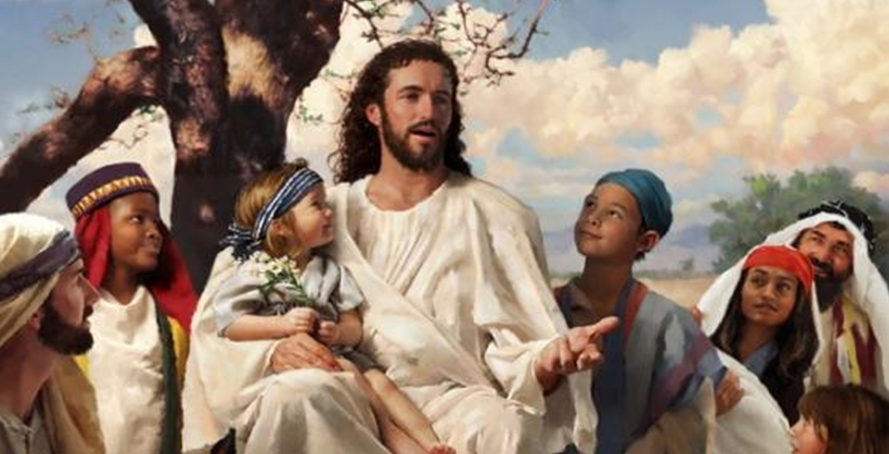
We pray:
I thank you, Jesus for my feelings.
I can listen to my feelings.
I thank you that I know when I’m happy.

Slide 93
I know when I feel safe.
Thank You, Jesus, that I can talk about my feelings.

Slide 94
Thank Jesus for giving me people who love me.
The people who love me care about my feelings.
They care about me.
They work hard to keep me and my body safe.

Slide 95
Jesus, I have the right to work hard
to keep me safe, too.

Slide 96
Thank you, Jesus. You love me.
You care for me. Amen.

