Slide 1
The kNOw Program
Diocese of Lansing Safe Environment Program

Slide 2
The kNOw Program will help you to be safe and respected.

Slide 3
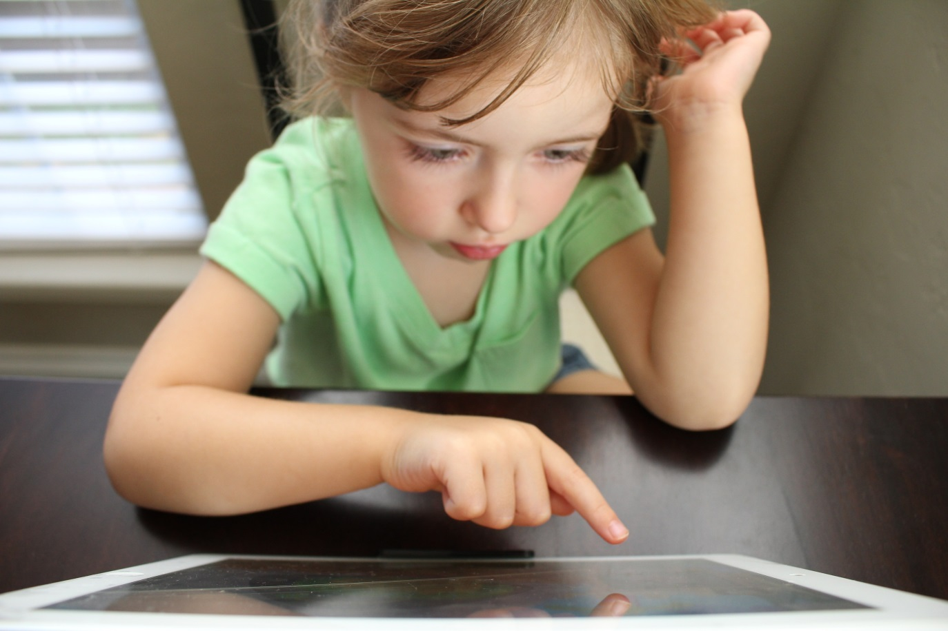
People Take Very Good Care of Things That Are Special.

Slide 4
People Take Very Good Care Of Special Things.

Slide 5
People Take Very Good Care Of Special Things.

Slide 6
This Little Guy Deserves
Special Care!

Slide 7
What Would You Do For This Little Guy If He Was Yours?

Slide 8
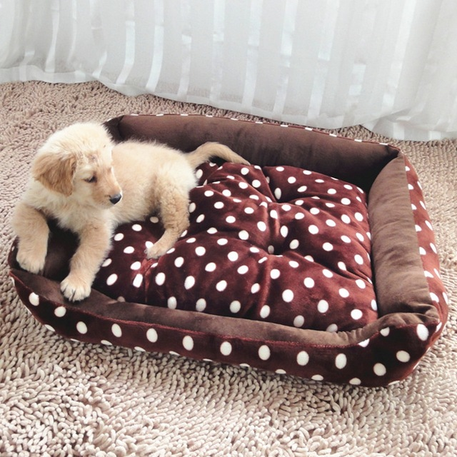
Would You Give Him A Special Bed?

Slide 9
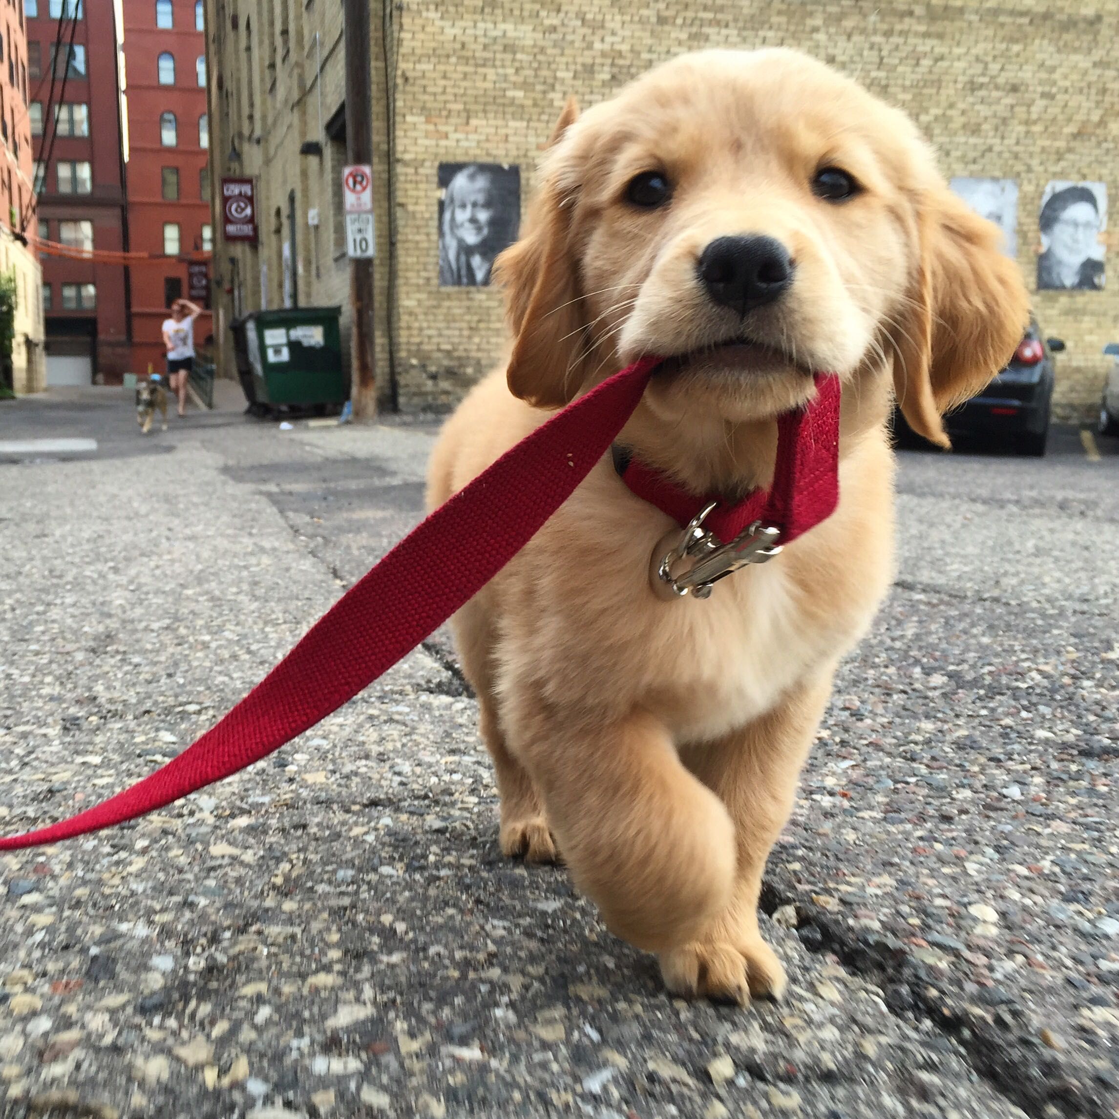
Would You Take Him for A Nice Long Walk?

Slide 10
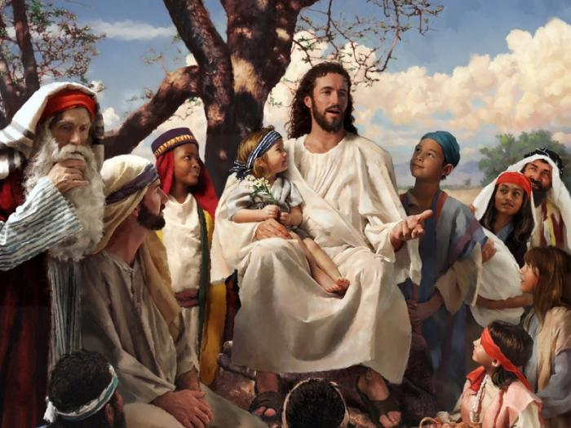
To Jesus, YOU Are Very Special.

Slide 11
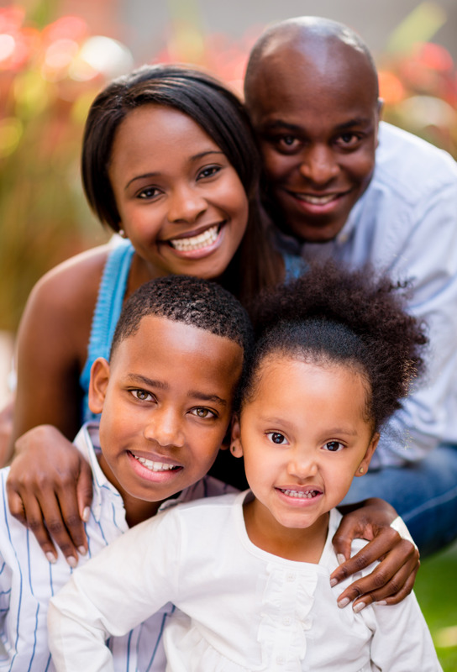
People Should Take Care Of You!

Slide 12
Jesus Wants You To Be Happy.
He Wants Your Family & Community To Take Special Care Of You.
YOU Can Help Take Care of You, Too!

Slide 13
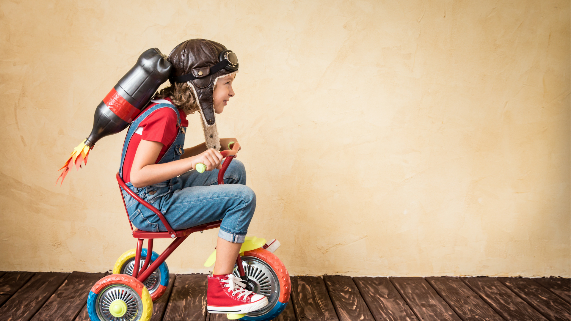
Jesus Says, "You are Loved.
Jesus says, "I want you to be Safe!"

Slide 14
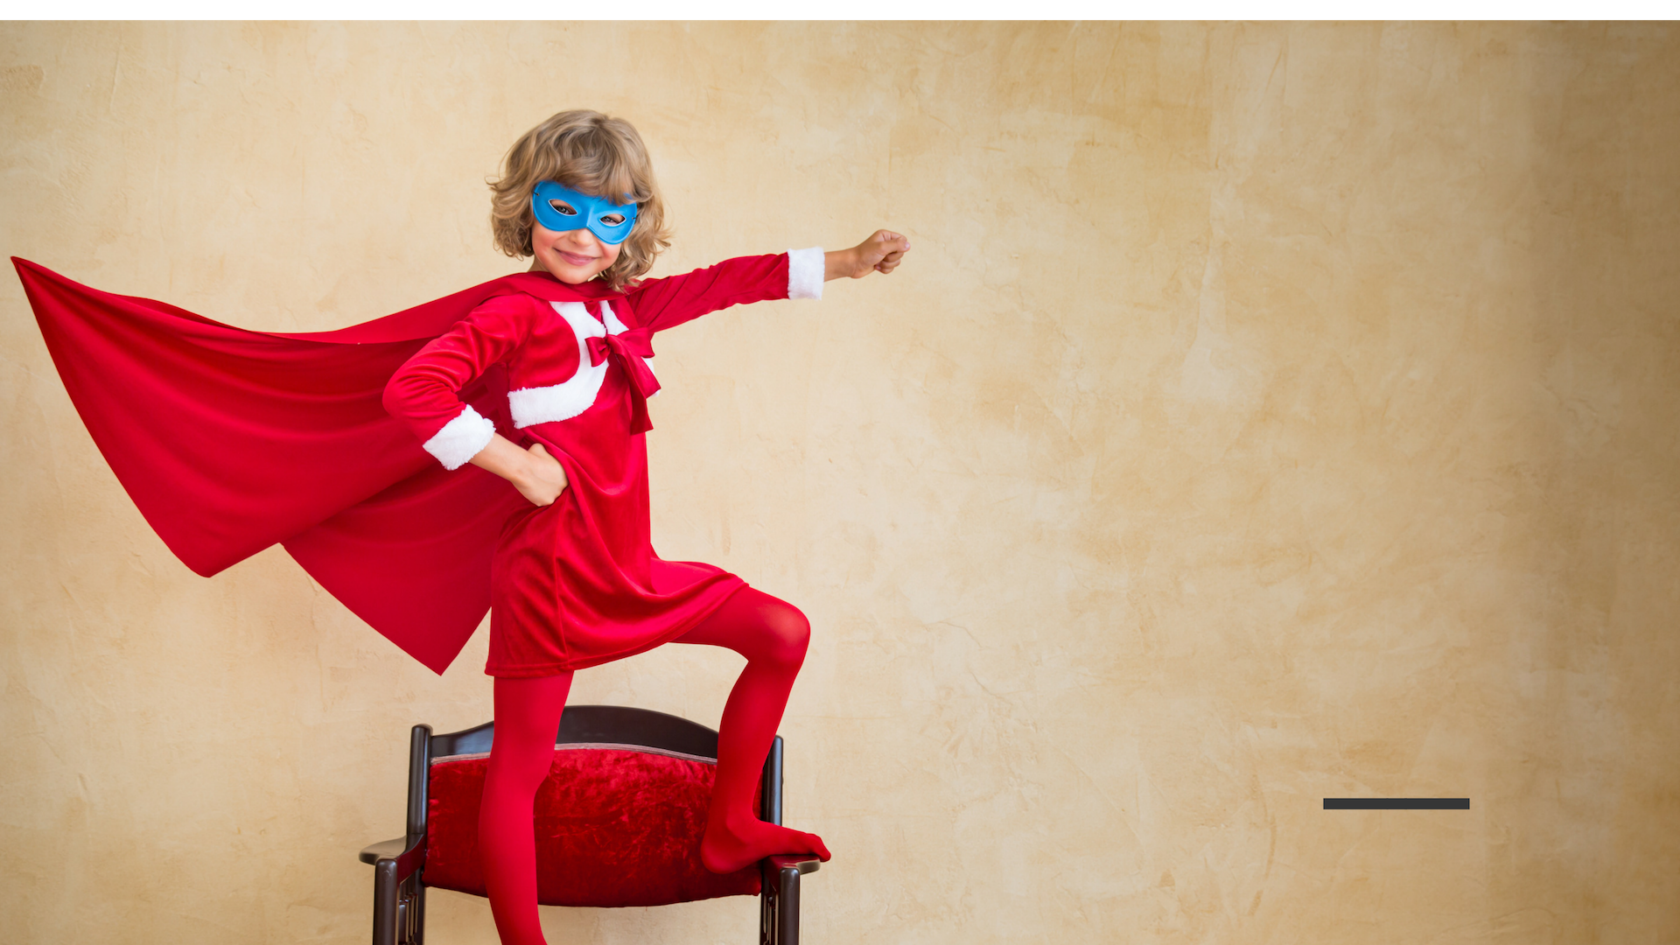
Jesus Wants You To Know You're Loved.
He Wants You To Know You're Safe!

Slide 15
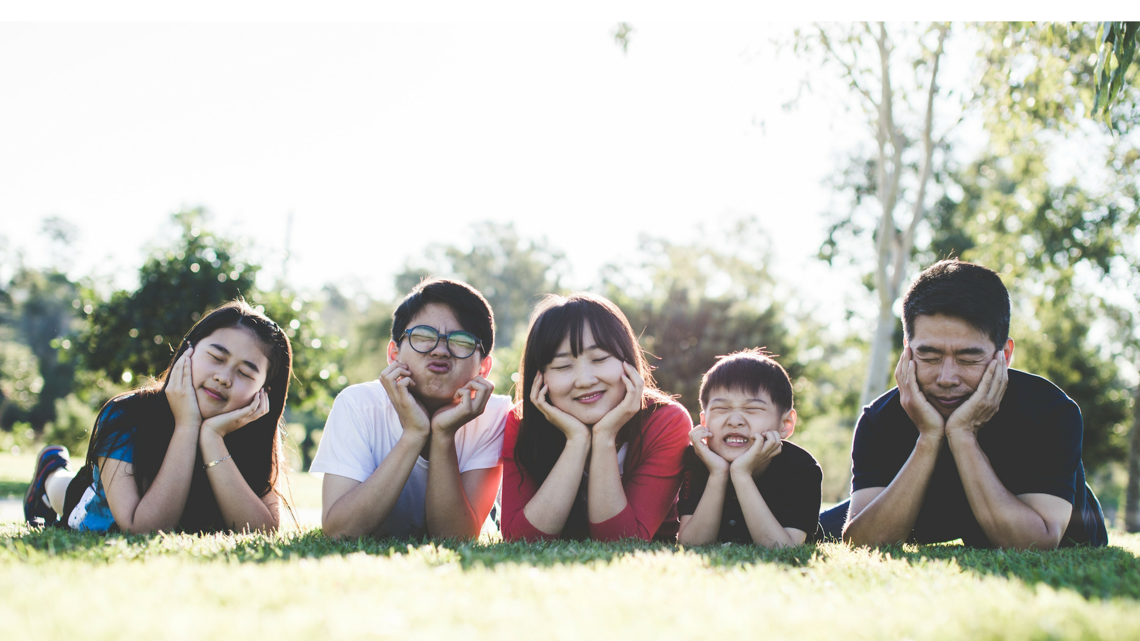
You Probably Have A Family To Help Care For You.

Slide 16
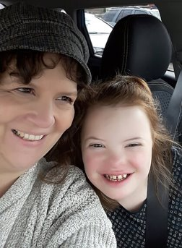
You Probably Have A Family To Help Care For You.

Slide 17
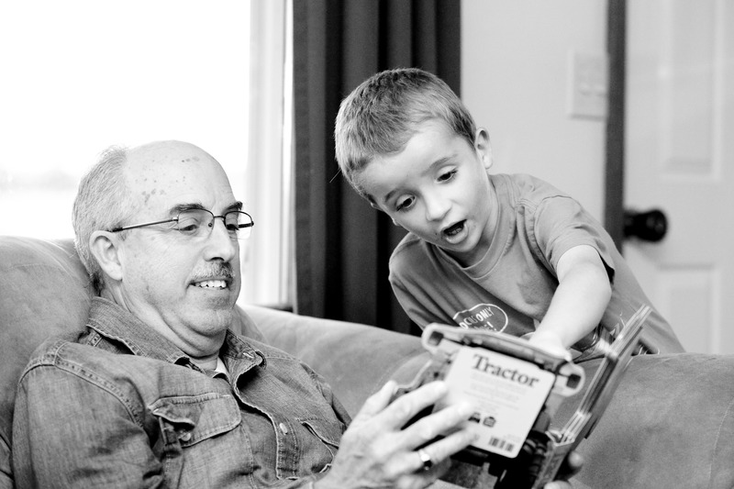
Grandfathers & Grandmothers Can Help Care For You, Too!

Slide 18
Teachers Can Help You To Know You're Cared For, Too!

Slide 19
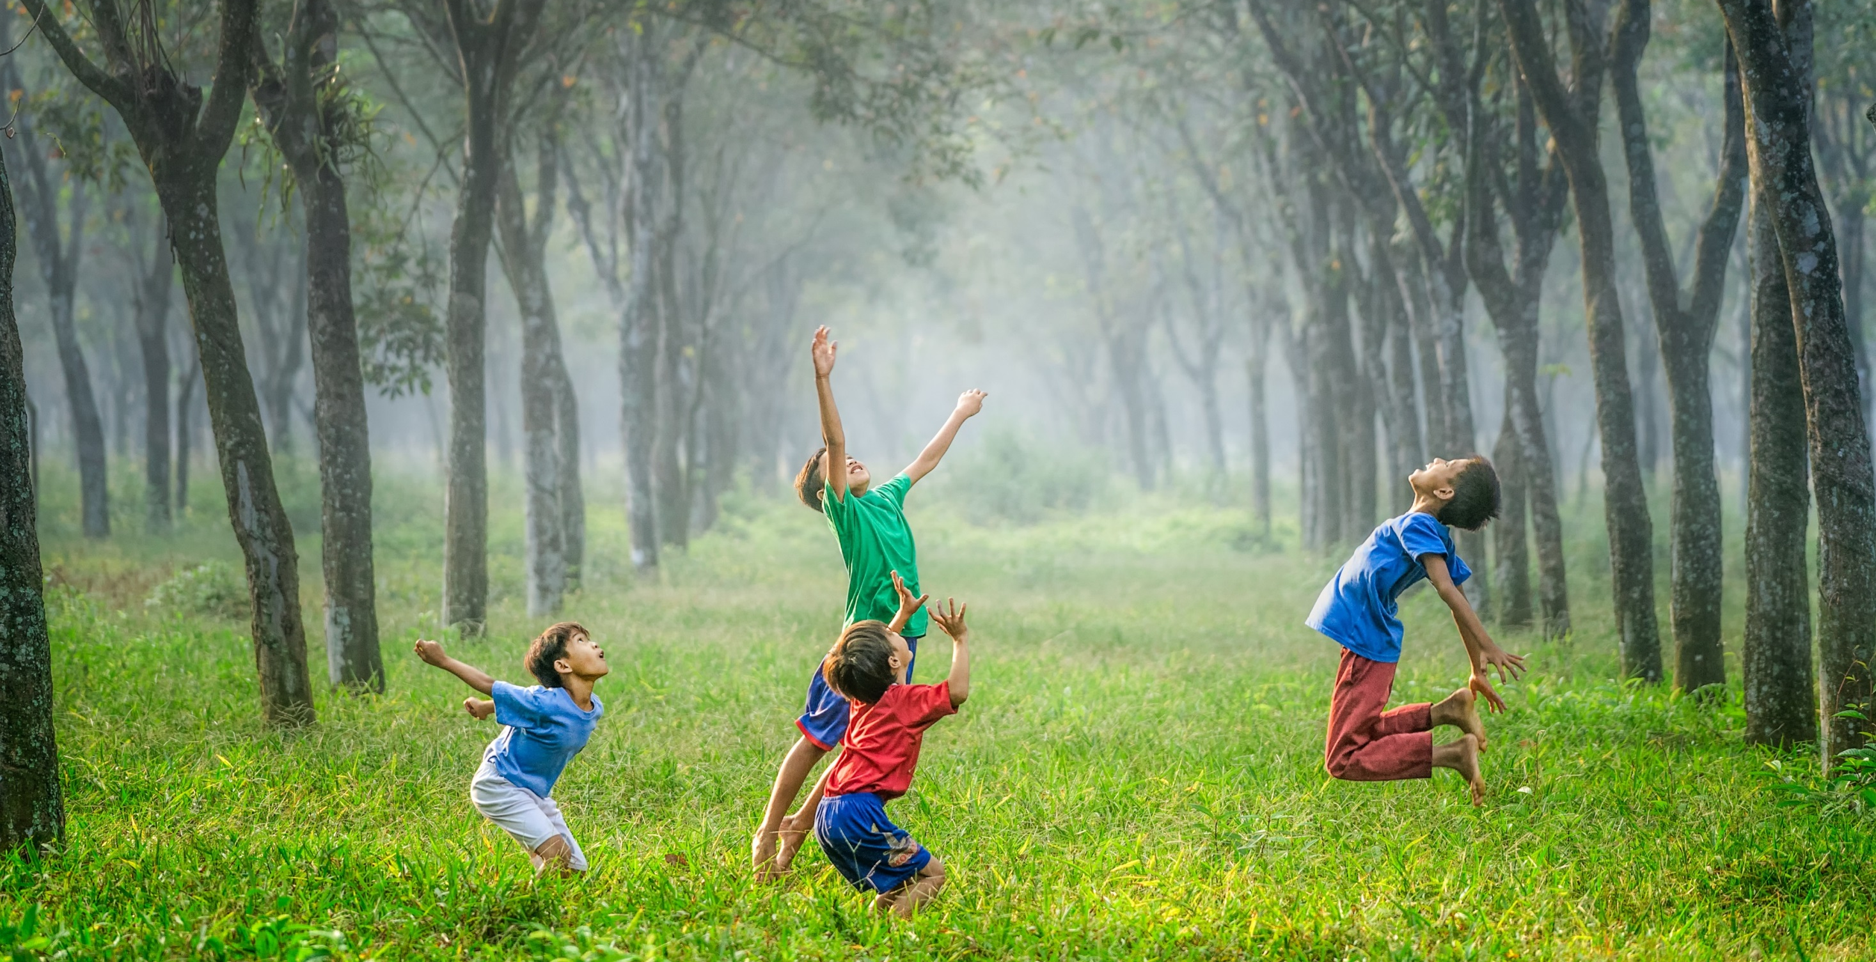
There Is So Much To You!
You're Made Of A Body, A Soul, Feelings, Thoughts & Ideas!

Slide 20
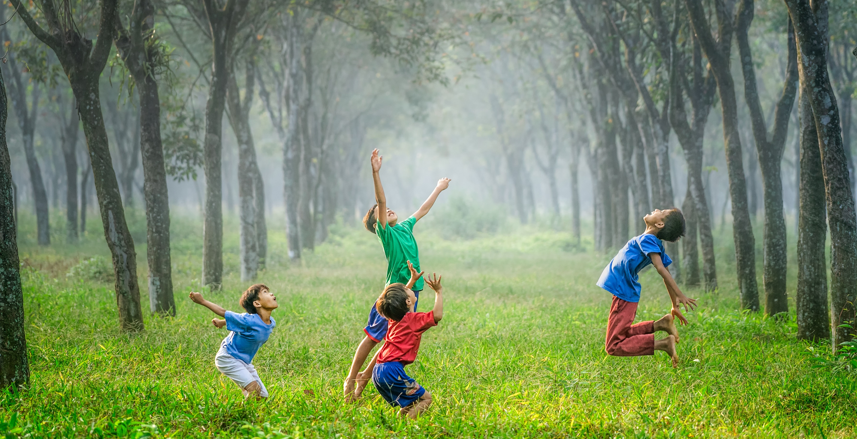
There Is So Much To You!
You Really Are Pretty Amazing & Special!

Slide 21
There Is So Much To You!
God Wants You To Be Safe.

Slide 22
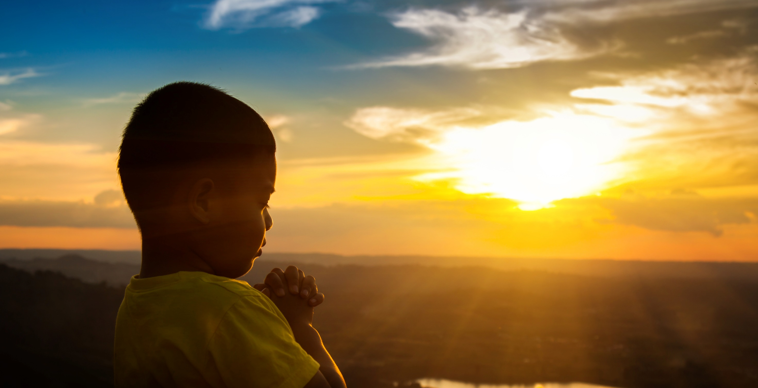
Let's Talk About Your Soul.
Your Soul is The Place Where God Comes To Live Inside Of You.
You Can't See Your Soul, But It Still Deserves Very Special Care.

Slide 23
Let's Talk About Your Soul.
The People Who Love You Know Your Soul Is Special.
The People Who Love You Help You To Talk To God. They Help You To Learn To Pray.
You DO Pray because That's Where You Meet Jesus. He Loves You So Much.

Slide 24
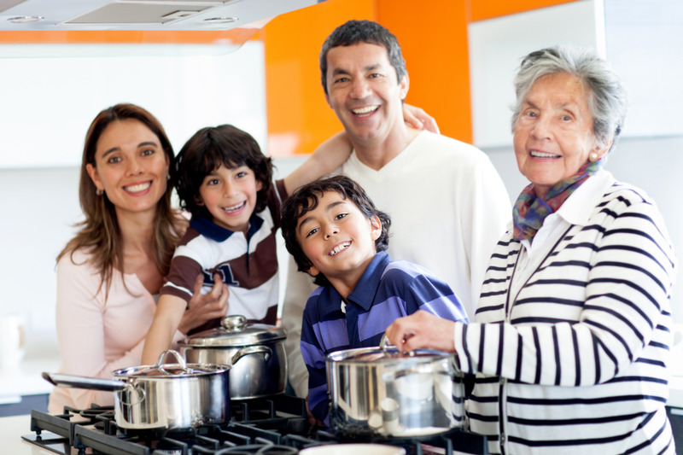
Your Feelings Are Special, Too.
The People Who Love You, Care About Your Feelings.
They Want You To Feel Safe & Loved.

Slide 25
The People Who Love You Care About Your Feelings.
You Talk About Your Feelings With People You Trust.

Slide 26
Another Special Part Of You Is Your Body.
The People Who Love You Take Special Care Of Your Body.

Slide 27
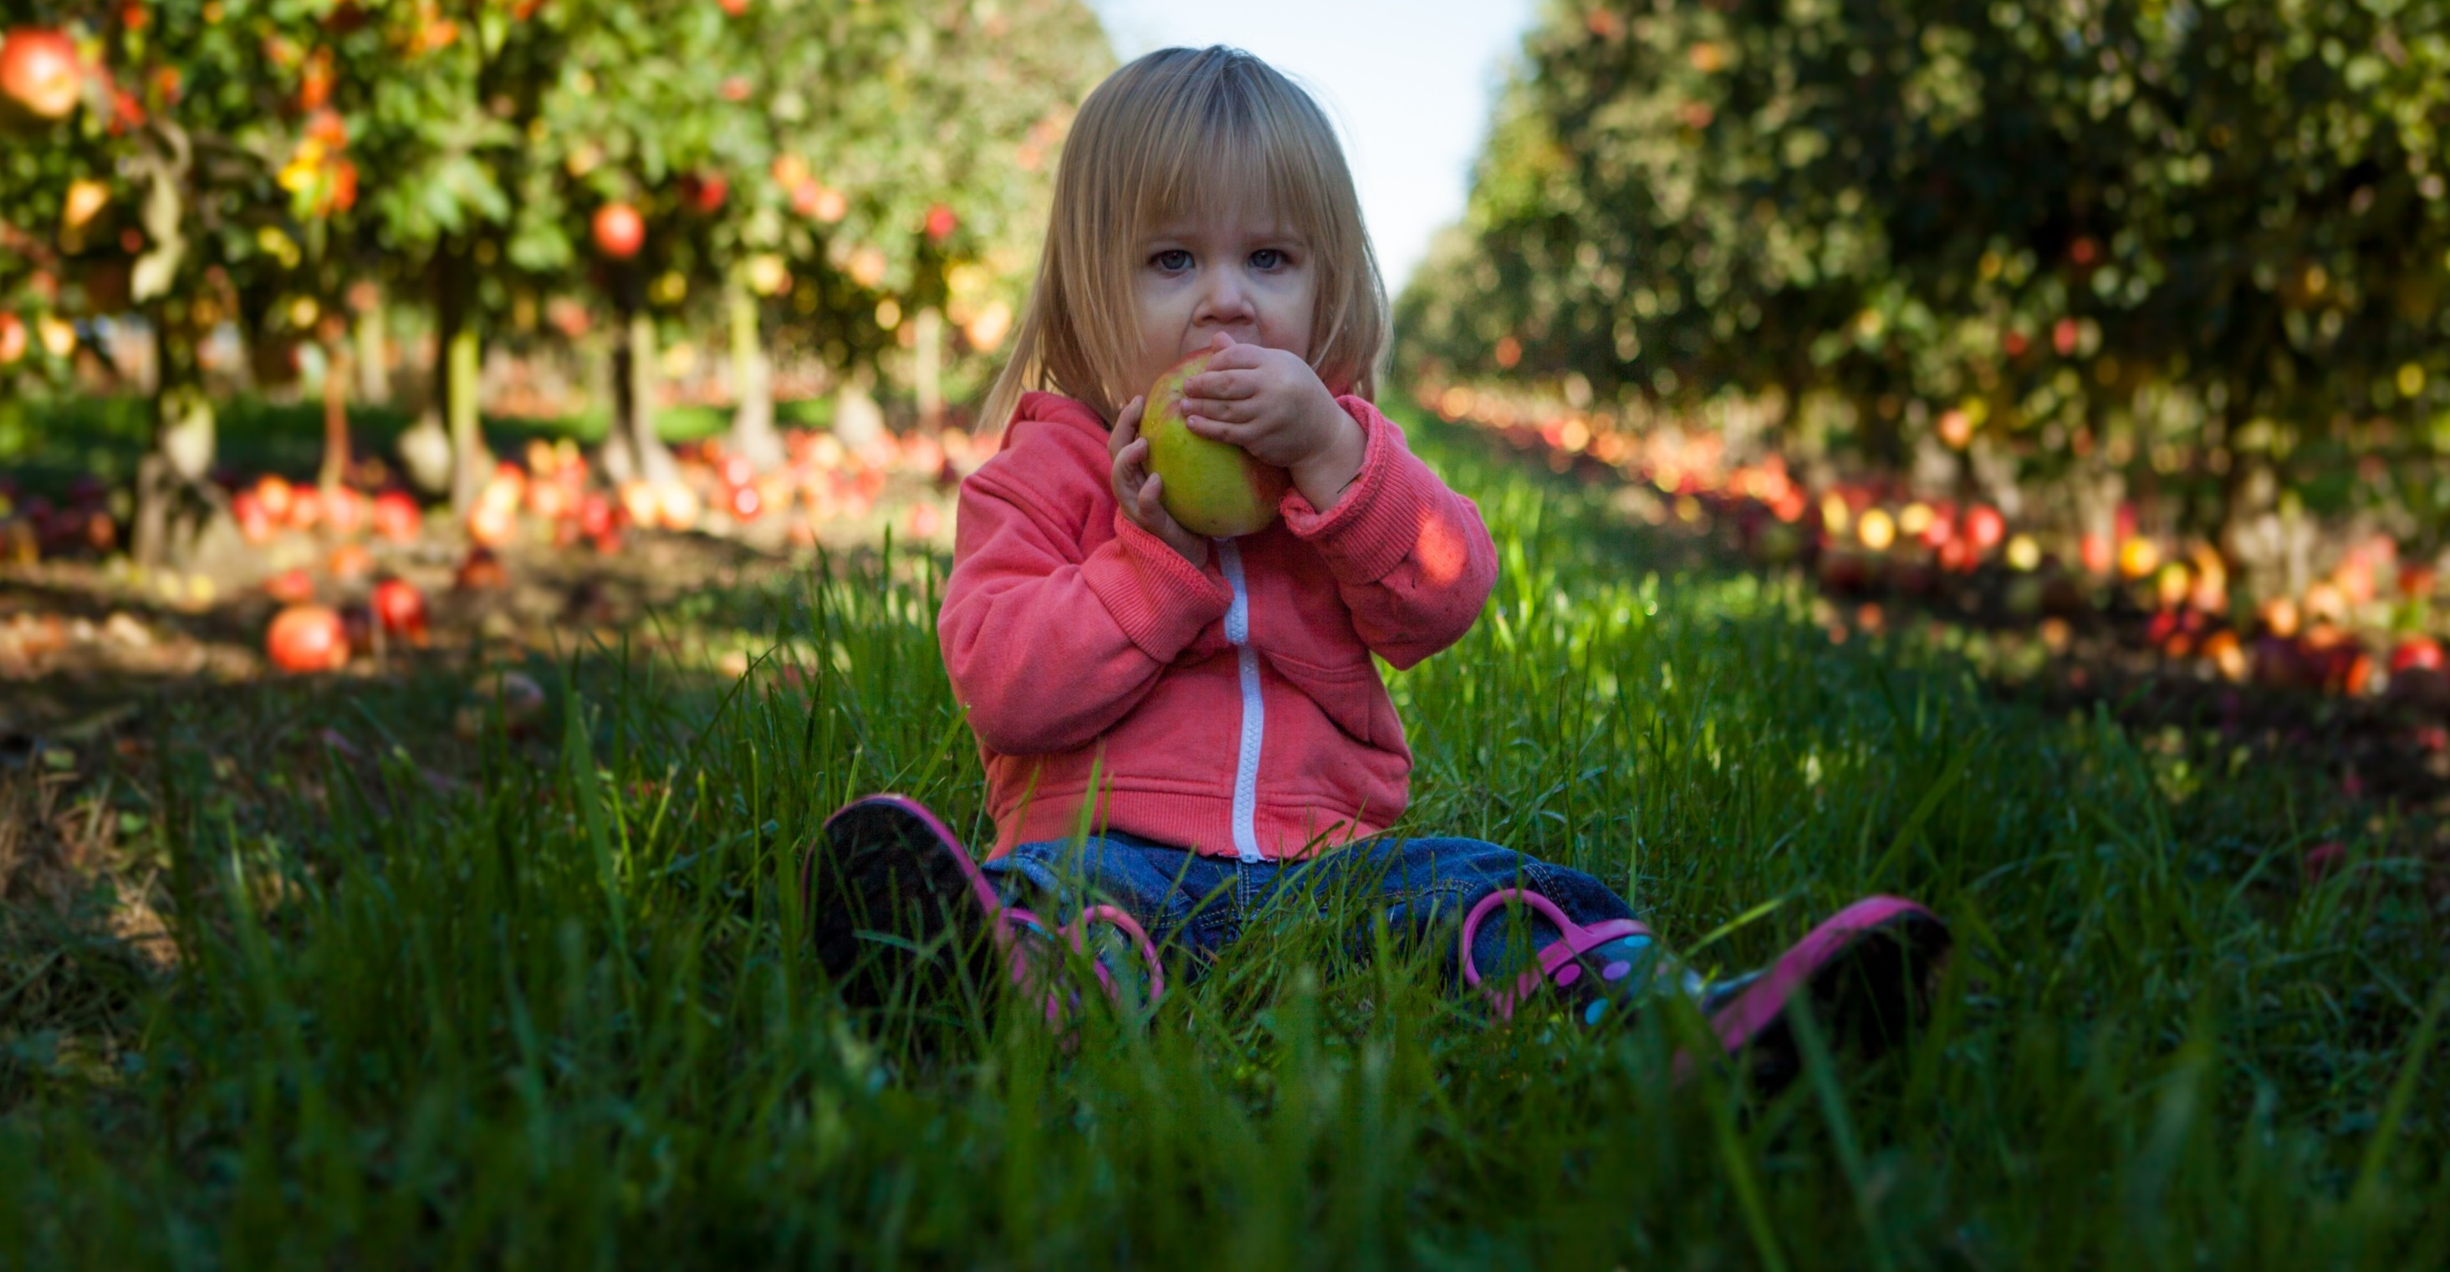
Another Special Part Of You Is Your Body.
The People Who Love You Take Special Care Of Your Body.

Slide 28
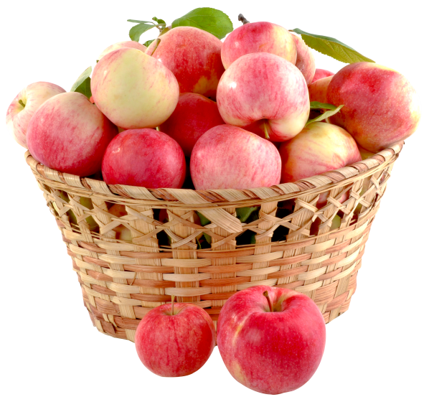
They Give You Healthy Food To Eat.
You Help Take Care Of Your Own Body; You Eat Healthy Foods.

Slide 29
The People Who Love You Make Your Home A Safe Place To Live.

Slide 30
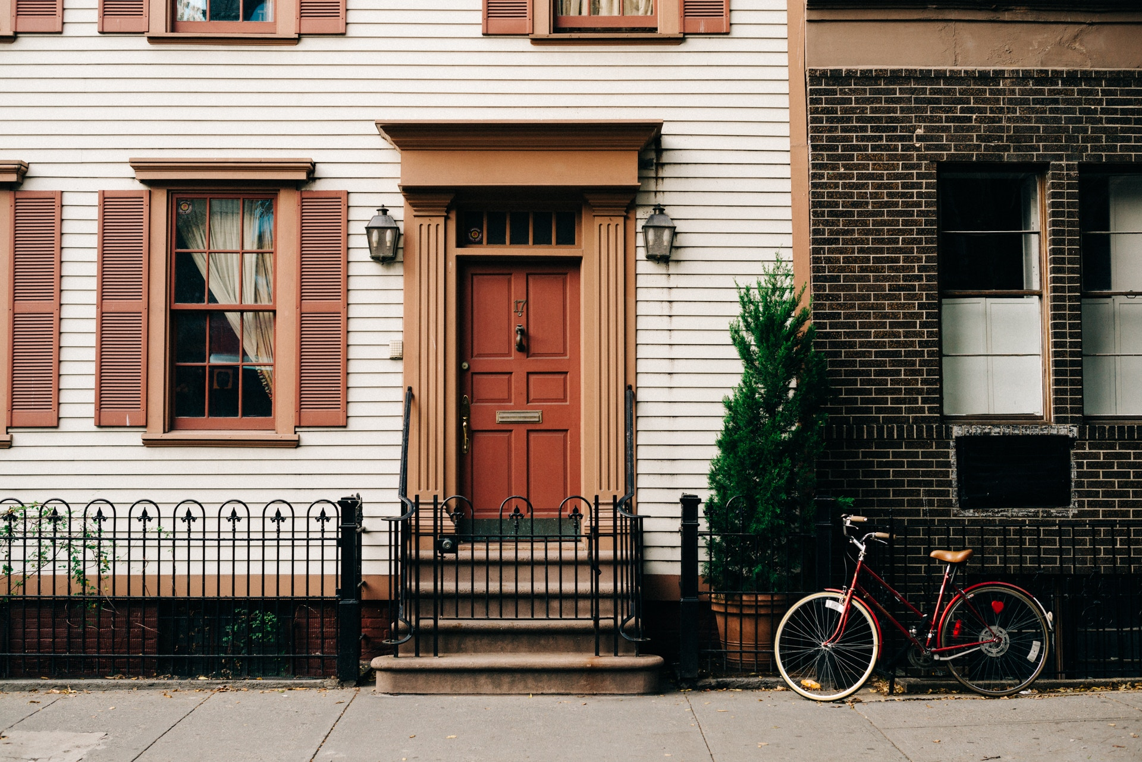
What does your family do to make your home safe?

Slide 31
The People Who Love You Take Care Of Your Body. They Show You How To Be Safe.
You Care for Your Own Body By Making Good Choices, Safe Choices.

Slide 32
You Can Do A Lot Of Awesome Things With Your Body.
You
Can Play.

Slide 33
You Can Do A Lot Of Awesome Things With Your Body.
You Can Sleep.

Slide 34
You Can Do A Lot Of Awesome Things With Your Body.
You
Can Hug.

Slide 35
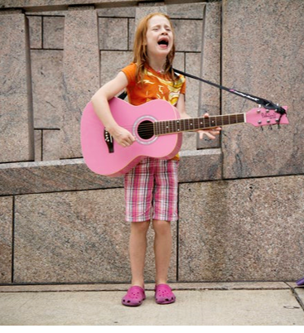
You Can Do A Lot Of Awesome Things With Your Body.
You
Can Sing!

Slide 36
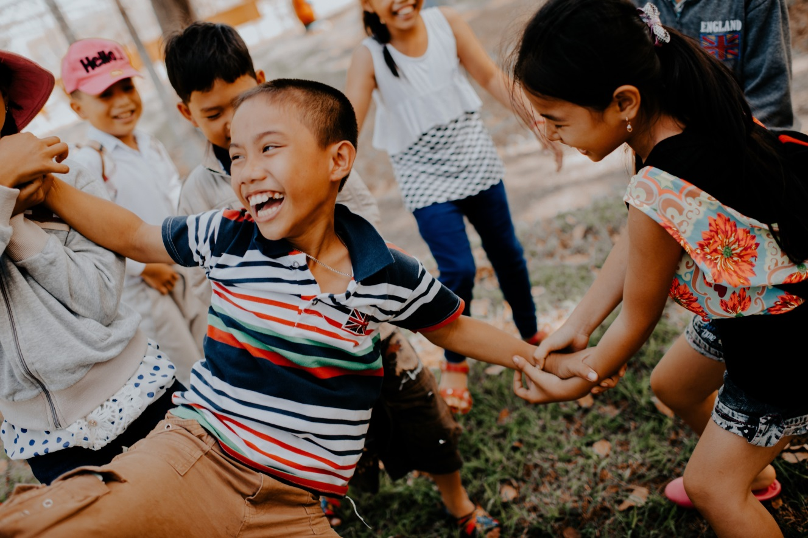
You Can Do A Lot Of Awesome Things With Your Body.
You Can
Laugh
With
Friends.

Slide 37
You Can Do A Lot Of Awesome Things With Your Body.
You
Can
Help
Others.

Slide 38
God Did An Amazing Job Of Making You Special-
Your Body,
Your Feelings &
Your Soul.

Slide 39
No One
Should Ever Try To Hurt
Your Feelings.

Slide 40
No One
Should Ever Try To Hurt
Your Soul.

Slide 41
No One
Should Ever Try To Hurt
Your Body.

Slide 42
Let's Talk About Your Special, Holy Body.
You Wear Clothes On Your Body, To Protect Your Body From The Weather.

Slide 43
Let's Talk About Your Special, Holy Body.
And Clothes
Look Nice!

Slide 44
Let's Talk About Your Special, Holy Body.
Also, Clothes Cover The Most Private Parts Of Your Body.

Slide 45
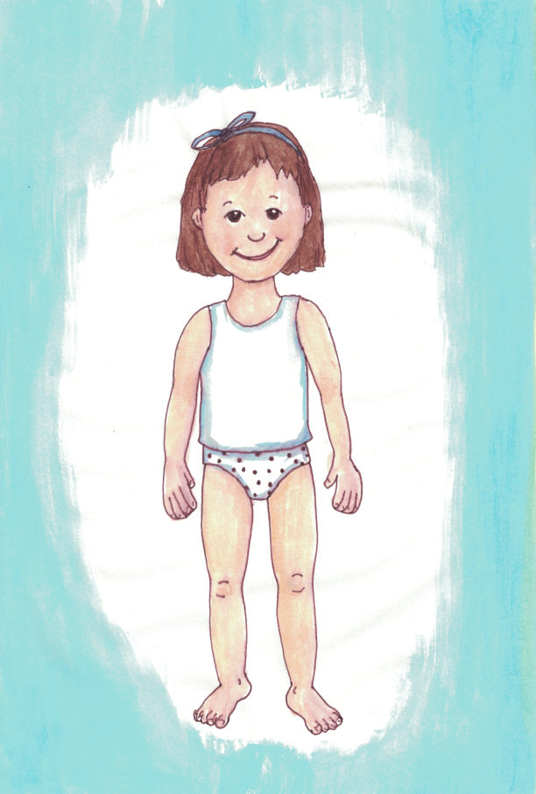
Let's Talk About Your Special, Holy Body.
See?
This Boy & Girl Aren't Dressed To Go To School.

Slide 46
Let's Talk About Your Special, Holy Body.
They Are Not Dressed To Go Play With Friends.

Slide 47
Let's Talk About Your Special, Holy Body.
But, Their Clothes Cover The Most Special and Private Parts Of Their Bodies.

Slide 48
Let's Talk About Your Special, Holy Body.
The People Who Love You Want Your Private Body Parts To Be Safe and Respected.
YOU Can Help Make Sure
YOUR Body and
YOUR Private Body Parts Are Safe and Respected.

Slide 49
Let's Talk About Your Special, Holy Body.
What can You Do to Help Make Sure Your Private Body Parts are Safe and Respected?
You Can Do A Lot .

Slide 50
If You feel Worried About This, You Can Say:
"Hey. My Private Body Parts Will Be Safe & Respected."
You Can Even Say That Loudly.

Slide 51
If You feel Worried About This, You Can Say:
"Hey. My Private Body Parts Will Be Safe & Respected. No Touching.
No Looking."
You Can Even Say That Loudly.

Slide 52
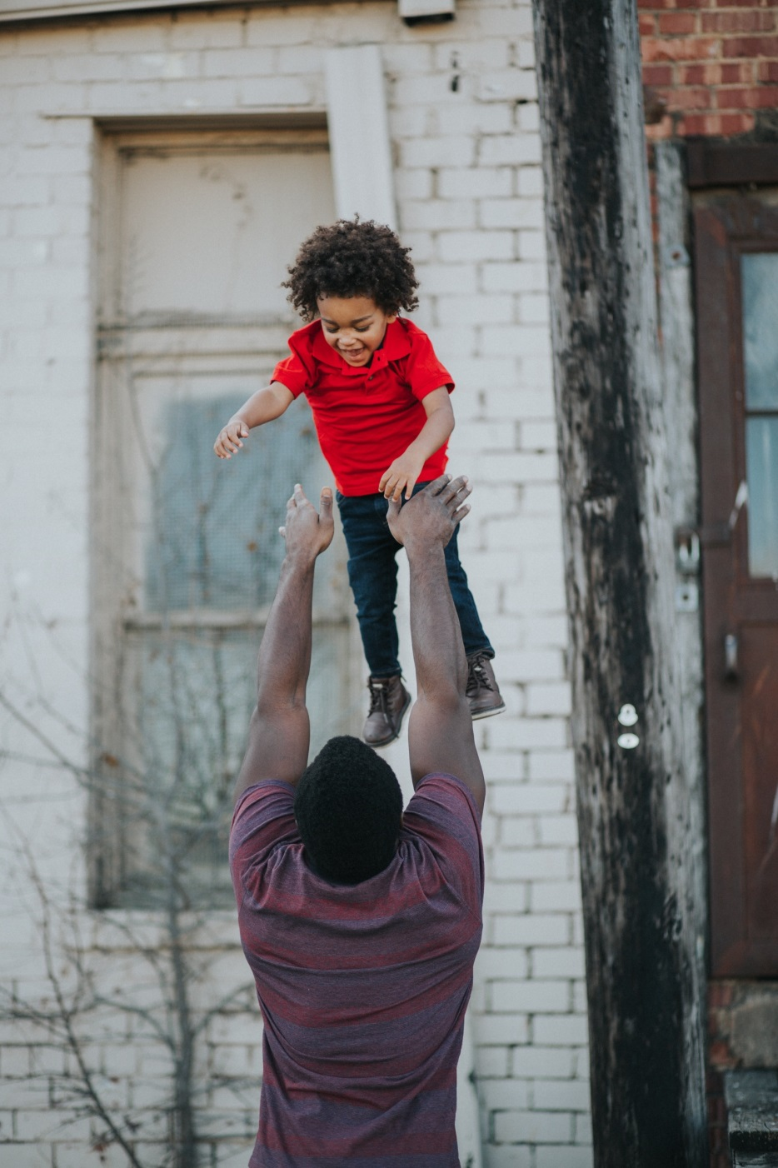
Your Body Is Special. If Your Body Needs Special Care, Someone Who Loves You Can Help.
A Doctor or Nurse Can Help You, Too.
You Can Talk About This With The Adults Who Love & Care For You.

Slide 53
Maybe You Feel Worried Because Someone Has Tried To Make Your Body Disrespected Or Unsafe.
Tell An Adult Who Loves and Cares for You. Say,
"I Feel Worried. I Want To Talk About Feeling Disrespected.”

Slide 54
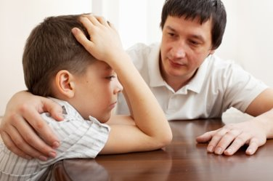
Who can you talk to about this?
Think. Which adult cares for you, and for your feelings?
Who wants to keep you safe from harm?
Which adult respects the privacy and holiness of your body? ​ ​
Think in your mind--​ who is that person?

Slide 55
THAT Person is a
Trusted Adult.
You can talk to
That Person
About
These Kinds of Things.

Slide 56
What Ways Could A Person Disrespect Your Boundaries?
What Ways Could Another Person Disrespect The Privacy Of Your Body?
Well, Most People Won't Ever Want Or Try To Disrespect The Privacy & Holiness Of Your Body.
But... ... ...

Slide 57
Did Someone Try to Show You Pictures of Private, Holy Body Parts?

Slide 58
Tell a trusted adult as quickly as possible.

Slide 59
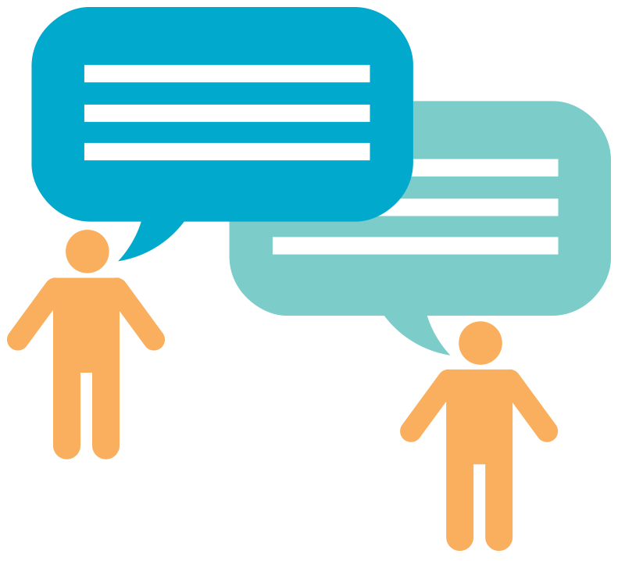
Maybe a person wants to talk about your private body parts.

Slide 60
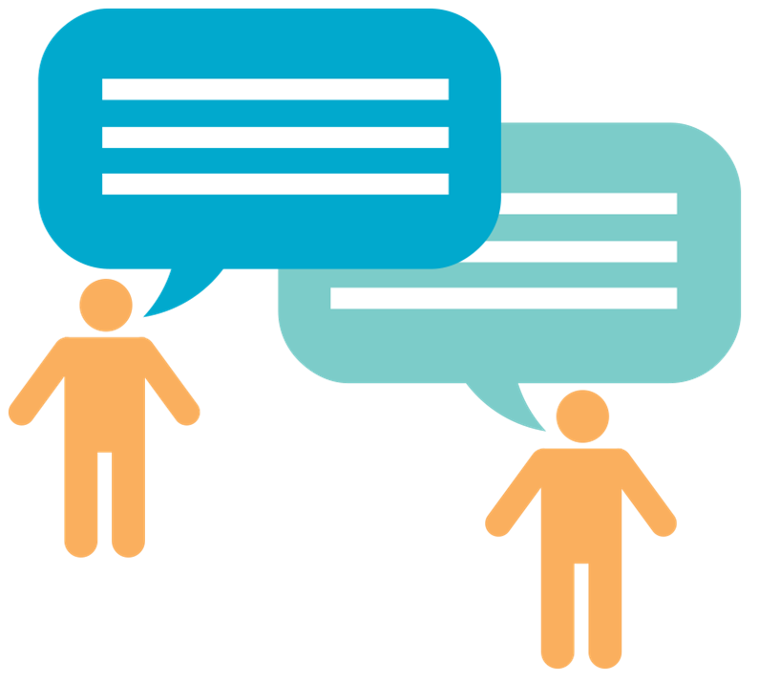
Tell a trusted adult as quickly as possible.

Slide 61
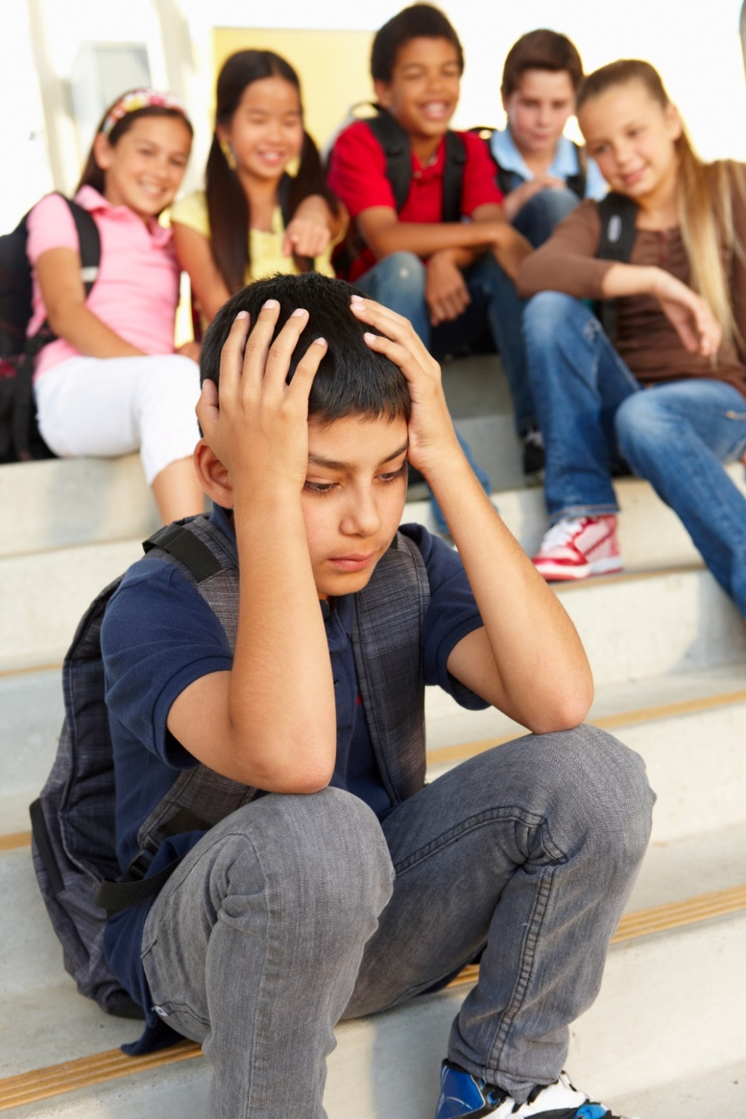
Maybe a friend wants you to talk about another person’s private body parts.

Slide 62
Go away from that talk as soon as possible.
Tell a trusted adult right away.

Slide 63
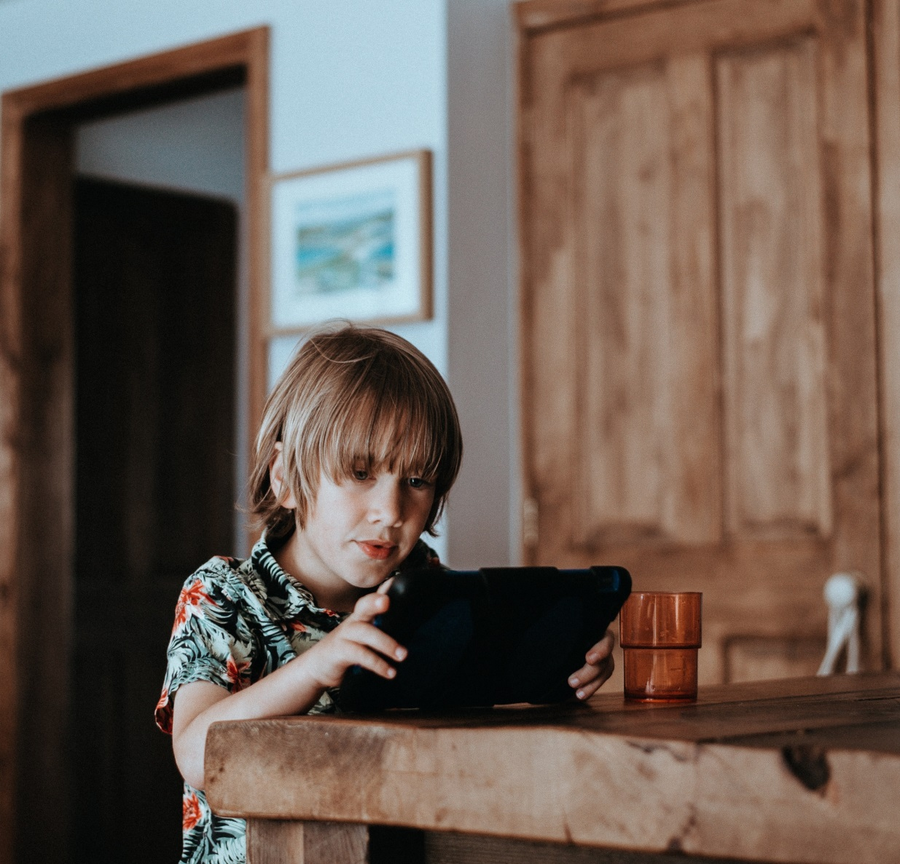
What if someone wants to show you movies and pictures that disrespect the privacy and holiness of another person’s body?

Slide 64
Even if you already looked, tell a trusted adult as quickly as possible.
You Will Not Be in Trouble.
A Trusted Adult Will Help You

Slide 65
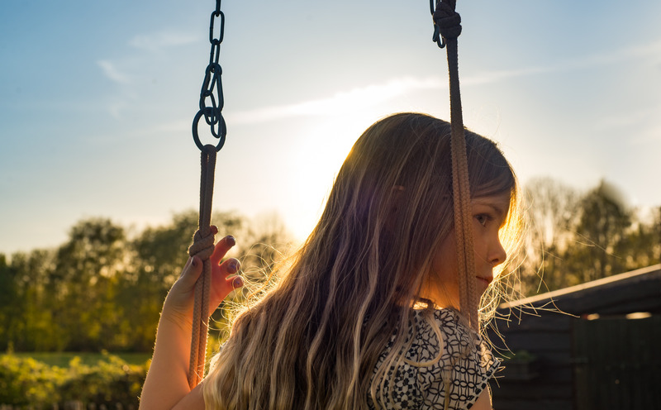
Maybe a person wants to be close to you in ways that make you feel uncomfortable.
You can say, “Don’t be so close to me.”

Slide 66
If they ignore you, or make a joke of it,
say, “This disrespects me.”
Tell a trusted adult as quickly as possible.

Slide 67
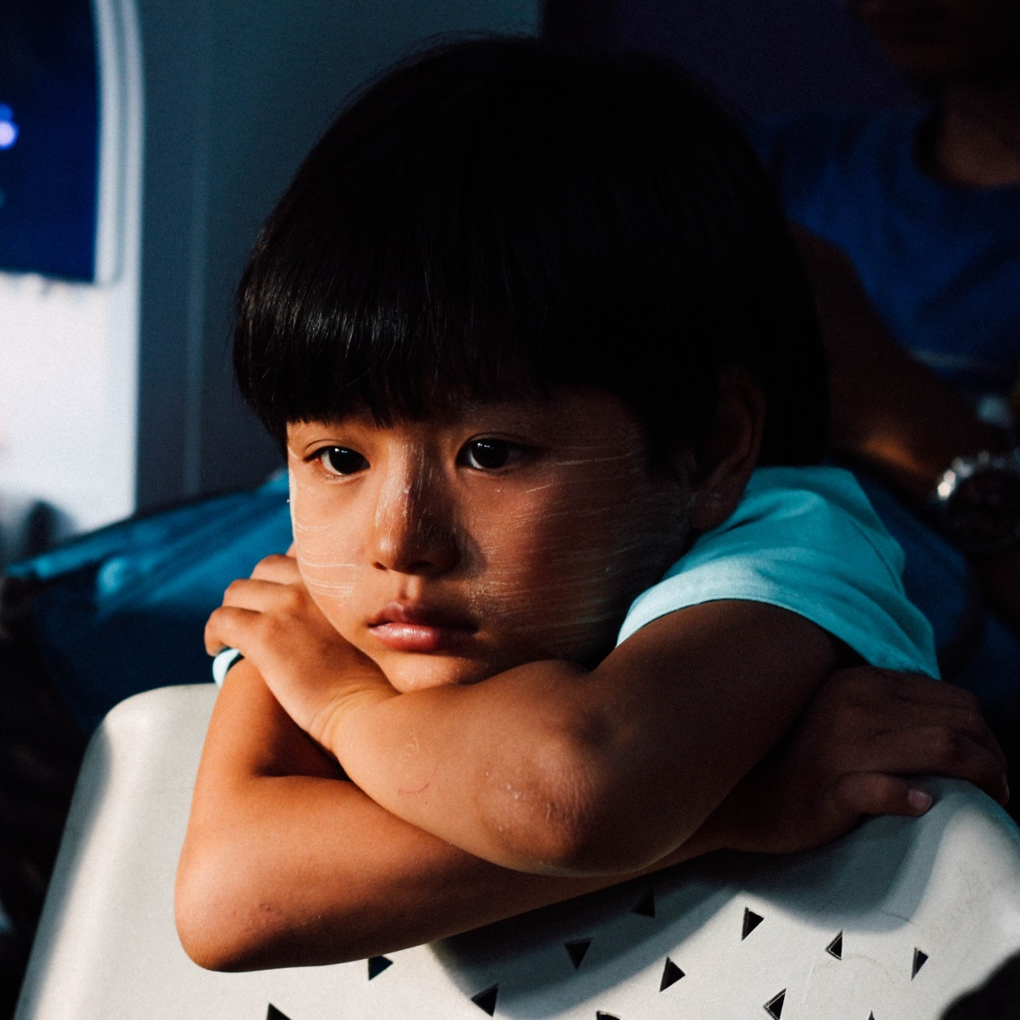
Sometimes, a person who may want to disrespect you may try to make you feel sorry or silly for having boundaries.

Slide 68
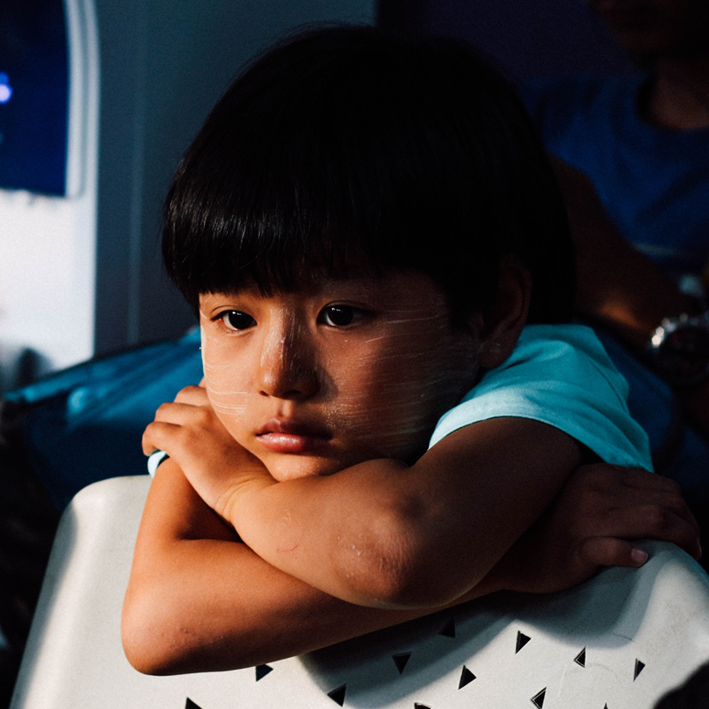
That person may try to make you feel ashamed of having the feelings you have.

Slide 69
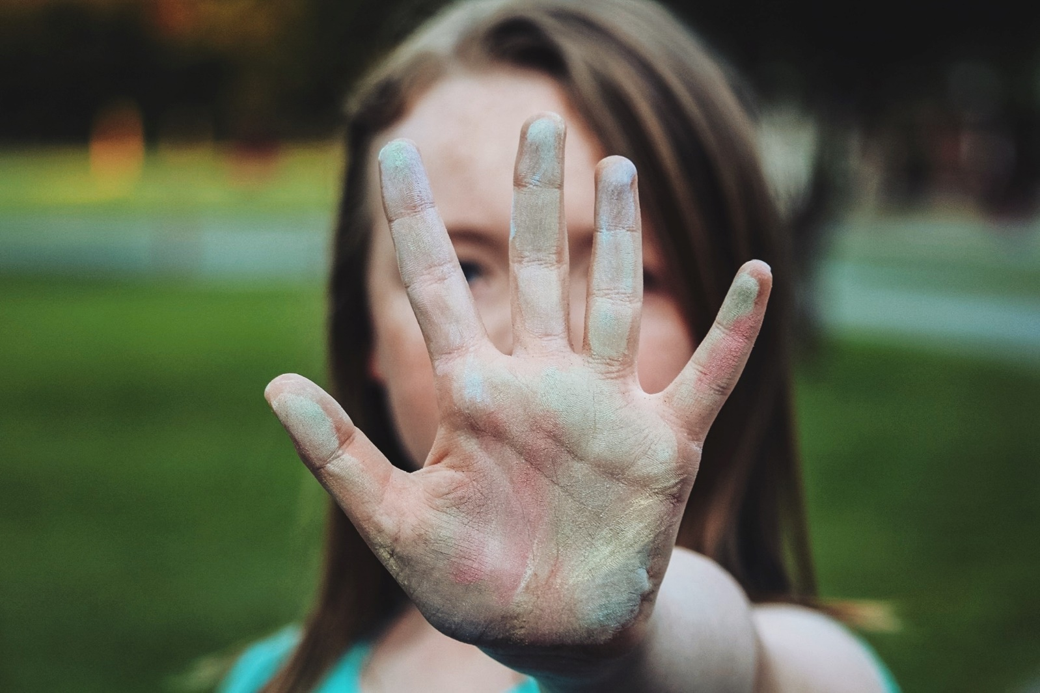
Don’t buy that.
The people who love you care about your feelings.
The people who love you will not try to make you feel ashamed of your feelings.
Don’t Buy That.

Slide 70
If A Person is Disrespecting You, It Doesn't Matter Who They Are; If they are the same gender or opposite,
If they are the same
age or not.
Tell a Trusted Adult.

Slide 71
It Doesn't Matter Who The Person Is;
Even if the Person disrespecting you is in charge of you in some way...
Tell a Trusted Adult.

Slide 72
Maybe the person disrespecting you told you not to tell anyone.
Don't listen to them.
Tell a Trusted Adult.

Slide 73
If ANYONE does
these things to you,
or says these
things to you,
Tell a Trusted Adult.

Slide 74
If ANYONE tries to frighten you into not telling,
or tries to give you gifts so that you won't tell,
or says you will be in trouble if you tell, don’t believe them.
Tell a trusted adult.

Slide 75
You are special to God, and special to yourself, and special to others.
You are special.
You deserve to be respected and safe.
If you ever feel disrespected, tell an adult you trust.
You matter.

Slide 76
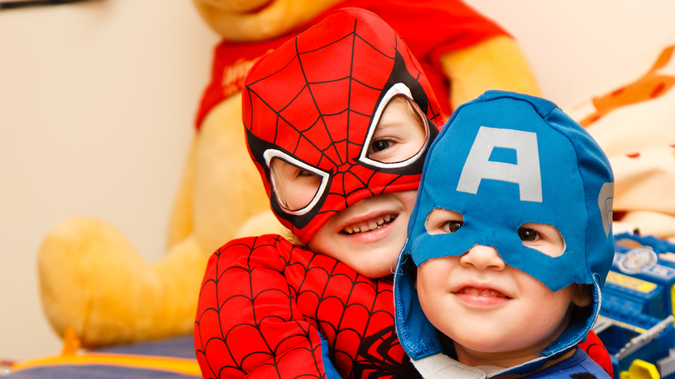
If you ever know that your friend has been hurt or disrespected, tell a trusted adult.

Slide 77
If you feel worried, or disrespected, trusted adults want to know about your feelings.

Slide 78
If you feel worried or disrespected, a trusted adult will listen to you when you talk about
your feelings.

Slide 79
A trusted adult will listen to you. They will help to make things better. A trusted adult will work hard to make sure you feel safe.

Slide 80
Jesus loves you.
He has made you
amazing and special.
He made your body special.
He has given you important feelings.
He has given you people who love you and who care about you.

Slide 81
Jesus loves you.
He wants you to
kNOw
you matter.

Slide 82
Jesus loves you.
He wants you to
kNOw
you deserve to be safe and respected.

Slide 83
Jesus loves you.
He wants you to kNOw you have the
right to say
“NO!”

Slide 84
Say: I kNOw I am a child of God. I kNOw I deserve to be safe and respected.

Slide 85
Say: I kNOw my body is holy and private. NO touching or looking.

Slide 86
Say: I kNOw other people’s bodies are holy and private. NO touching, NO looking.

Slide 87
Say: I kNOw that I can say
“NO touching.” “NO looking.”
I can even say it LOUDLY.

Slide 88
Say: I kNOw I can ask a trusted adult to help me. I kNOw a trusted adult will help me.

Slide 89
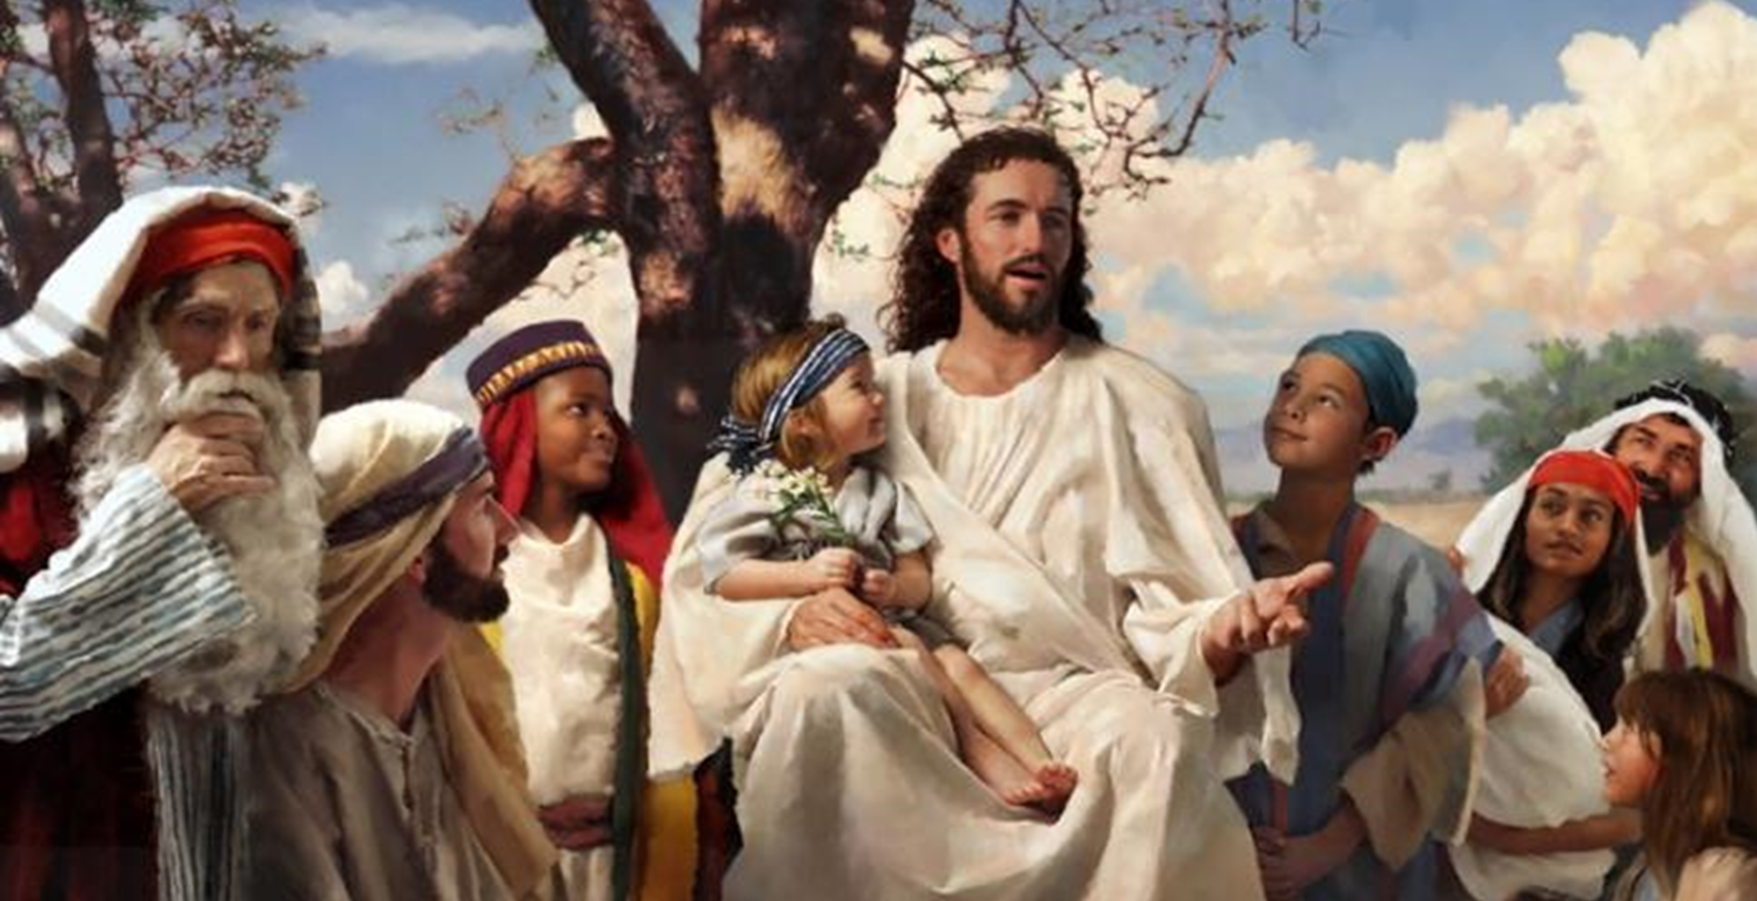
We pray: Thank you, Jesus, for my feelings. I can listen to my feelings. I know when I’m happy.

Slide 90
I know when I feel safe. I Thank You, Jesus, that I can talk about my feelings.

Slide 91
I Thank Jesus for giving me adults who I trust. They care about my feelings. They care about me. They work hard to keep me and my body safe.
.

Slide 92
Jesus, I have the right to work hard to keep me safe, too.

Slide 93
Thank you, Jesus.
You love me. You care for me.
Amen.

