Slide 1

The kNOw Program
Diocese of Lansing Safe Environment Project

Slide 2

People Take Very Good Care of Things That Are Special.

Slide 3


People Take Very Good Care Of Special Things.

Slide 4


People Take Very Good Care Of Special Things.
Diary

Slide 5

People Take Care Of Very Special Things.

Slide 6

This Little Guy Deserves
Special Care!

Slide 7
What Would You Do For This Little Guy If He Was Yours?

Slide 8

What Special Things Would You Do For This Little Guy If He Was Yours?

Slide 9
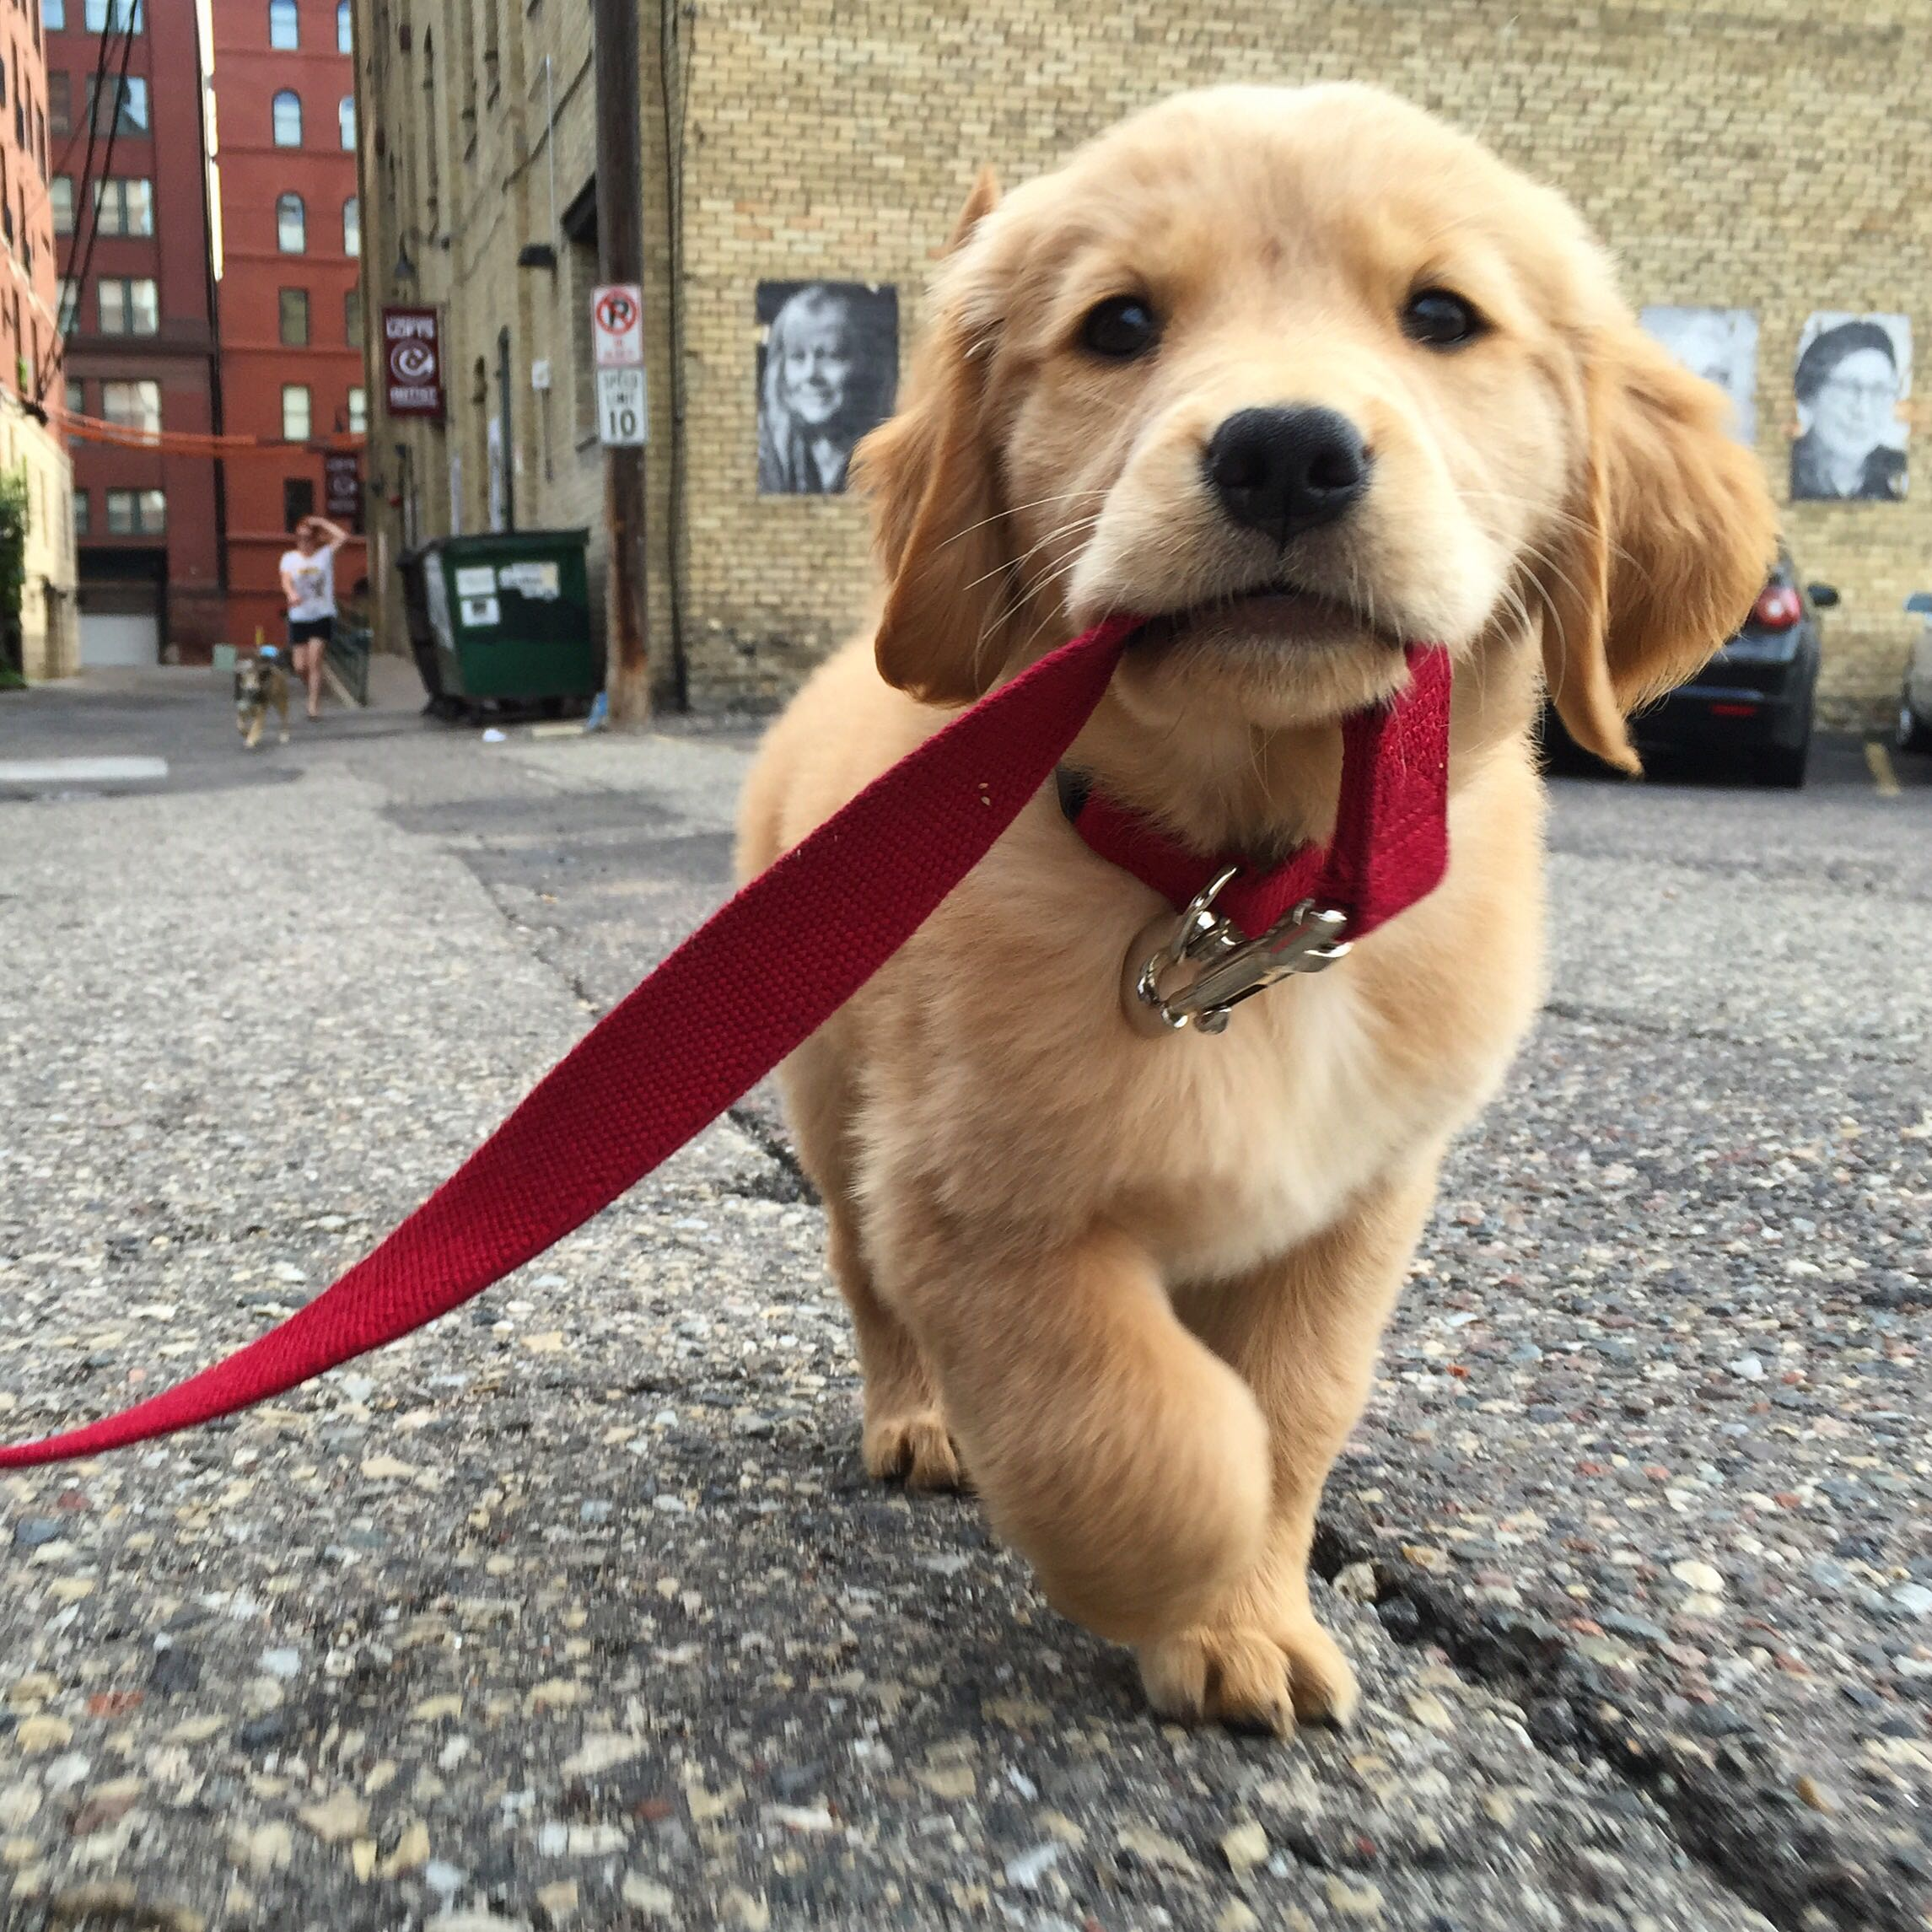
What Special Things Would You Do For This Little Guy If He Was Yours?

Slide 10
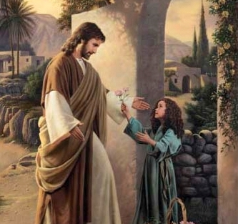
To Jesus,
YOU Are
Very Special.

Slide 11
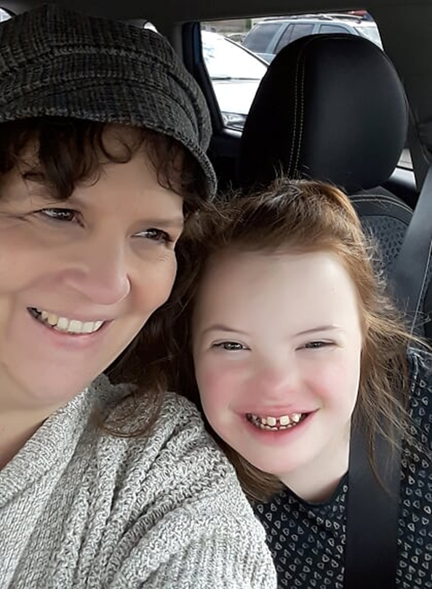
It's Only RIGHT
That People Should
Take Care Of You!

Slide 12

Jesus Wants You To Be Happy.
He Wants Your Family & Community To Take Special Care Of You.
He Wants YOU To Take Care of You, Too!

Slide 13
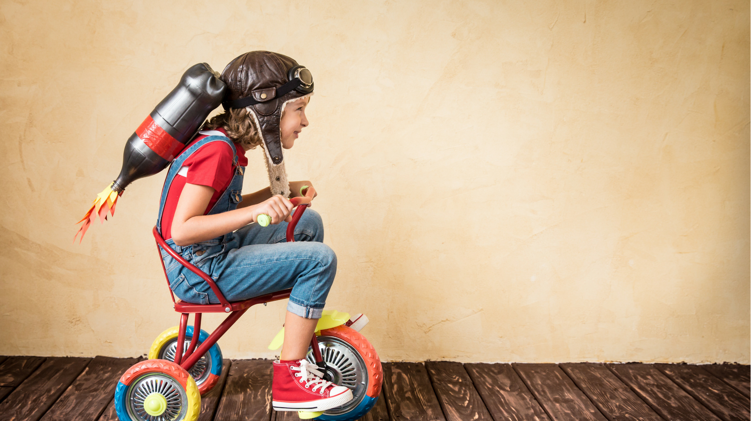
Jesus Wants You To Know You're Loved.
He Wants You To
Know You're Safe!

Slide 14
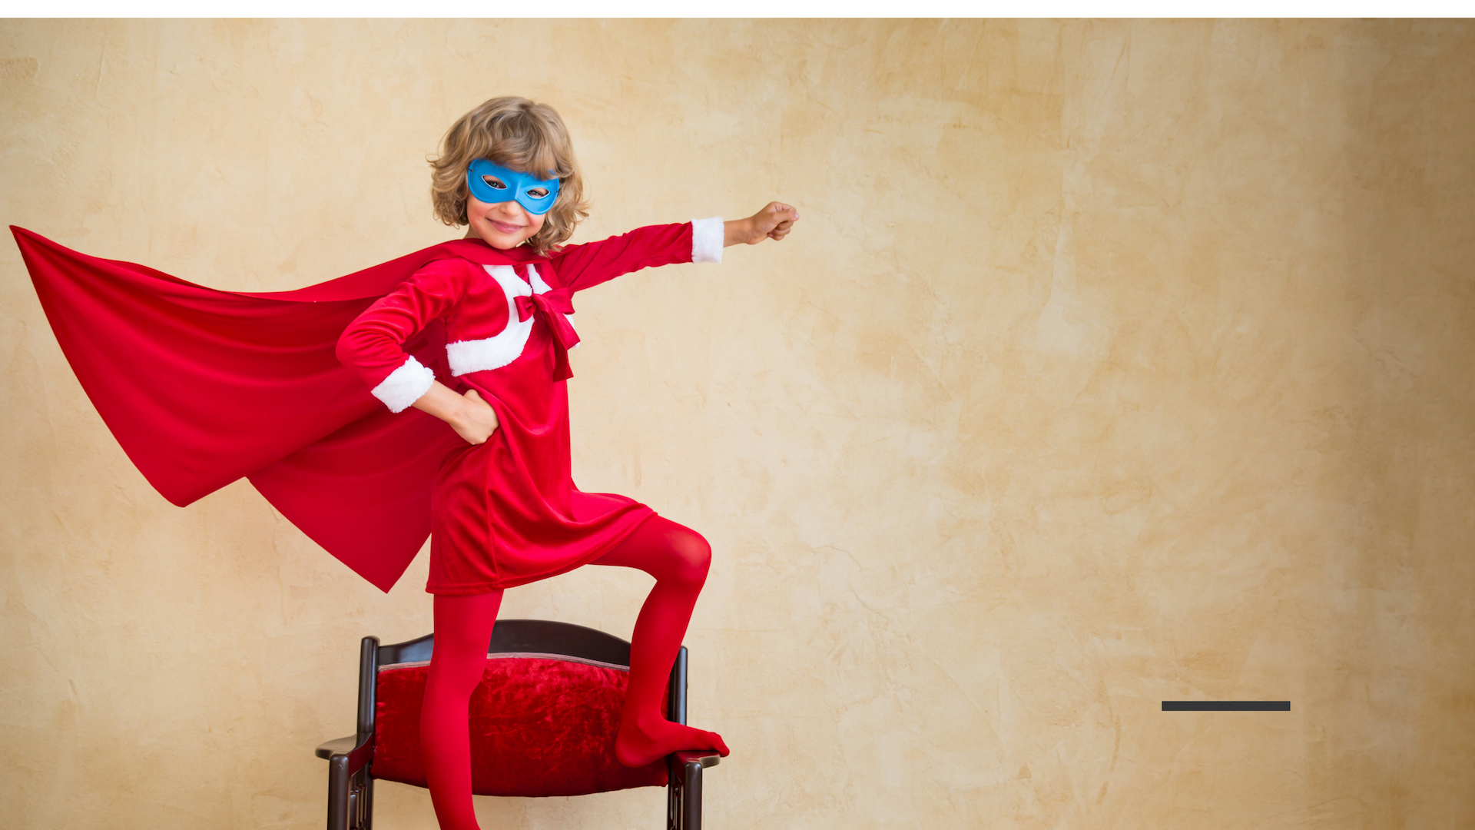
Jesus Wants You To Know You're Loved.
He Wants You To
Know You're Safe!

Slide 15
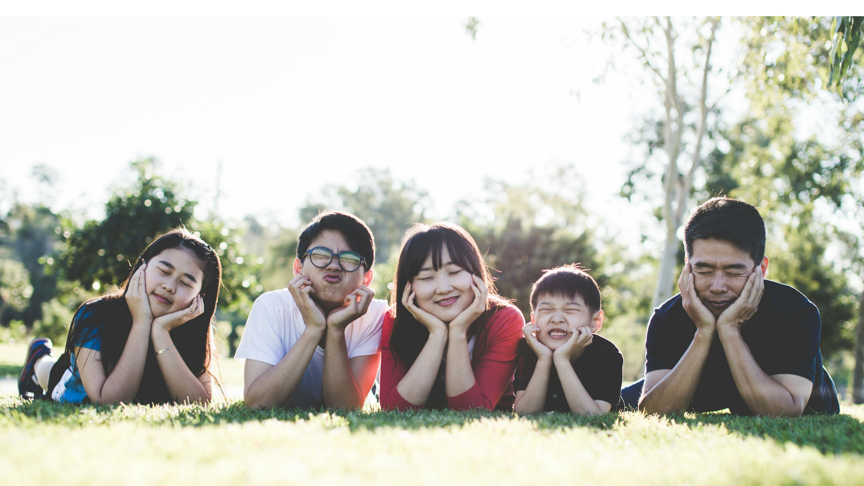
You Probably Have A Family To Help Care For You.

Slide 16
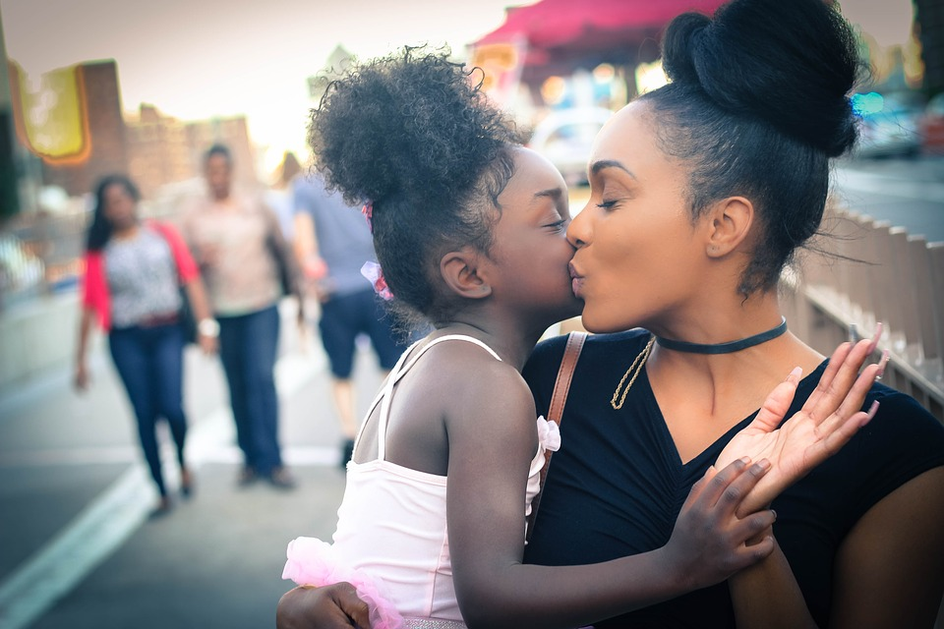
You Probably Have A Family
To Help Care
For You.

Slide 17
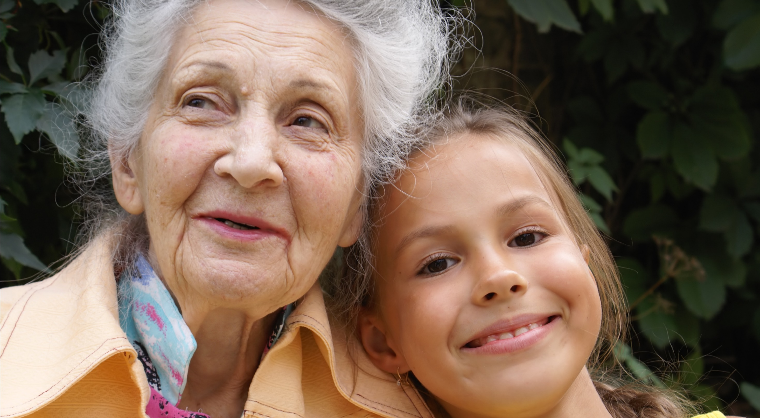
Grandfathers &
Grandmothers
Can Help Care
For You, Too!

Slide 18

Teachers Can Help You To Know You're Cared For, Too!

Slide 19
Can you think of an adult who cares for you?
Think in your mind--
who is that person?

Slide 20

There Is So Much To You!
You're Made Of A Body, A Soul, Feelings, Thoughts & Ideas!

Slide 21
There Is So Much To You!
You Really Are Pretty Amazing & Special!

Slide 22
There Is So Much To You!
God Wants You To Be Safe.

Slide 23

Let's Talk About Your Soul.
It Deserves Special Care Because It's The Place Where God Comes To Live Inside Of You.
Even Though You Can't See Your Soul, It Still Deserves Very Special Care.

Slide 24
Let's Talk About Your Soul.
The People Who Love You Know Your Soul Is Special.
They Help You Learn To Talk To God- To Pray.
YOU Know Your Soul Is Really Special, So You Do Pray & Spend Time With God- Who Loves You.

Slide 25
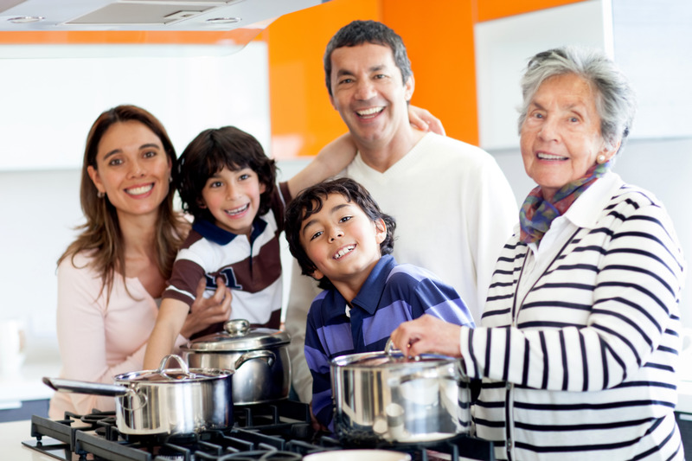
Your Feelings Are Special, Too.
The People Who Love You, Care About Your Feelings.
They Want You To Feel Safe & Loved.

Slide 26
The People Who Love You Want You To Know They Care About Your Feelings.
You Help To Take Care Of Your Own Feelings By Talking About Your Feelings With People You Trust.

Slide 27
Can you think of an adult who cares for you, and who cares about your feelings?
Think in your mind--
who is that person?

Slide 28
Another Special Part Of You Is Your Body.
The People Who Love You Take Special Care Of Your Body.

Slide 29

The People Who Love You Take Special Care Of Your Body.
They Give You Healthy Food To Eat.
You Help To Take Care Of Your Own Body By Making Healthy Food Choices.

Slide 30
The People Who Love You Take Care Of Your Body By Making Your Home A Safe Place To Live.

Slide 31

What does your family do to make your home safe?

Slide 32

The People Who Love You Take Care Of Your Body By Showing You How To Be Safe.
You Take Care Of Your Own Body By Making Good Choices, Safe Choices.

Slide 33

You Take Care Of Your Own Body By Making Good Choices, Safe Choices.

Slide 34
What other choices can you make to keep you safe?

Slide 35
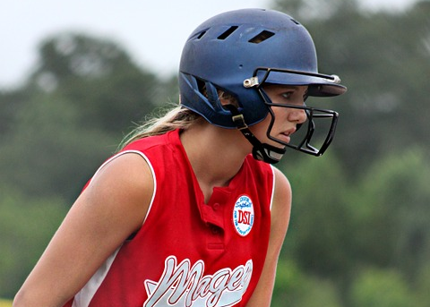
You Can Do A Lot Of Awesome Things With
Your Body.
You
Can Play.

Slide 36

You Can Do A Lot Of Awesome Things With
Your Body.
You Can Sleep.

Slide 37
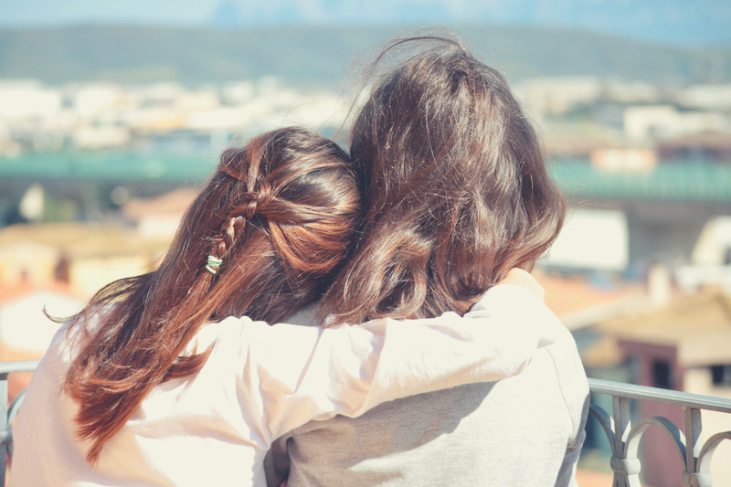
You Can Do A Lot Of Awesome Things With
Your Body.
You
Can Hug.

Slide 38
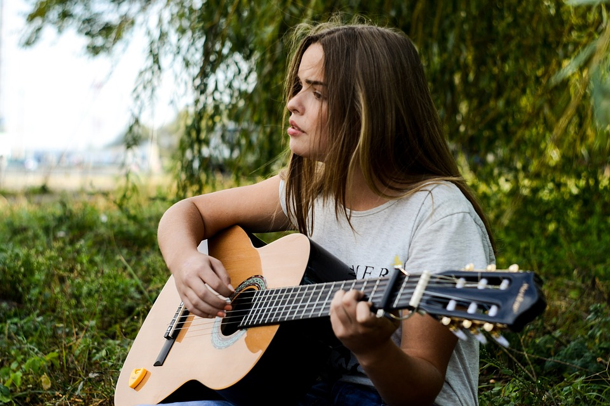
You Can Do A Lot Of Awesome Things With
Your Body.
You
Can Sing!

Slide 39
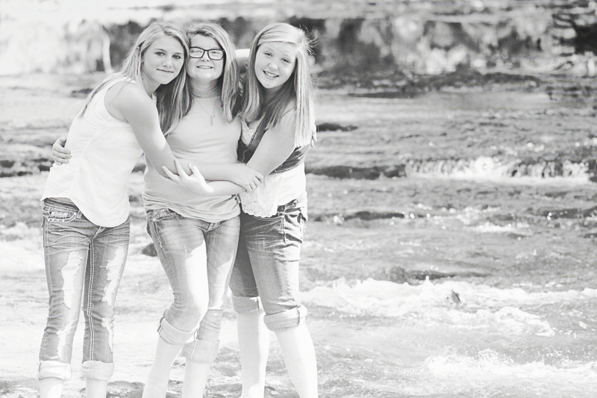
You Can Do A Lot Of Awesome Things With
Your Body.
You
Laugh
With
Friends.

Slide 40
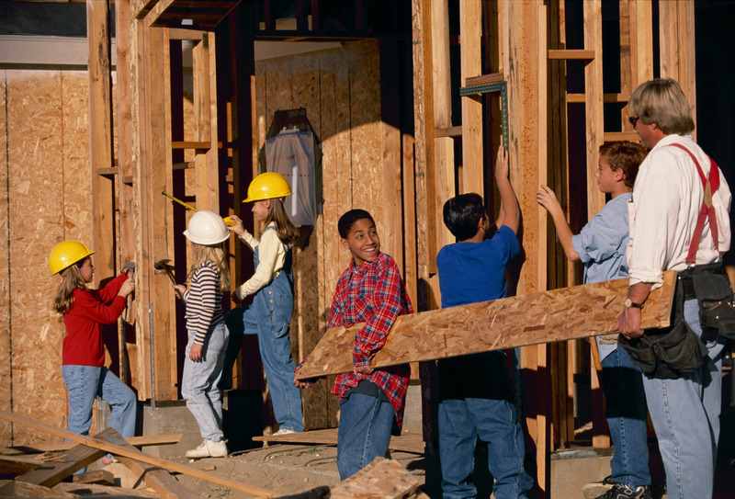
You Can Do A Lot Of Awesome Things With
Your Body.
You
Can
Help
Others

Slide 41
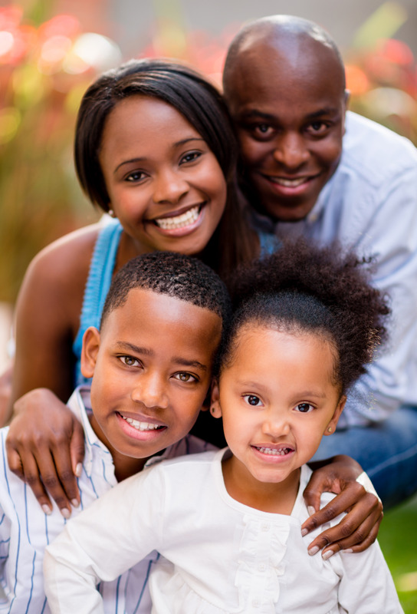
God Did An Amazing Job Of Making Everything About You Special-
Your Body,
Your Feelings &
Your Soul.

Slide 42
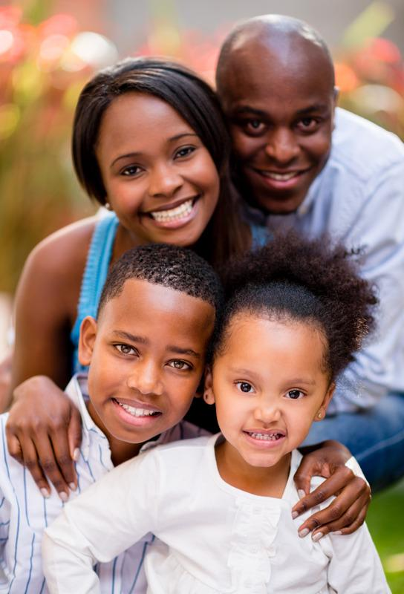
No One
Should Ever Try To Hurt
Your Feelings.

Slide 43
No One
Should Ever Try To Hurt
Your Soul.

Slide 44
No One
Should Ever Try To Hurt
Your Body.

Slide 45

Let's Talk About Your Special, Holy Body.
You Wear Clothes On Your Body, To Protect Your Body From The Weather.

Slide 46
Let's Talk About Your Special, Holy Body.
You Also Wear Clothes Because They Look Nice!

Slide 47
Let's Talk About Your Special, Holy Body.
Also, You Wear Clothes On Your Body To Cover The Most Private Parts Of Your Body.

Slide 48
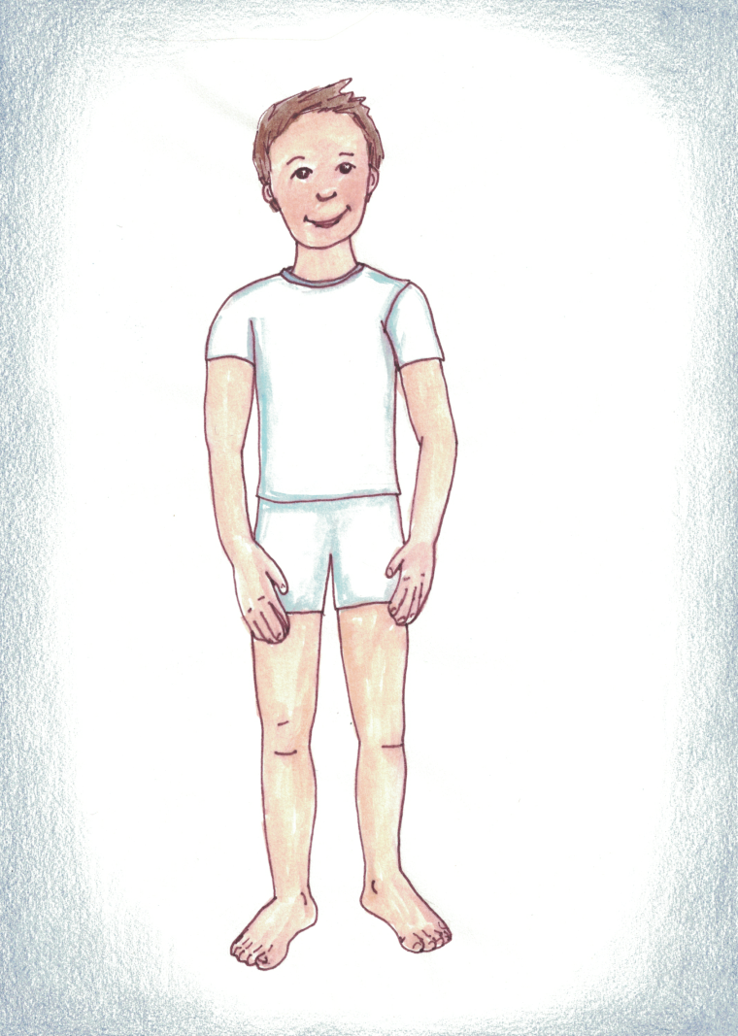
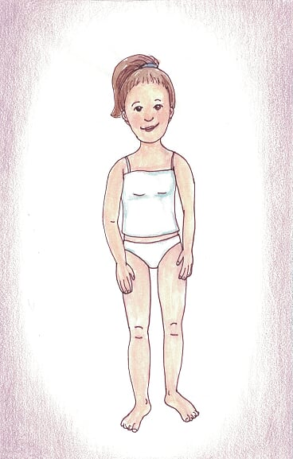
Let's Talk About Your Special, Holy Body.
This Boy & Girl Aren't Dressed To Go To School.

Slide 49
Let's Talk About Your Special, Holy Body.
They aren't dressed to go out with friends.

Slide 50
Let's Talk About Your Special, Holy Body.
But their clothes still cover the most special and private parts of their body.

Slide 51
Let's Talk About Your Special, Holy Body.
The People Who Love You Want To Make Sure Your Private Body Parts Are Safe and Respected.

Slide 52
Let's Talk About Your Special, Holy Body.
YOU Have The Right To Make Sure
YOUR Body &
YOUR Private Body Parts Are Safe and Respected.

Slide 53
Let's Talk About Your Special, Holy Body.
There's A Lot You Can Do To Make Sure
Your Body & Your Private Body Parts Are
Safe and
Respected.

Slide 54


You Can Say:
"I Have Boundaries. My Private Body Parts Will Be Safe & Respected."
You Can Even Say That Loudly.

Slide 55
You Can Say:
"My Private Body Parts Will Be Safe & Respected. No Touching. No Looking."
You Can Even Say That Loudly.

Slide 56
Your Body Is Special. If For Some Reason, Your Body Needs Special Care, Someone Who Loves You Can Help.
A Doctor or a Nurse Can Help You, Too.
You Can Talk About This With The Adults Who Love & Care For You.

Slide 57
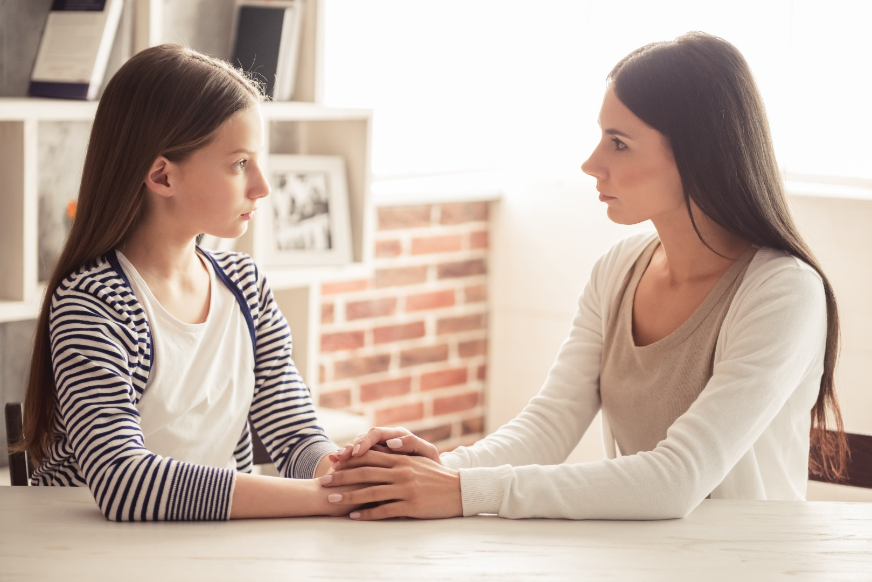
Think again of an adult who cares for you, and who cares about your feelings. Think of an adult who wants to keep you safe from harm. Think of an adult who respects the privacy and holiness of your body. ​
​
Think in your mind--​
who is that person?

Slide 58
That is
an adult
you can
trust.

Slide 59

If You Feel Worried That Someone Has Tried To Make Your Body Disrespected Or Unsafe, You Can Tell an adult you trust.
You Can Say,
"I Feel Worried. I Want To Talk About Feeling Disrespected.”

Slide 60

What Are Some Of The Ways That Another Person Might Disrespect Your Boundaries?
What Are Some Of The Ways That Another Person Might Disrespect The Privacy Of Your Body?
Well, Most People Won't Ever Want Or Try To Disrespect The Privacy & Holiness Of Your Body.
But... ... ...

Slide 61

Maybe A Person Wants To Text You Pictures Of A Sexual Nature…

Slide 62

Maybe a friend wants to share a text he or she has received– a text that has a sexual nature.

Slide 63
That is disrespecting you. And it’s usually against the law.
Say, “This disrespects me” and tell an adult whom you trust as quickly as possible.

Slide 64
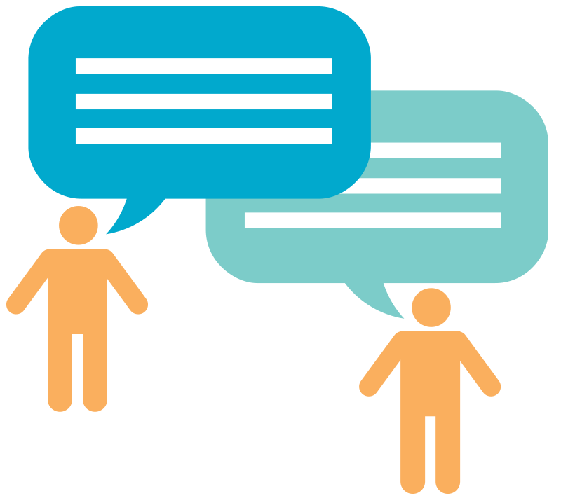
Maybe a person wants to say things to you – things of a sexual nature.
Or maybe a person or group of people wants to talk about your private body parts.

Slide 65
That is disrespecting you. And it’s usually against the law.
Say, “This disrespects me” and tell an adult whom you trust as quickly as possible.

Slide 66
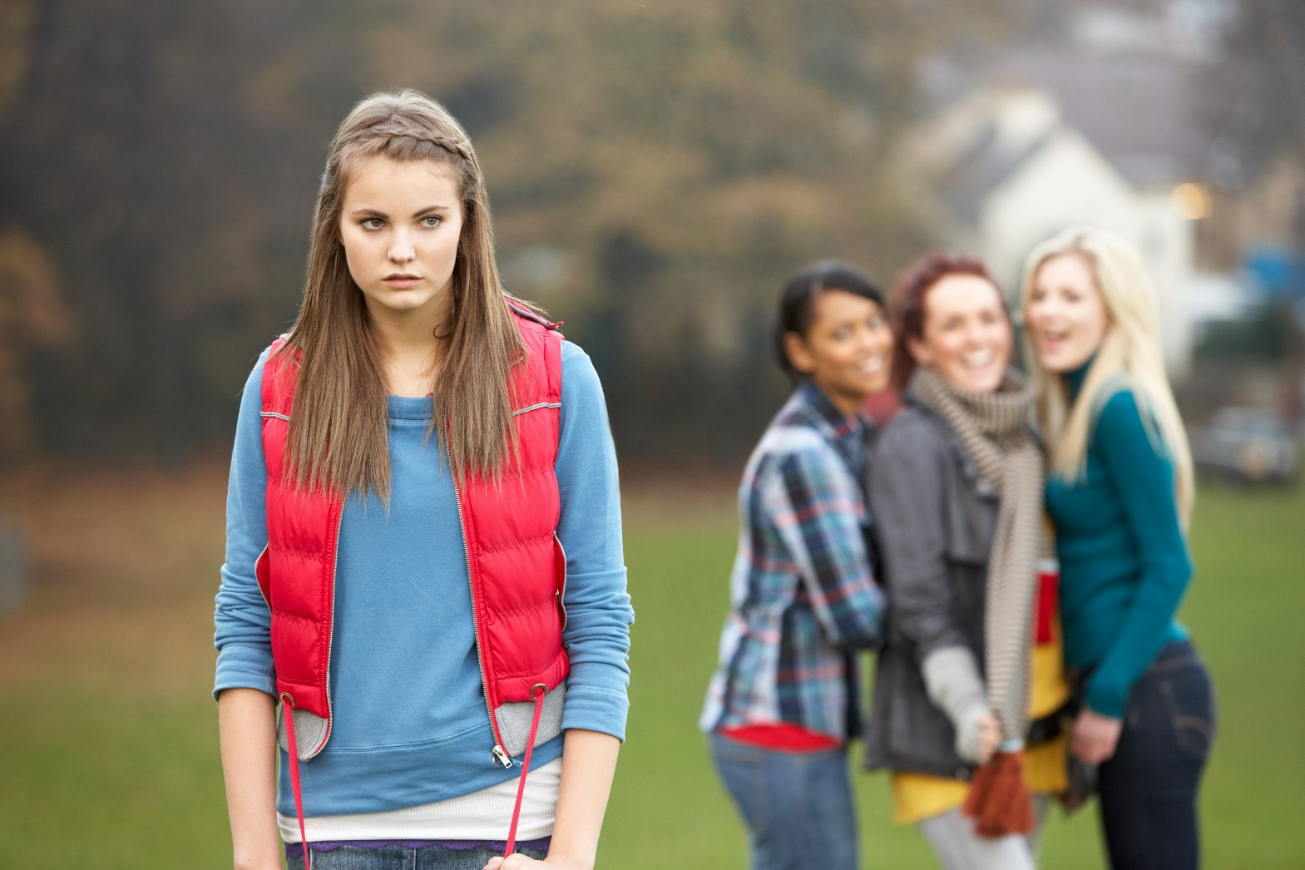
Maybe a friend or group of friends wants you to join in a conversation talking about another person’s private body parts.

Slide 67
Say “This disrespects me AND it disrespects the other person.”
Tell an adult whom you trust as quickly as possible.

Slide 68

Maybe a person wants to show you websites or photographs or movies of a sexual nature– movies and pictures that disrespect the privacy and holiness of another person’s body.

Slide 69
That is disrespecting you. And it’s usually against the law.
Say, “This disrespects me.” Tell an adult whom you trust as quickly as possible.

Slide 70
Maybe a person wants you to take pictures of yourself that disrespect the holiness and privacy of your own body.

Slide 71
That is disrespecting you. And it’s usually against the law.
Say, “This disrespects me.” Tell an adult whom you trust as quickly as possible.

Slide 72
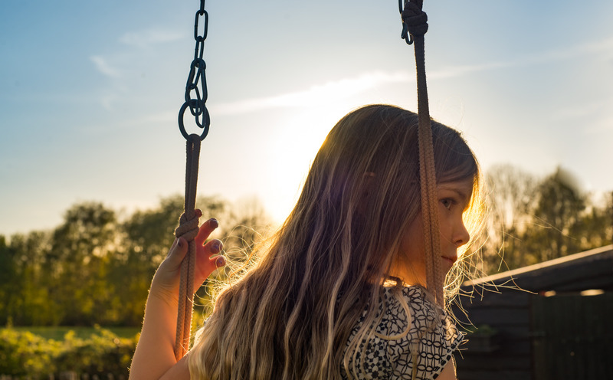
Maybe a person wants to be close to you in ways that make you feel uncomfortable. You can say, “I don’t want you to be so close to me.”

Slide 73
If they ignore you, or make a joke of it, that is disrespecting you.
Say, “This disrespects me.” Tell an adult whom you trust as quickly as possible.

Slide 74
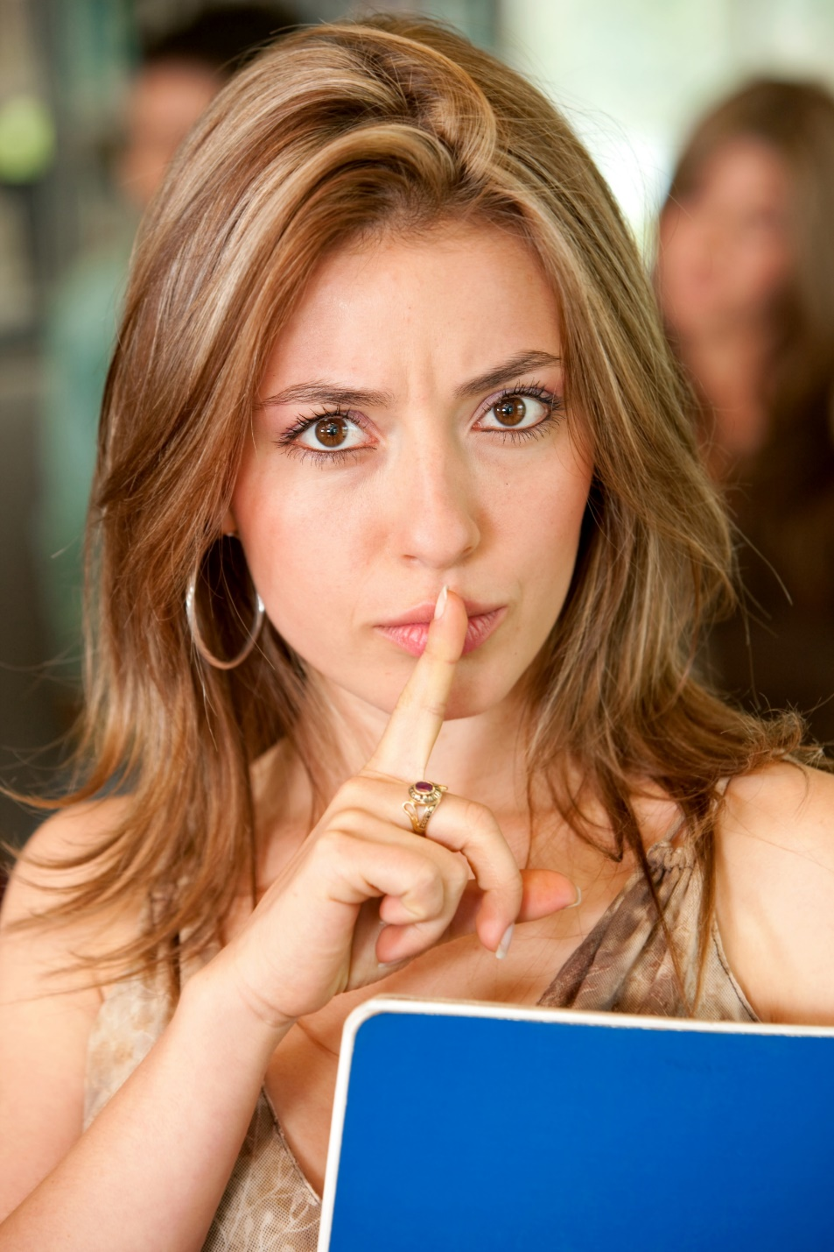
Sometimes, a person who may want to disrespect you may try to make you feel sorry or silly for having boundaries.

Slide 75
That person may try to make you feel ashamed of having the feelings you have.

Slide 76
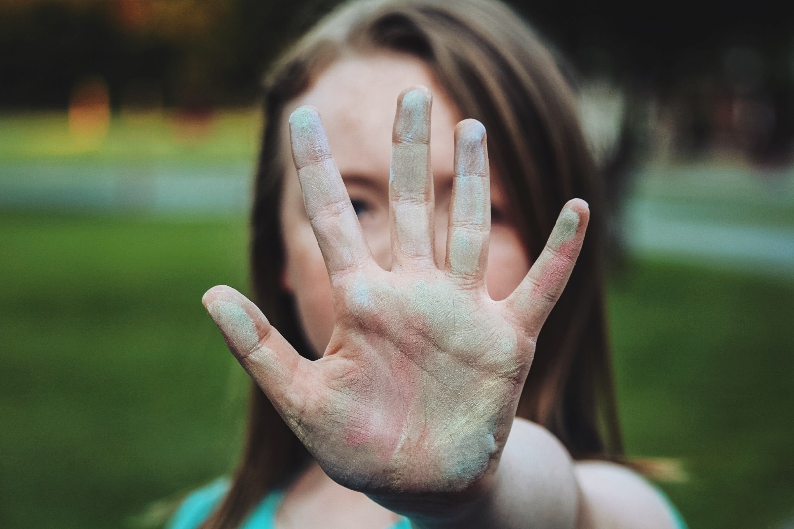
Don’t buy that. The people who love you care about your feelings. The people who love you will not try to make you feel ashamed of your feelings.
Don’t Buy That.

Slide 77
It doesn’t matter if
the person who is disrespecting you is
the same gender or opposite, the same
age or not.
Don't buy it.

Slide 78
It doesn’t matter if the person who is disrespecting you is in charge of you in some way.
Don't buy it.

Slide 79
It doesn’t matter if the person disrespecting you tells you not to tell anyone.
Don't buy it.

Slide 80
Those things don't matter.
If ANYONE does these things to you, or says these things to you,
tell a trusted adult.

Slide 81
If ANYONE tries to frighten you into not telling,
or tries to give you gifts so that you won't tell,
or says you will be in trouble if you tell,
don’t believe them.

Slide 82
You are special to God, and special to yourself, and special to others.
You are special.
You deserve to be respected and safe. If you ever feel disrespected, tell an adult you trust.
You matter.

Slide 83

Maybe you have a friend who has been disrespected or hurt in this way. Maybe he or she has told you about it and asked you to promise not to tell anyone.

Slide 84

Even if you promised not to tell, tell a trusted adult. A good friend will not let another friend keep a damaging or dangerous secret. A good friend will get help.

Slide 85
If you feel worried, or disrespected, the people who love & respect you want to know about your feelings.

Slide 86
If you feel worried, or disrespected, the people who love you and respect you will listen
to you when you talk about
your feelings.
Notes:
44

Slide 87
The people who love you will listen to you and help to make things better. The people who love you will work hard to make sure you feel safe.

Slide 88
Jesus loves you.
He has made you
amazing and special. He made your body special. He has given you important feelings. He has given you people who love you and who care about you.

Slide 89
Jesus loves you.
He wants you to
kNOw
you matter.

Slide 90
Jesus loves you.
He wants you to
kNOw
you deserve
to be safe
and respected.

Slide 91
Jesus loves you.
He wants you to
kNOw
you have the right to say
“NO!”

Slide 92
Say:
I kNOw I am a child of God.
I kNOw I deserve to be safe and respected.

Slide 93
Say:
I kNOw my body is holy and private.
NO touching or looking.

Slide 94
Say:
I kNOw my body is holy and private.
NO touching or looking.

Slide 95
Say:
I kNOw that I can say
“NO touching.”
“NO looking.”
I can even say it LOUDLY.

Slide 96
Say:
I kNOw I can ask a trusted adult to help me.
I kNOw a trusted adult will help me.

Slide 97
We pray:
I thank you, Jesus, for my feelings.
I thank you that I can listen to my feelings.
I thank you that I know when I’m happy.

Slide 98
I thank You
that I know
when I feel safe.
Thank You, Jesus, that I can talk about my feelings.

Slide 99
I Thank you, Jesus,
for giving me people
who love me.
The people who love me
care about my feelings.
They care about me.
They work hard
to keep me
and my body safe.
.

Slide 100
Jesus,
I know I have the right
to keep me safe, too.

Slide 101
Thank you, Jesus,
for loving me and for caring about me.
Amen.

Slide 102
A Parents’ and Educators’ Prayer:
Heavenly Father, send Your Holy Spirit. In Jesus’ name, please send Your Spirit. Make our children invisible to evil-doers. And make evil-doers visible to us so that, through the power of Your Spirit, we may expel them from our communities and end abuse of children. In Jesus’ Holy Name we pray. Amen.

