Slide 1
The kNOw Program
Diocese of Lansing Safe Environment Program

Slide 2
People Take Very Good Care of Things That Are Special.

Slide 3
People Take Very Good Care Of Special Things.

Slide 4
People Take Very Good Care Of Special Things.

Slide 5
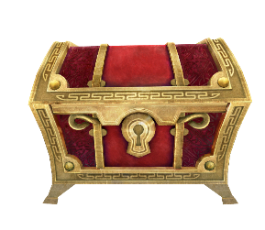
People Take Care Of Very Special Things.

Slide 6
This Little Guy Deserves
Special Care!

Slide 7
What Would You Do For This Little Guy If He Was Yours?

Slide 8
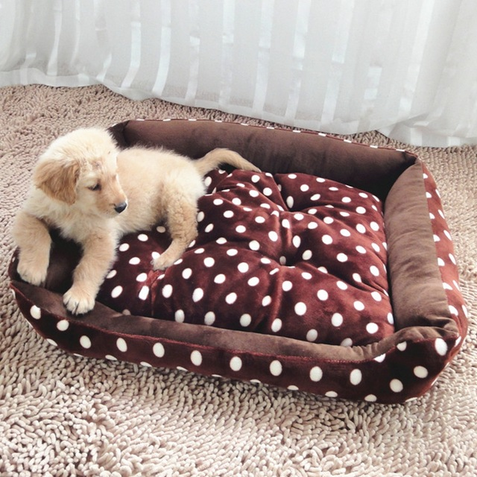
What Special Things Would You Do For This Little Guy If He Was Yours?

Slide 9
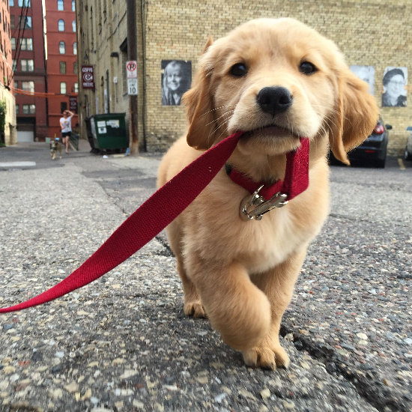
What Special Things Would You Do For This Little Guy If He Was Yours?

Slide 10
To Jesus, YOU Are Very Special.

Slide 11
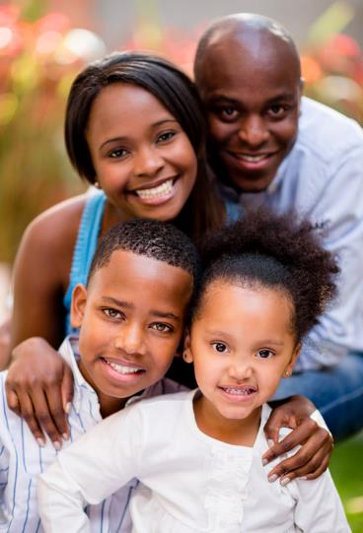
It's Only RIGHT That People Should Take Care Of You!

Slide 12
Jesus Wants You To Be Happy.
He Wants Your Family & Community To Take Special Care Of You.
He Wants YOU To Take Care of You, Too!

Slide 13
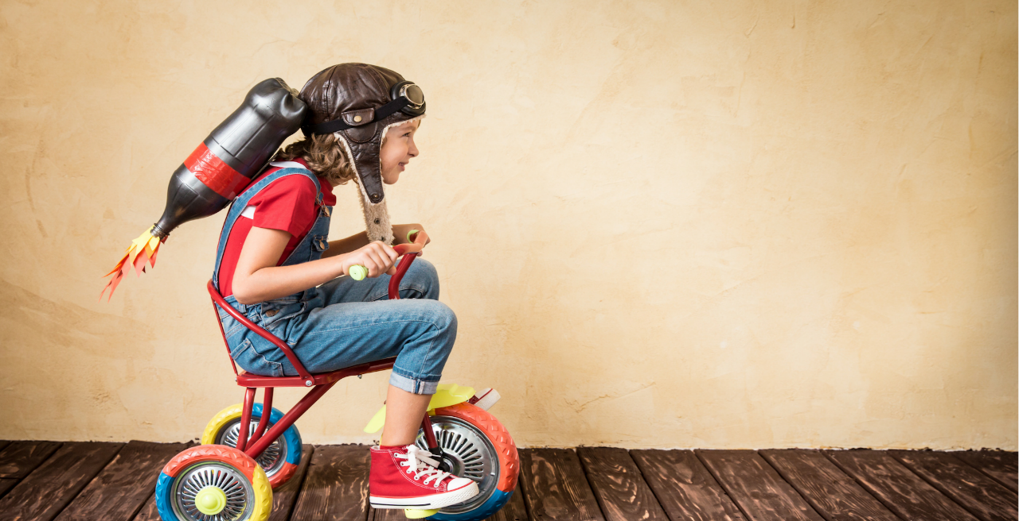
Jesus Wants You To Know You're Loved.
He Wants You To Know You're Safe!

Slide 14
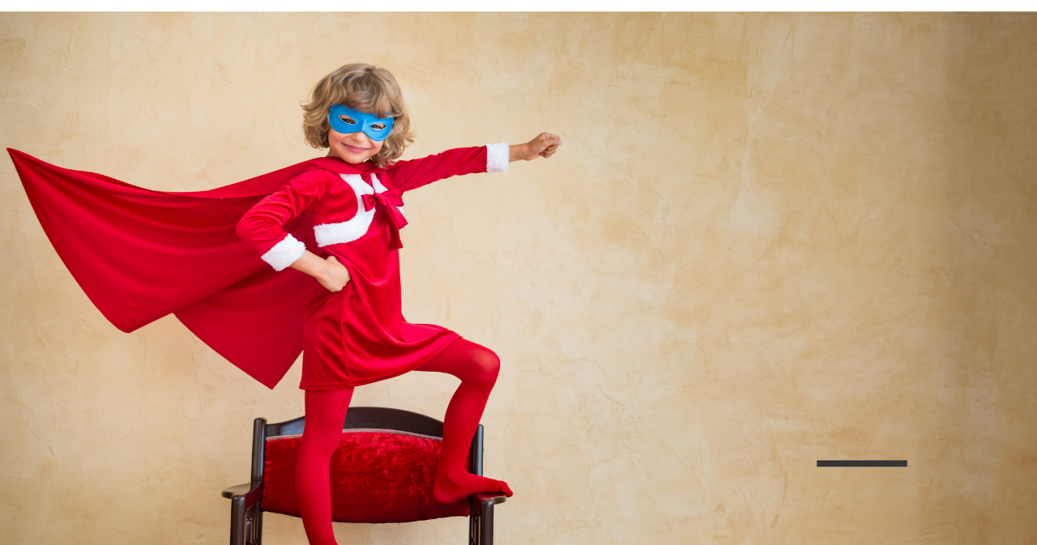
Jesus Wants You To Know You're Loved.
He Wants You To Know You're Safe!

Slide 15
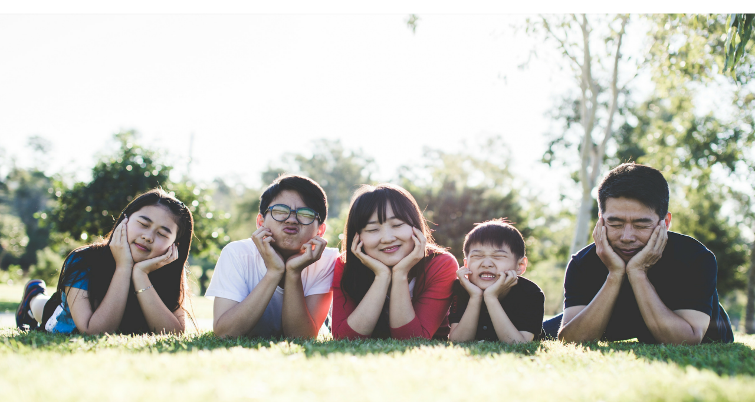
You Probably Have A Family To Help Care For You.

Slide 16
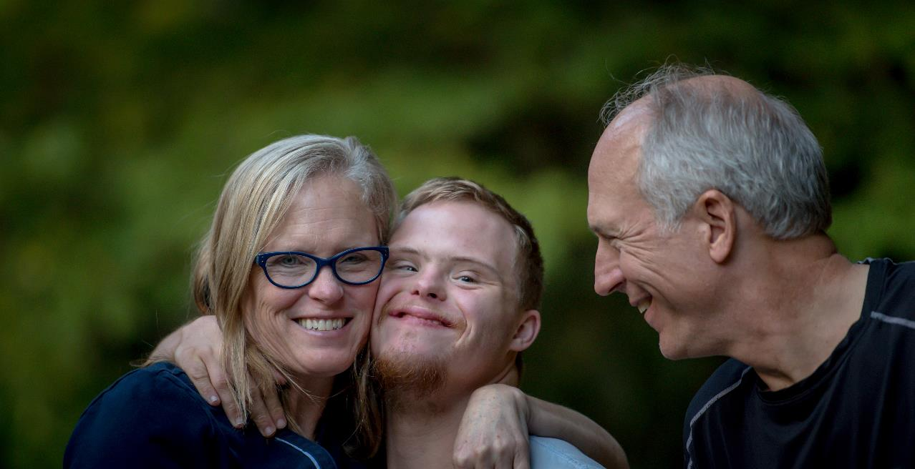
You Probably Have A Family To Help Care For You.

Slide 17
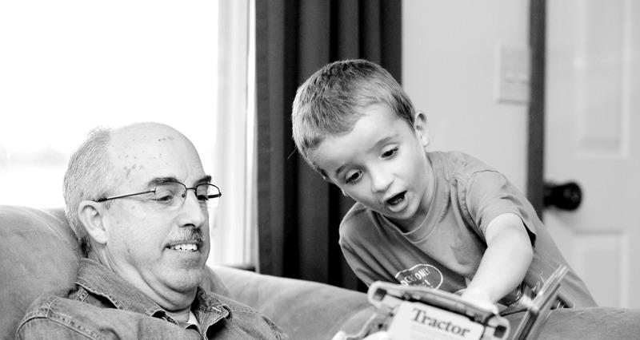
Grandfathers & Grandmothers Can Help Care For You, Too!

Slide 18
Teachers Can Help You To Know You're Cared For, Too!

Slide 19
Can you think of an adult who cares for you? Think in your mind-- who is that person?

Slide 20
There Is So Much To You!
You're Made Of A Body, A Soul, Feelings, Thoughts & Ideas!

Slide 21
There Is So Much To You!
You Really Are Pretty Amazing & Special!

Slide 22
There Is So Much To You!
God Wants You To Be Safe.

Slide 23
Let's Talk About Your Soul.
It Deserves Special Care Because It's The Place Where God Comes To Live Inside Of You.
Even Though You Can't See Your Soul, It Still Deserves Very Special Care.

Slide 24
Let's Talk About Your Soul.
The People Who Love You Know Your Soul Is Special.
They Help You Learn To Talk To God- To Pray.
YOU Know Your Soul Is Really Special, So You Do Pray & Spend Time With God- Who Loves You.

Slide 25
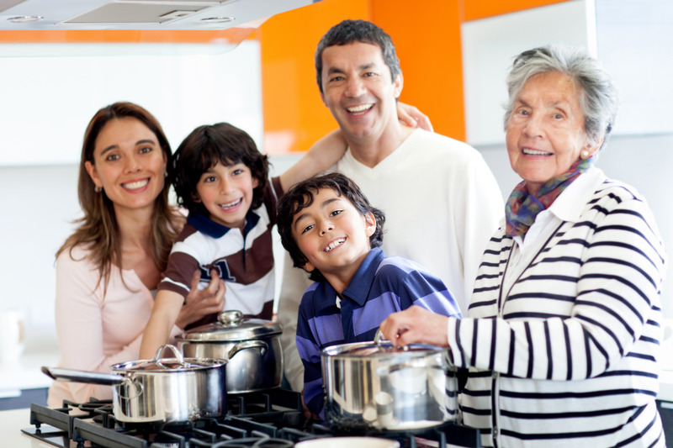
Your Feelings Are Special, Too.
The People Who Love You, Care About Your Feelings.
They Want You To Feel Safe & Loved.

Slide 26
The People Who Love You Want You To Know They Care About Your Feelings.
You Help To Take Care Of Your Own Feelings By Talking About Your Feelings With People You Trust.

Slide 27
Can you think of an adult who cares for you, and who cares about your feelings?
Think in your mind-- who is that person?

Slide 28
Another Special Part Of You Is Your Body.
The People Who Love You Take Special Care Of Your Body.

Slide 29
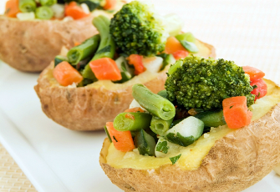
The People Who Love You Take Special Care Of Your Body.
They Give You Healthy Food To Eat.
You Help To Take Care Of Your Own Body By Making Healthy Food Choices.

Slide 30
The People Who Love You Take Care Of Your Body By Making Your Home A Safe Place To Live.

Slide 31
What does your family do to make your home safe?

Slide 32
The People Who Love You Take Care Of Your Body By Showing You How To Be Safe.
You Take Care Of Your Own Body By Making Good Choices, Safe Choices.

Slide 33
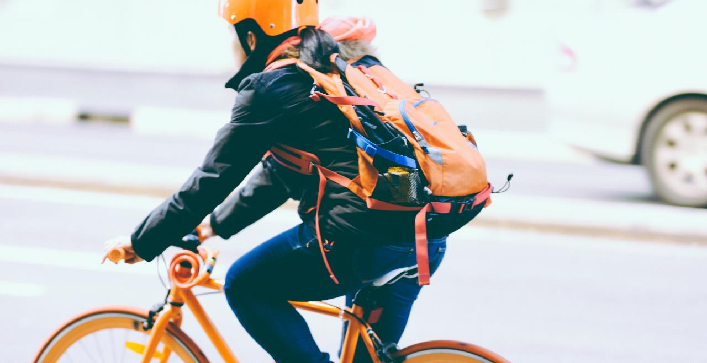
You Take Care Of Your Own Body By Making Good Choices, Safe Choices.

Slide 34
What other choices can you make to keep you safe?

Slide 35
You Can Do A Lot Of Awesome Things With Your Body.
You
Can Play.

Slide 36
You Can Do A Lot Of Awesome Things With Your Body.
You
Can Hug.

Slide 37
You Can Do A Lot Of Awesome Things With Your Body.
You
Can Sing!

Slide 38
You Can Do A Lot Of Awesome Things With Your Body.
You Can Sleep.

Slide 39
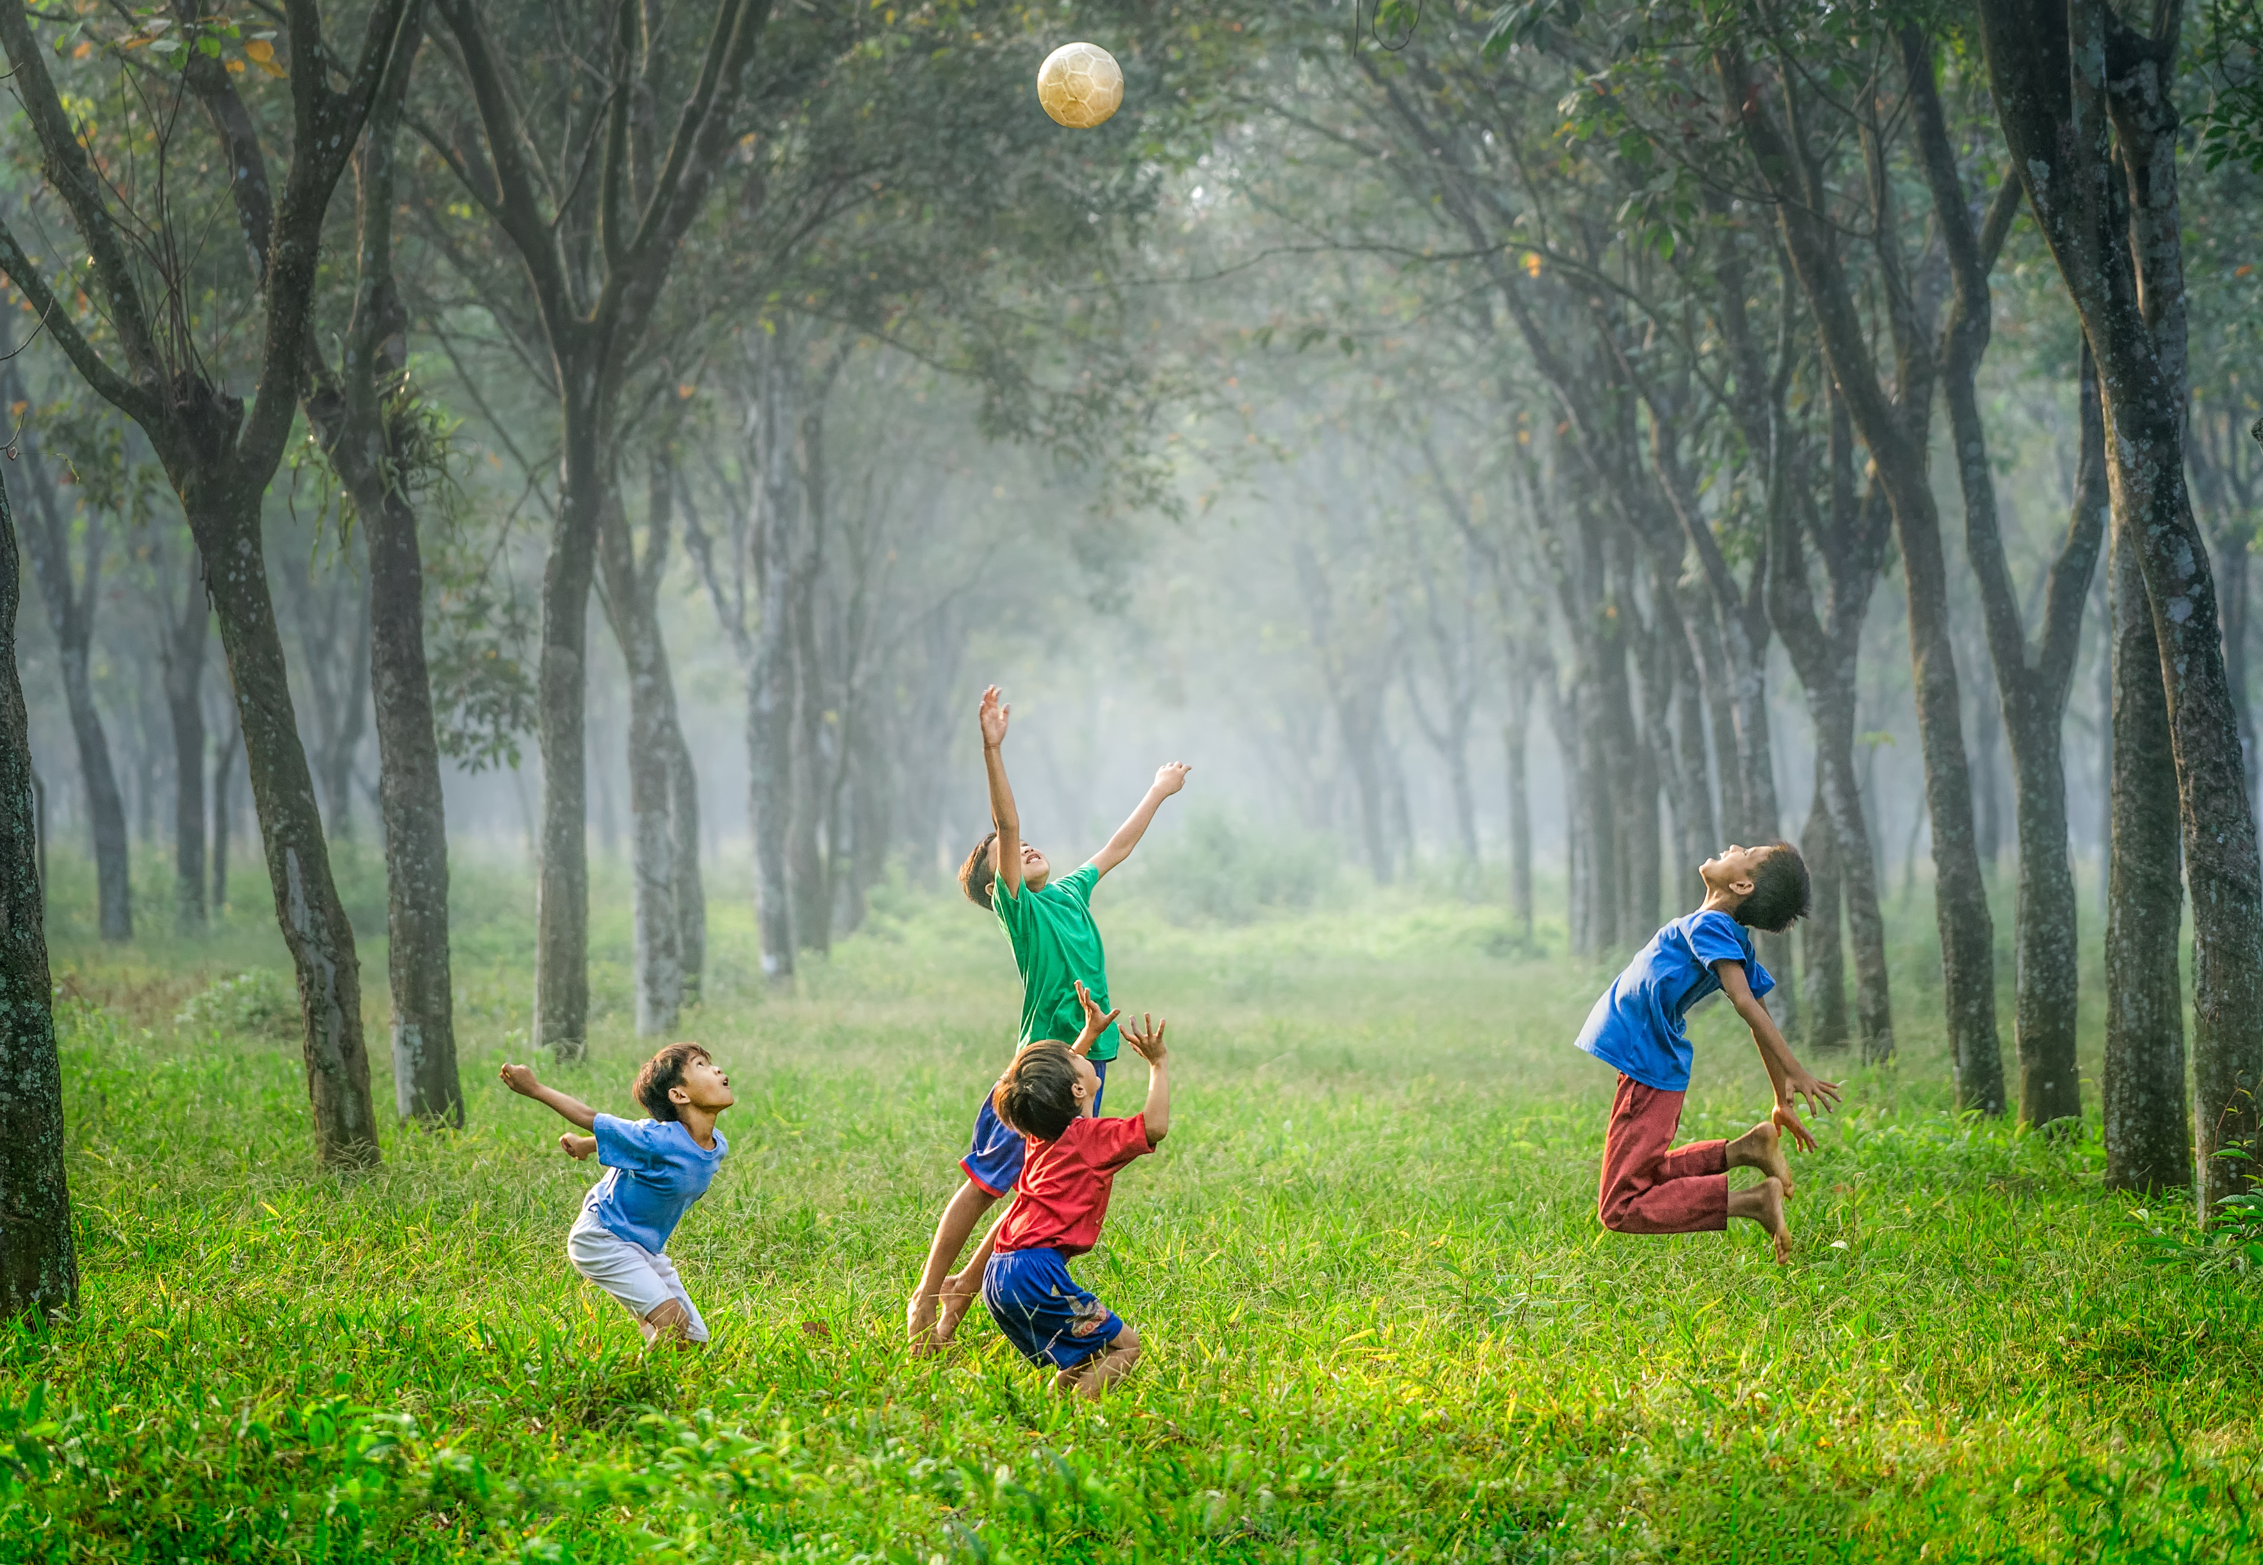
You Can Do A Lot Of Awesome Things With Your Body.
You Can
Laugh
With
Friends.

Slide 40
You Can Do A Lot Of Awesome Things With Your Body.
You
Can
Help
Others

Slide 41
God Did An Amazing Job Of Making Everything About You Special-
Your Body,
Your Feelings &
Your Soul.

Slide 42
No One
Should Ever Try To Hurt
Your Feelings.

Slide 43
No One
Should Ever Try To Hurt
Your Soul.

Slide 44
No One
Should Ever Try To Hurt
Your Body.

Slide 45
Let's Talk About Your Special, Holy Body.
You Wear Clothes On Your Body, To Protect Your Body From The Weather.

Slide 46
Let's Talk About Your Special, Holy Body.
You Also Wear Clothes Because They Look Nice!

Slide 47
Let's Talk About Your Special, Holy Body.
Also, You Wear Clothes On Your Body To Cover The Most Private Parts Of Your Body.

Slide 48
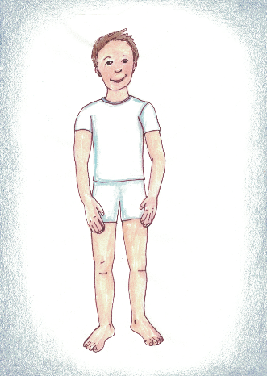
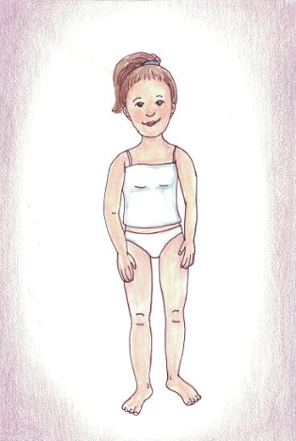
Let's Talk About Your Special, Holy Body.
This Boy & Girl Aren't Dressed To Go To School.

Slide 49
Let's Talk About Your Special, Holy Body.
They aren't dressed to go out with friends.

Slide 50
Let's Talk About Your Special, Holy Body.
But their clothes still cover the most special and private parts of their body.

Slide 51
Let's Talk About Your Special, Holy Body.
The People Who Love You Want To Make Sure Your Private Body Parts Are Safe and Respected.

Slide 52
Let's Talk About Your Special, Holy Body.
YOU Have The Right To Make Sure
YOUR Body &
YOUR Private Body Parts Are Safe & Respected.

Slide 53
Let's Talk About Your Special, Holy Body.
There's A Lot You Can Do To Make Sure
Your Body & Your Private Body Parts Are
Safe & Respected.

Slide 54
You Can Say:
"I Have Boundaries. My Private Body Parts Will Be Safe & Respected."
You Can Even Say That Loudly.

Slide 55
You Can Say:
"My Private Body Parts Will Be Safe & Respected. No Touching. No Looking."
You Can Even Say That Loudly.

Slide 56
Your Body Is Special. If For Some Reason, Your Body Needs Special Care, Someone Who Loves You Can Help.
A Doctor or a Nurse Can Help You, Too.
You Can Talk About This With The Adults Who Love & Care For You.

Slide 57
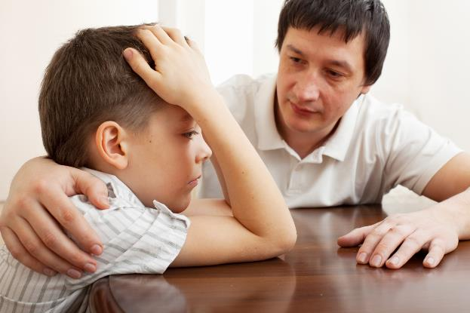
Think again of an adult who cares for you, and who cares about your feelings. Think of an adult who wants to keep you safe from harm. Think of an adult who respects the privacy and holiness of your body. ​ ​
Think in your mind--​ who is that person?

Slide 58
That is an adult you can trust.

Slide 59
If You Feel Worried That Someone Has Tried To Make Your Body Disrespected Or Unsafe, You Can Tell an adult you trust.
You Can Say,
"I Feel Worried. I Want To Talk About Feeling Disrespected.”

Slide 60
What Are Some Of The Ways That Another Person Might Disrespect Your Boundaries?
What Are Some Of The Ways That Another Person Might Disrespect The Privacy Of Your Body?
Well, Most People Won't Ever Want Or Try To Disrespect The Privacy & Holiness Of Your Body.
But... ... ...

Slide 61
Maybe A Person Wants To Text You Pictures Of A Sexual Nature…

Slide 62
Maybe a friend wants to share a text he or she has received– a text that has a sexual nature.

Slide 63
That is disrespecting you. And it’s usually against the law.
Say, “This disrespects me” and tell an adult whom you trust as quickly as possible.

Slide 64
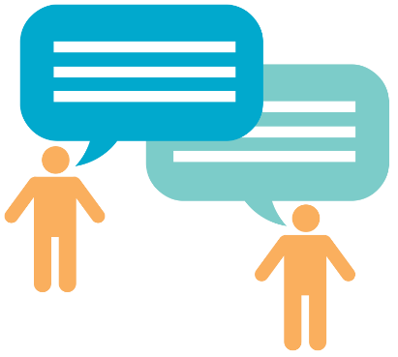
Maybe a person wants to say things to you – things of a sexual nature.
Or maybe a person or group of people wants to talk about your private body parts.

Slide 65
That is disrespecting you. And it’s usually against the law.
Say, “This disrespects me” and tell an adult whom you trust as quickly as possible.

Slide 66
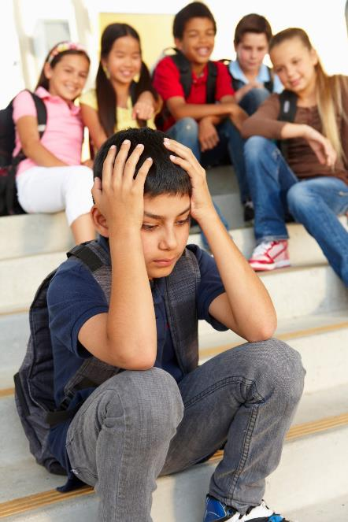
Maybe a friend or group of friends wants you to join in a conversation talking about another person’s private body parts.

Slide 67
Say “This disrespects me AND it disrespects the other person.”
Tell an adult whom you trust as quickly as possible.

Slide 68
Maybe a person wants to show you websites or photographs or movies of a sexual nature– movies and pictures that disrespect the privacy and holiness of another person’s body.

Slide 69
That is disrespecting you. And it’s usually against the law.
Say, “This disrespects me.” Tell an adult whom you trust as quickly as possible.

Slide 70
Maybe a person wants you to take pictures of yourself that disrespect the holiness and privacy of your own body.

Slide 71
That is disrespecting you. And it’s usually against the law.
Say, “This disrespects me.” Tell an adult whom you trust as quickly as possible.

Slide 72
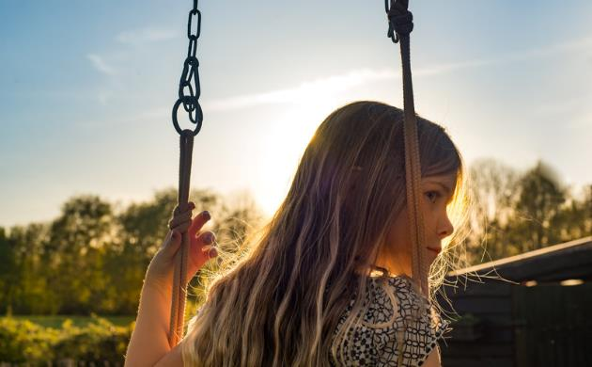
Maybe a person wants to be close to you in ways that make you feel uncomfortable. You say, “I don’t want you to be so close to me.”

Slide 73
If they ignore you, or make a joke of it, that is disrespecting you.
Say, “This disrespects me.” Tell an adult whom you trust as quickly as possible.

Slide 74
Sometimes, a person who may want to disrespect you may try to make you feel sorry or silly for having boundaries.

Slide 75
That person may try to make you feel ashamed of having the feelings you have.

Slide 76
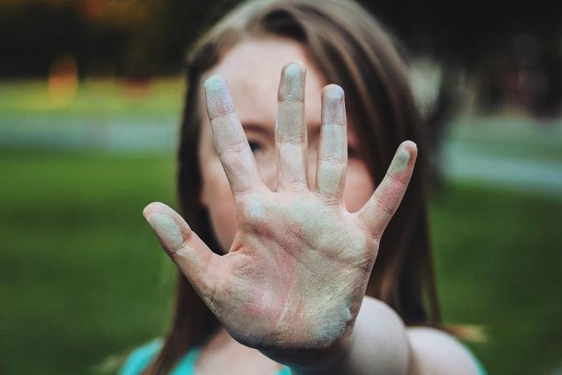
Don’t buy that. The people who love you care about your feelings. The people who love you will not try to make you feel ashamed of your feelings.
Don’t Buy That.

Slide 77
It doesn’t matter if
the person who is disrespecting you is
the same gender or opposite, the same
age or not.
Don't buy it.

Slide 78
It doesn’t matter if the person who is disrespecting you is in charge of you in some way.
Don't buy it.

Slide 79
It doesn’t matter if the person disrespecting you tells you not to tell anyone.
Don't buy it.

Slide 80
Those things don't matter.
If ANYONE does these things to you, or says these things to you, tell a trusted adult.

Slide 81
If ANYONE tries to frighten you into not telling,
or tries to give you gifts so that you won't tell,
or says you will be in trouble if you tell, don’t believe them.
Tell a trusted adult.

Slide 82
You are special to God, and special to yourself, and special to others.
You are special.
You deserve to be respected and safe. If you ever feel disrespected, tell an adult you trust.
You matter.

Slide 83
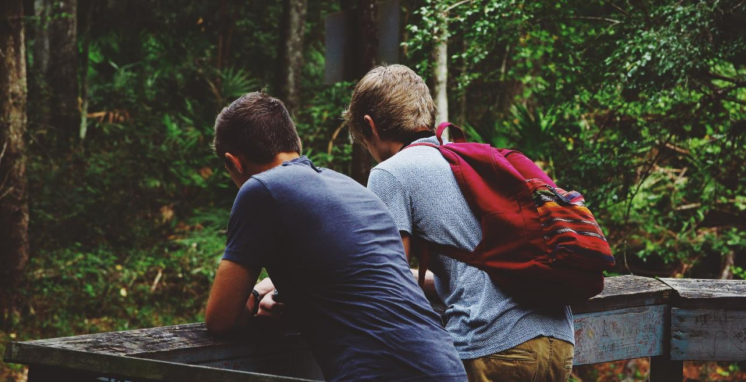
Maybe you have a friend who has been disrespected or hurt in this way. Maybe he or she has told you about it and asked you to promise not to tell anyone.

Slide 84
Even if you promised not to tell, tell a trusted adult. A good friend will not let another friend keep a damaging or dangerous secret. A good friend will get help.

Slide 85
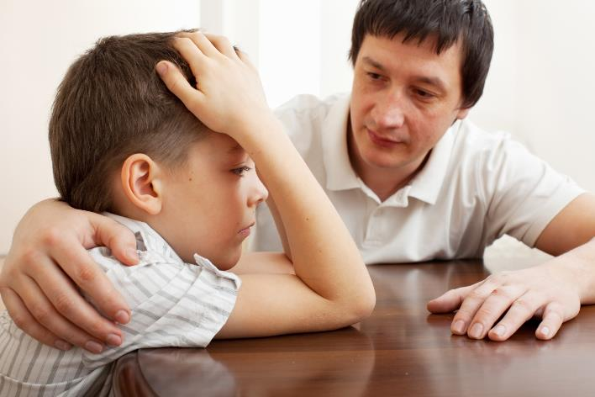
If you feel worried, or disrespected, the people who love & respect you want to know about your feelings.

Slide 86
If you feel worried, or disrespected, the people who love you and respect you will listen to you when you talk about
your feelings.

Slide 87
The people who love you will listen to you and help to make things better. The people who love you will work hard to make sure you feel safe.

Slide 88
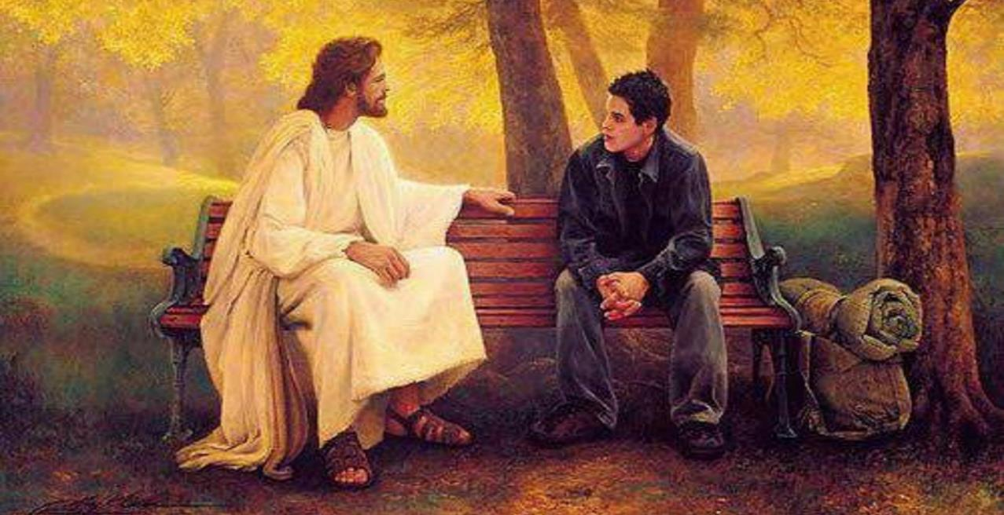
Jesus loves you. He has made you amazing and special. He made your body special. He has given you important feelings. He has given you people who love you and who care about you.

Slide 89
Jesus loves you. He wants you to kNOw you matter.

Slide 90
Jesus loves you.
He wants you to kNOw you deserve to be safe and respected.

Slide 91
Jesus loves you.
He wants you to kNOw you have the right to say “NO!”

Slide 92
Say: I kNOw I am a child of God. I kNOw I deserve to be safe and respected.

Slide 93
Say: I kNOw my body is holy and private. NO touching or looking.

Slide 94
Say: I kNOw other people’s bodies are holy and private. NO touching, NO looking.

Slide 95
Say: I kNOw that I can say
“NO touching.” “NO looking.”
I can even say it LOUDLY.

Slide 96
Say: I kNOw I can ask a trusted adult to help me. I kNOw a trusted adult will help me.

Slide 97
We pray: Thank you, Jesus, for my feelings. I thank you that I can listen to my feelings. I thank you that I know when I’m happy.

Slide 98
I thank You that I know when I feel safe. Thank You, Jesus, that I can talk about my feelings.

Slide 99
I Thank you, Jesus, for giving me people who love me. The people who love me care about my feelings. They care about me. They work hard to keep me and my body safe.
.

Slide 100
Jesus, I know I have the right to keep me safe, too.

Slide 101
Thank you, Jesus. You love me. You care for me. Amen

